Slide 1
Image: Catherine Yeulet/Photos.com
Image: Miroslav Ferkuniak /Photos.com
Image: Ken Hurst/Photos.com
Fourth Edition 2020
www.smilesforlifeoralhealth.org
Last Modified September 2021
Copyright STFM 2005-2021
Notes:
Speaker Notes
Module 5
Oral Health for Women: Pregnancy and Across the Lifespan
Smiles for Life, 4th Edition
Copyright STFM 2005-2021

Slide 2

Authors and Editors
  Hugh Silk, M.D., M.P.H.
  Emily Cooper, M.D.
Consultants
  OB/GYN – Lucy Chie, M.D., M.P.H.
  Dentistry - Rocio Quinonez, D.M.S, M.P.H.
Smiles for Life Editors
  Melinda Clark, M.D.
  Karlynn Sievers, M.D.
Funded By
The images in this presentation are not to be reproduced/downloaded for purposes other than personal use. Republication, retransmission, reproduction, or other use of the Licensed Material is prohibited.
Notes:
This course addresses the importance of oral health before, during, and after pregnancy. Clinicians will explore the prevalence of oral disease during pregnancy and its consequences for both mothers and children, as well as review dental treatment guidelines for pregnant women.
Acknowledgements:
Course Steering Committee Editors
Hugh Silk, M.D.
Consultants
OB/GYN – Lucy Chie,
Dentistry - Rocio Quinonez, D.M.S, M.P.H.
Smiles for Life Editor
Melinda Clark, M.D.
Last Modified:
January 2018

Slide 3
Educational Objectives
At the conclusion of this presentation, participants will be able to:
Elicit risk factors for periodontal disease and dental caries
Perform an oral examination using proper anatomical terms and terminology
Reduce the risk of caries transmission from mother to child
Apply the evidence for periodontitis affecting perinatal outcomes
Counsel pregnant patients about the safety of dental care and improve dental access for pregnant women through interprofessional collaboration
Acknowledge and address health inequity as it applies to pregnant women and oral health
Manage common oral conditions in pregnancy
Promote and address oral health issues across the lifespan for women
Notes:
The educational objectives for the relationship of oral to systemic health course are:
Elicit risk factors for periodontal disease and dental caries
Perform an oral examination using proper anatomical terms and terminology
Reduce the risk of caries transmission from mother to child
Apply the evidence for periodontitis affecting perinatal outcomes
Manage common oral conditions in pregnancy
Counsel pregnant patients about the safety of dental care and improve dental access for pregnant women through interprofessional collaboration
Acknowledge and address health inequity as it applies to pregnant women and oral health
Promote and address oral health issues across the lifespan for women

Slide 4
Oral Anatomy, Terminology and Examination
Chapter Objectives
Elicit risk factors for periodontal disease and dental caries
Perform an oral examination using proper anatomical terms and terminology
Notes:
Learning objectives targeted in this chapter:
Elicit risk factors for periodontal disease and dental caries
Perform an oral examination using proper anatomical terms and terminology

Slide 5
Oral Disease Risk Factors
Individual
  Personal history of caries or periodontal disease
  Low socioeconomic status
  Medications containing sugar or causing xerostomia
  Chronic disease such as diabetes
  Emotional or physical disabilities
Environmental
  Non-fluoridated community water
  Access to dental and medical care
Behavioral
  Poor oral hygiene habits
  High sugar-containing diet
  Lack of routine dental care
  Alcohol and tobacco use
Race/Ethnicity
  Social injustice and inequity affect overall health and health profoundly through stress and other means
  Fewer dental providers of colour
  Dental providers often less accessible in communities of colour (e.g. location, hours, etc)
Notes:
Take a history to elicit risks for caries and periodontal disease.
Individual
• Personal history of caries or periodontal disease
• Low socioeconomic status
• Medications that contain sugar or cause xerostomia. Saliva is very protective acting as a buffer to acidity
Chronic disease such as diabetes
• Emotional or physical disabilities that prevent one from caring for oneself due to inability, lack of motivation, or a focus on other health related or social issues.
Behavioral
• Poor oral hygiene habits – lack of brushing and flossing, or improper technique
• High sugar-containing diet especially taken on a frequent basis (snacking, grazing)
• Lack of routine dental visits
• Alcohol and tobacco use
Environmental/Societal
• Non-fluoridated community water
• Poor access to dental and/or medical care due to lack of dental insurance or local providers not taking public insurance
Race/Ethnicity
Social injustice and inequity affects overall health and health profoundly through stress and other means
There are fewer dental providers of colour
Dental providers may be less accessible in communities of colour (e.g. location, hours, etc)

Slide 6
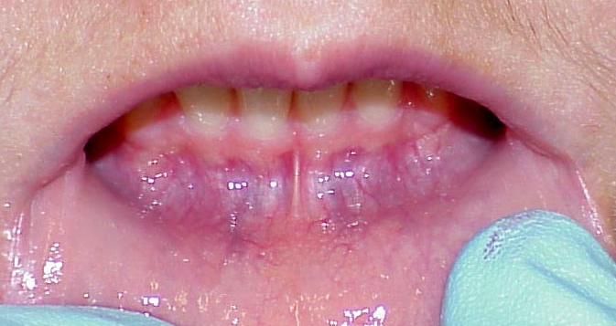
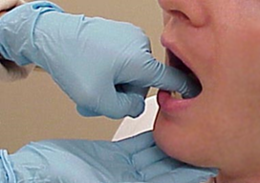
Adult Oral Examination
Proper exam requires
  Adequate lighting
  Tongue depressor
  Gloves
Systematic Approach
  Internal structures
    Teeth and gingiva
    Soft and hard tissues
    Lateral borders and undersurface of tongue
    Posterior pharynx
  External structures
    Lips
    Palpate floor of mouth and neck
Photos: Ellen Eisenberg, DMD
Notes:
A systematic approach to examination is important. Any health provider who cares for pregnant women should at a minimum examine the teeth and gums for hygiene, inflammation, and disease. Use a tongue depressor or gloved hand to retract the upper and lower lip to visualize the gum line; plaque is often located where the teeth meet the gum. Be sure to look for lesions on the mucosa and tooth decay. Ideally, examine the tongue using a gauze to hold the tip of the tongue and a gloved hand to palpate the floor of the mouth. A detailed description of the complete oral examination is available in Smiles for Life Module 7: The Oral Examination. In order to do this well, a provider needs some basic knowledge of anatomy, terminology, basic pathology which are reviewed on the next few slides.
A proper exam requires:
Adequate lighting
Tongue depressor
Pair of gloves
Use a Systematic Approach to the Exam:
Internal structures
Teeth and gingiva
Soft and hard tissues
Lateral borders and undersurface of tongue
Posterior pharynx
External structures
Lips
Palpate floor of mouth and neck

Slide 7
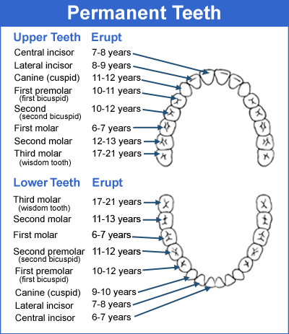
Adult Dentition
Permanent teeth begin to erupt around age 6 years and are all in by 21 years
Most adults have 32 teeth, which include:
  8 incisors
  4 canines
  8 premolars
  12 molars
Notes:
A reminder of what to look for. Permanent teeth begin to erupt around age 6 years and are all present by 21 years. Some adults have their third molars (wisdom teeth) or premolars extracted to relieve crowding, or they may be absent or never erupt, so there may be only 24 to 28 teeth present.
A full complement of teeth includes:
8 incisors
4 canines
8 premolars
12 molars

Slide 8
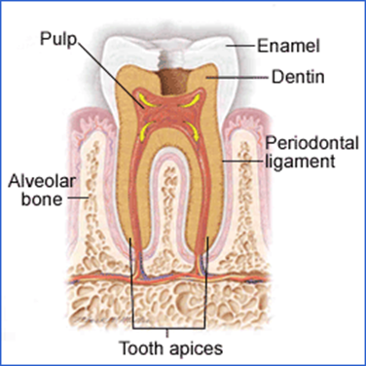
Tooth Anatomy
  Outer protective layer is enamel
  Middle layer is dentin
  Pulp is composed of nerves and blood vessels that exit the tooth via the apices
  Root connects to alveolar bone via the periodontal ligament
Graphic: AAFP Home Study Program—with permission
Notes:
Familiarity with dental nomenclature helps facilitate effective communication with dentists.
Anatomy of the Tooth
The outer protective layer of the tooth is enamel, which is extremely hard. Note it stops at the gumline so gum recession leave the tooth at risk.
The middle layer is dentin.
The pulp is composed of nerves and blood vessels that exit the tooth via the apices (which is how local issues can spread systemically).
The root connects to alveolar bone via the periodontal ligament.

Slide 9
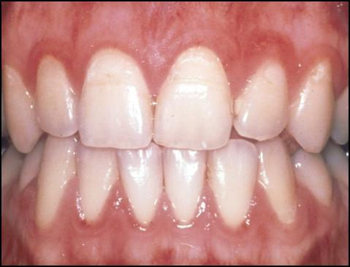
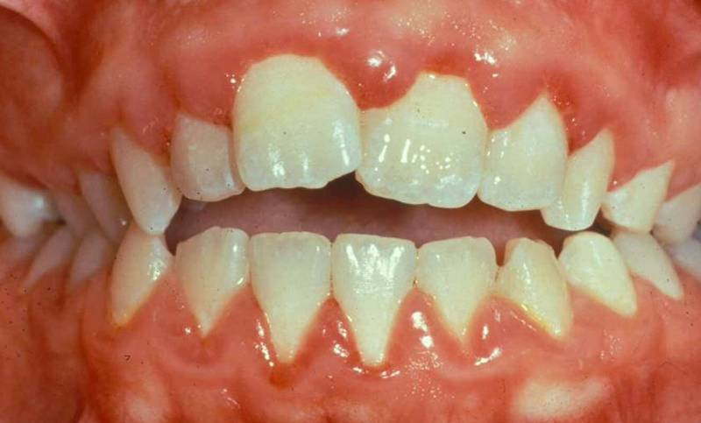
Gingivitis
Superficial inflammation of gingiva
Common: 25-75% of pregnant women
Etiology
  Plaque buildup
  Changes in hormone levels
Symptoms
  Mild gum swelling
  Tenderness, erythema, bleeding
  Second to eighth month of gestation
Treatment: Improve oral hygiene and dental care
Photo: Judith Skelton, MEd, PhD
Photo: John McDowell, DDS
Notes:
Gingivitis is superficial inflammation of the gingiva. Pregnancy-related gingivitis is common affecting 25–75% of pregnant women. It likely occurs because of immunosuppression and hormonal changes resulting in an altered response to bacterial plaque.
Etiology
Plaque buildup from poor oral hygiene triggers gingival inflammation
Changes in hormone levels as a result of puberty, pregnancy, and diabetes modify the gingival response to plaque, resulting in increased gingivitis.
During the second trimester, there is a shift from predominant periodontal pathogens to destructive anaerobes, which results in worsening gingival inflammation.
Decrease in cellular immunity during pregnancy exacerbates this process.
Symptoms
Mild gum swelling
Tenderness
Erythema
Bleeding gums when brushing
Typically identified in the second month and peaks in the eighth month of pregnancy.
Treatment
Routine brushing (twice daily) and flossing (daily)
Regular dental visits for cleanings, anticipatory guidance and radiographs
Photos show erythema and swelling of the gingiva.
References
Barak S, Oettinger-Barak O, Oettinger M et al. Common oral manifestations during pregnancy: A review. Obstetrical and Gynecological Survey. 2003; 58(9): 624-628.
Boggess KA. Maternal Oral Health in Pregnancy. Obstet and Gynecol. 2008; 111(4): 976-986.

Slide 10
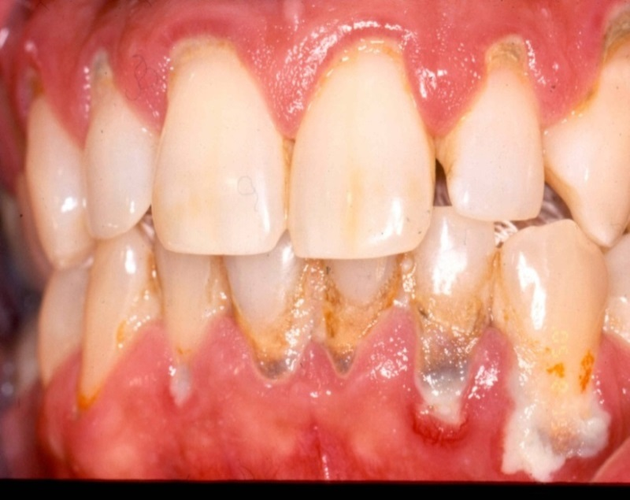
Periodontitis
Deep inflammation of gingiva and ligament
Affects 15% of pregnant women
Etiology
  Exposure to bacterial plaque cause chronic inflammation and infection
Symptoms
  Few obvious symptoms early
  Patients with advanced disease have loose teeth and eventual tooth loss
Treatment
  Proper oral hygiene and regular dental visits
  Routine professional dental care including scaling and antibiotics as needed
Photo: Efthimia Ioannidou, DDS, MDS
Notes:
Periodontitis is a chronic inflammatory disease of the peridontium which occurs in response to bacterial plaque on teeth. It is a somewhat common oral disease affecting 15% of pregnant women.
Progression of the disease results in destruction of the supporting ligaments and bone, increasing tooth mobility and eventually tooth loss.
Symptoms
Periodontitis in its earliest stages may have no obvious symptoms
Dentists can detect early disease through clinical probing of the gingival and radiographs
Patients with advanced disease will have loose teeth
Etiology
Chronic exposure of the periodontal tissues to bacterial plaque causes chronic inflammation.
The body's host response to the bacteria, magnifying or suppressing the inflammatory response, helps determine the manifestation and progression of the disease.
Chronic inflammation leads to destruction of the periodontal ligament, loss of supporting bone, tooth loosening, and eventual tooth loss.
Smoking, diabetes, HIV, pregnancy, and poor oral hygiene can all contribute to the development of periodontitis.
Preventative Measures & Treatment
Good oral hygiene and regular dental visits to monitor hygiene and remove subgingival plaque helps preventing or control inflammation
Established disease may require more advanced dental treatment including deep root scaling (cleaning below the gum surface) and antibiotics
References
Novak MJ. Classification of diseases and conditions affecting the periodontium. In: Clinical Periodontology. M.G. Newman, H. H Takei, F. A. Carranza Eds. Philadelphia: W.B. Saunders, 2002.
Boggess KA. Maternal Oral Health in Pregnancy. Obstet and Gynecol. 2008; 111(4): 976-986.

Slide 11
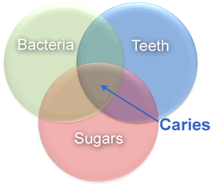
Dental Caries
Etiology
Bacteria (strep mutans and others) metabolize carbohydrates and create acids which dissolve the tooth enamel
Other individual, behavioral, and societal contributing factors discussed in depth on Oral Disease Risk Factors slide
Symptoms
Symptom free in early stage
White spots become brown spots and then cavities
Once a cavity forms, the root becomes exposed and pain occurs
Treatment
Prevention is key: oral hygiene, healthy diet, routine dental visits
Once cavities occur, restorations (fillings), extractions, and/or root canal are needed
Dental caries is the process of destruction of the tooth
Notes:
What Causes Dental Caries?
• Dental caries develops when oral bacteria (mutans streptococci and dozens of other bacteria) interact with dietary carbohydrates.
• Bacteria metabolize the sugars from the carbohydrates into acid, which dissolve tooth enamel - especially in areas of existing enamel weakness.
• Reducing the oral bacterial load or ingesting carbohydrates less frequently, will both result in less damage to the enamel.
Impact of individual, behavioral, race, and societal contributing factors are reviewed in depth on Oral Disease Risk Factors slide 5.
Treatment
• Prevention is key – good oral hygiene (twice a day brushing, daily flossing), proper diet (no sugar between meals), dental visits twice a year for cleanings, examination and x-rays as needed.
• For cavities, restorations (fillings), extractions, or root canal are needed depending on the depth/degree of disease. A root canal is a cleaning out of the center of the tooth to preserve its integrity and save the tooth.

Slide 12
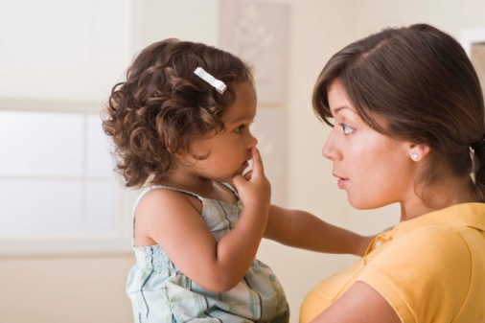
Reduce the Risk of Caries Transmission from
Mother to Child
Chapter Objective
Reduce the risk of caries transmission from mother to child
Image: Jupiterimages/Photos.com
Notes:
Learning objective targeted in this chapter:
Reduce the risk of caries transmission from mother to child.

Slide 13
The Maternal-Child Linkage
Dental caries is a transmissible disease!
Mothers are the main source of passing caries-causing bacteria to their infants
Any caregiver is a potential source of transmission
Transmission occurs via saliva contact such as tasting food
If caregiver bacterial levels are high, transmission is more likely
Transmission can occur even before the first teeth erupt
    Babies born by caesarean delivery more likely to have early acquisition of S. mutans
    May be due to decreased exposure to maternal microorganisms during birth, compete for colonization in the predentate mouth
  If colonization is delayed (>age 2), child may have fewer caries
  Caregivers often pass on bad habits (high sugar intake, poor oral hygiene)
  Message is: BRUSH FOR TWO!
Notes:
How Are Mutans Streptococci Transferred?
Mothers are the main source of passing streptococci mutans, the bacteria responsible for causing caries, to their infants. However, any caregiver presents as a potential source of transmission.
Transmission occurs via saliva contact such as tasting or pre-chewing food.
If caregiver bacterial levels are high, transmission is more likely
Transmission can occur even before the first teeth erupt at about 6 months of age. Evidence suggests that babies born by caesarean delivery are more likely to have early acquisition of S. mutans, possibly due to decreased exposure to maternal microorganisms during birth, which can compete for colonization in the predentate environment.
If colonization is delayed until after age two, then the child will have fewer caries.
Caregivers with caries also often pass on bad habits (high sugar intake, poor oral hygiene).
Message to moms should be BRUSH FOR TWO!
References
De Abreu da Silva Bastos, V, Freitas-Fernandes, LB, et al. Mother-To-Child Transmission Of Streptococcus Mutans: A Systematic Review And Meta-Analysis. Journal of Dentistry. 2015; 43: 181-191.
Finlayson, TL, Gupta, A, et al. Prenatal Maternal Factors, Intergenerational Transmission of Disease, And Child Oral Health Outcomes. Dent Clin N Am. 2017; 61: 483-518.
US Department of Health and Human Services. Oral health in America. A Report of the Surgeon General. Rockville, MD: US Department of Health and Human Services, National Institute of Dental and Craniofacial Research, National Institutes of Health; 2000.
Ramos-Gomez FJ, Weintraub JA, Ganskyet SA, et al. Bacterial, behavioral and environmental factors associated with early childhood caries. Journal of Clinical Pediatric Dentistry. 2002; 26(2): 165-173.
Douglass JM, LI Y, Tinanoff N. Systematic review of the association between mutans streptococci in primary caregivers and mutans streptococci and dental caries in their children. Pediatric Dentistry. 2008, 30(5): 375-387.

Slide 14
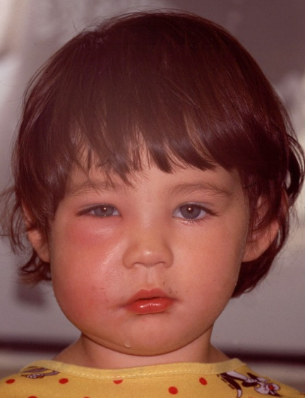
Reducing the Risk
Untreated caries can lead to:
  Infections
  Pain
  Poor self-esteem
  Missed school/Work
  Nutritional deficiencies
  Sleep disruption
Caregivers can decrease their own
caries levels by:
  Receiving regular comprehensive dental care, including during pregnancy
  Limiting the frequency of sugar in the diet
  Maintaining excellent oral hygiene
Photo: ICOHP
Notes:
What are the Consequences?
Dental caries is the most common chronic disease of childhood. In fact, it is five times more common than asthma. Untreated caries can lead to local and systemic complications, such as:
Infections (Dental abscess, facial cellulitis, brain abscess)
Pain
Nutritional & growth changes
Sleep dysfunction
Poor self-esteem
What can be Done?
There is promising evidence to show that caregivers can decrease their risk of passing on mutans streptococci to their children by decreasing their own caries levels.
Promising strategies include:
Receiving regular comprehensive dental care at least every 6 months that begins during pregnancy because caries causing bacteria are passed to infants as early as 6 months of age
Limiting the frequency of sugar in the diet
Maintaining excellent oral hygiene and using fluoride containing toothpaste
Using preventive agents such as :
Topical fluoride rinses
Anti-bacterial mouthrinses such as chlorhexidene (for short periods of time such as weeks. Note that prolonged use can lead to darkening of the tongue)
Xylitol containing gums chewed 4 times per day
References
US Department of Health and Human Services. Oral health in America. A Report of the Surgeon General. Rockville, MD: US Department of Health and Human Services, National Institute of Dental and Craniofacial Research, National Institutes of Health; 2000.
Ramos-Gomez FJ, Weintraub JA, Ganskyet SA, et al. Bacterial, behavioral and environmental factors associated with early childhood caries. Journal of Clinical Pediatric Dentistry. 2002; 26(2):165-173.
Douglass JM, LI Y, Tinanoff N. Systematic review of the association between mutans streptococci in primary caregivers and mutans streptococci and dental caries in their children. Pediatric Dentistry 2008, 30(5):375-387.
American Academy of Pediatric Dentistry. Guideline on Perinatal Oral Health Care. Revised 2011. 33(6): 118-123.

Slide 15
Postpartum Interventions
  Promote breast feeding
    Breast fed children are less likely to develop caries
    American Academy of Pediatrics recommends exclusive breastfeeding for the first 6 months of life and continuing until at least age 12 months
  Consider xylitol gum or brief chlorhexidine rinse programs for mothers until child is age 2
  Child care:
    Ensure children are not put to bed with a bottle
      Teeth are at highest risk overnight when saliva levels are low
    Gently clean infants' gums after breastfeeding, brush twice daily with smear of fluoride toothpaste once teeth erupt (AAP AAPD recommendation)
    Recommend children see a dentist at 12 months of age
Notes:
At the postpartum visit with the mother, focus on the following:
Promote breast feeding.
Children who are breast feed are less likely to develop caries than those who are bottle fed, especially if there is ad lib use of bottles and sippy cups
Ensure mothers do not put children to bed with a bottle.
Teeth are at highest risk overnight when saliva levels are lowest.
Once teeth erupt, they should be brushed twice daily with a soft baby toothbrush using a smear of fluoridated toothpaste (at age 3, a pea size is recommended)
Recommend children see a dentist at 12 months of age.
Promote high dose xylitol gum or brief chlorhexidine rinse programs for mom until the child is age 2.
Xylitol can help decrease transmission of caries causing bacteria from mom to child.
If chlorhexidine rinses are used, be sure to use it for brief periods of time to reduce the risk of tooth staining.
References
Clark MB, Keels MA, Slayton RL. Fluoride Use in Caries Prevention in the Primary Care Setting. SECTION ON ORAL HEALTH. Pediatrics. 2020; 146 (6): 1-13.
Gomez SS, Weber AA Effectiveness of a Caries Prevention Program in Pregnant Women and Mothers on Their Offspring. Int J Pediatric Dent. 2001; 11:117-122.
Guideline on Infant Oral Health Care. AAPD. Revised 2014. www.aapd.org/media/Policies_Guidelines/ G_InfantOralHealthCare.pdf
Lynch H, Milgrom P. Xylitol and dental caries: An overview for clinicians. Journal of the California Dental Association. March 2003.

Slide 16
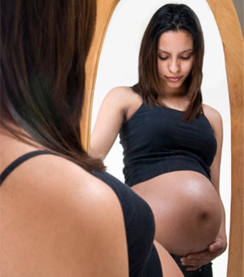
Effects of Periodontal Disease on Pregnancy
Chapter Objective
Apply the evidence for periodontitis affecting perinatal outcomes
Image: Ken Hurst/Photos.com
Notes:
Learning objective targeted in this chapter:
Apply the evidence for periodontitis affecting perinatal outcomes.

Slide 17
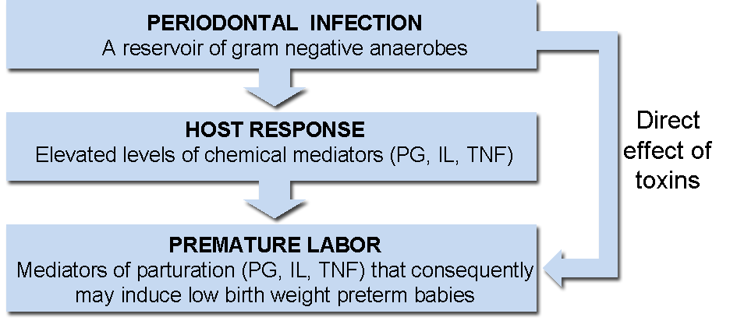
Mechanisms for Preterm Birth
Chart courtesy of: Kumar J and Samelson R. Oral Health Care During Pregnancy and Early Childhood: Practice Guidelines. Albany, NY. New York State Department of Health. 2006. P. 23; with permission
Notes:
Preterm birth is the number one cause of neonatal mortality in the U.S. and with substantial cost burdens. If treatment of periodontal disease in pregnant women improved pregnancy outcomes, this would clearly be a significant public health benefit.
Numerous studies have documented an association between maternal periodontal disease and preterm birth and low birth weight. Several studies also demonstrate positive associations between periodontal disease and preeclampsia and gestational diabetes. There are several potential explanations for these associations. Periodontal disease may have direct effects on the uterus through bacteremia causing direct infection of the chorioamnion. However, it is more likely that an indirect mechanism mediated by a systemic inflammatory response occurs.
Bacteremia: Direct Mechanism
Periodontal infection in the mouth may have direct effects on the uterus through bacteremia causing direct infection of the chorioamnion. Some studies have shown higher rates of periodontal pathogens within the placental tissues, such as P. gingivalis and F. nucleatum. Immunohistochemical and immunofluorescent stains of placental tissues have been used in some studies to support that placental colonization as opposed to mere transient bacterial presence can occur within the placental tissue.
Systemic Inflammatory Response: Indirect Mechanism
It is postulated that preterm birth results from a systemic inflammatory response to periodontal infection that increases prostaglandins and interleukins and affects labor initiation.
Inflammatory response may lead to placental blood flow restrictions, placental necrosis, and consequent low birth weight.
A similar mechanism has been proposed to explain the association seen between periodontitis and increased rates of heart disease and diabetes.
References
Fischer, LA, Demerath, E, et al. Placental Colonization With Periodontal Pathogens: The Potential Missing Link. American Journal of Obstetrics and Gynecology. November, 2019.
Abariga, SA, Whitcomb, BW. Periodontitis And Gestational Diabetes Mellitus: A Systematic Review And Meta-Analysis Of Observational Studies. BMC Pregnancy and Childbirth 2016; 16:344
Vivares-Builes, AM, Rangel-Rincón, LJ, et al. Gaps In Knowledge About The Association Between Maternal Periodontitis And Adverse Obstetric Outcomes: An Umbrella Review. J Evid Base Dent Pract. 2018; 1-27.
Boggess KA, Edelstein BL. Oral health in women during preconception and pregnancy: Implications for birth outcomes and infant oral health. Matern Child Health J. 2006; 10: S169-174.
Dörtbudak O, Eberhardt R, Ulm M, Persson GR. Periodontitis, a marker of risk in pregnancy for preterm birth. J Clin Periodontol. 2005; 32:45-52.
Goepfert AR, Jeffcoat MK, Andrews WW, Faye-Petersen O, Cliver SP, Goldenberg RL, et al. Periodontal Disease and Upper Genital Tract Inflammation in Early Spontaneous Preterm Birth. Obstetrics & Gynecology 2004; 104: 777-783.
Xiong X, Buekens P, Fraser WD, Beck J, Offenbacher S. Periodontal disease and adverse pregnancy outcomes: A systematic review. BJOG 2006; 113: 135-143.

Slide 18
Treatment Outcomes
Study | Study Type | Participants | Outcomes
Polyzos et al, 2009 | Meta-analysis of 7 RCTs | Case 1491 Control 1172 | Tx produced: Lower PTB OR 0.55 (p=0.008) Lower LBW OR 0.48 (p=0.049)
Offenbacher et al 2008 | RCT | Case 903 Control 903 | No difference in PTB, LBW
Srinivas et al 2009 | RCT | Case 311 Control 425 | No difference in PTB, IUGR, Preeclampsia
Newnham et al 2009 | RCT | Case 542 Control 540 | No difference in PTB
Cochrane 2017 | Meta-Analysis of 15 RCTs | 7161 participants | No difference in PTB, preeclampsia, or perinatal mortality; Lower LBW <2500g in subset of 7 studies, RR 0.67, 95% CI 0.48 to 0.95
Definitions: PTB=Preterm Birth, LBW=Low Birth Rate, OR=Odds Ratio, CI=Confidence Intervals, RR = Relative Risk
Notes:
Preterm birth is the number one cause of neonatal mortality in the U.S. and with substantial cost burdens. If treatment of periodontal disease in pregnant women improved pregnancy outcomes it would clearly be of major public health benefit.
The following table summarizes the current medical literature on this subject. At present, studies do not demonstrate that treatment of periodontal disease during pregnancy improves pregnancy outcomes. However, the studies do demonstrate that periodontitis improved with treatment and that treatment is safe during pregnancy. Studies are needed to determine if pre-pregnancy treatment would lower risk as treatment during pregnancy may be too late to avoid effects of inflammation or placental colonization.
Meta-analysis
Analysis offers a very thorough review of the latest evidence.
Inclusion criteria were rigorous with only good RCTs included.
Women in the treatment groups received deep scaling and root planing (vigorous removal of bacterial plaques, calculus deposits, and necrotic tissue) below and at the gum line; the standard of care for periodontitis management) before 24 weeks gestation
Women in the control groups received routine prenatal care but no specific dental care until after delivery when they were offered deep scaling and root planing.
Other studies listed are more recent studies not included in the meta-analysis
Definitions
PTB = Preterm Birth
LBW= Low Birth Weight
OR = Odds Ratio
CI = Confidence Intervals
RR = Relative Risk
References
Iheozor-Ejiofor Z, Middleton P, Esposito M, Glenny AM. Treating periodontal disease for preventing adverse birth outcomes in pregnant women. Cochrane Database of Systematic Reviews. 2017; Issue 6. Art. No.: CD005297.
Polyzos NP, Polyzos IP, Mauri D, et al. Effect of periodontal disease treatment during pregnancy on preterm birth incidence: a meta-analysis of randomized trials. Am J Obstet Gynecol. 2009; 200(3): 225-232.
Offenbacher S, Beck J, Jared H, et al. Maternal oral therapy to reduce obstetric risk(MOTOR): A report of a mulitcentered periodontal therapy randomized-controlled trial on rate of preterm delivery. Am J Obstet Gynecol. 2008; 199(6): S2.
Srinivas SK, Sammel MD, Stamilio DM, et al. Periodontal disease and adverse pregnancy outcomes: is there an association? Am J Obstet Gynecol. 2009; 200(5): 497.e1-8.
Newnham JP, Newnham IA, Ball CM, et al. Treatment of periodontal disease during pregnancy: a randomized controlled trial. Obstet Gynecol. 2009; 114: 1239-48.
Xiong X, Buekens P, Goldenberg RL et al. Optimal timing of periodontal disease treatment for prevention of adverse pregnancy outcomes: before or during pregnancy? Am J Obstet Gynecol. 2011; 205(111): e1-6.

Slide 19
The Bottom Line
  Periodontal disease is associated with preterm birth and low birth weight
  Periodontal treatment during pregnancy has not been shown to improve birth outcomes
  Periodontal treatment does improves the women’s oral health
  Periodontal treatment is safe during pregnancy
  Need additional research to determine if pre-pregnancy treatment would lower risk
Notes:
The Bottom Line
• Periodontal disease is associated with preterm birth and low birth weight as found in case-control and observational studies; however RCTs conducted during pregnancy have not resulted in improved outcomes as reviewed in the previous 2 slides
• Periodontal disease does improve with treatment during pregnancy, women feel better, their teeth will have a better chance of long term health, and this might mitigate other potential systemic risks of periodontal disease (e.g. heart disease)
• Periodontal treatment is safe during pregnancy
A recent editorial postulates that treatment of periodontitis during pregnancy may be too late as the inflammation cascade and bacteremia of treatment still occur when treatment occurs during pregnancy. Reducing periodontitis before pregnancy may reduce the factors of periodontitis that contribute to preterm labor.

Slide 20
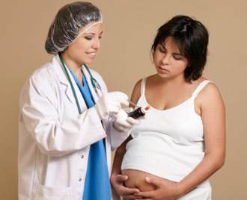
Oral Conditions in Pregnancy
Chapter Objective
Manage other common oral conditions in pregnancy
Image: Leah-Anne Thompson /Photos.com
Notes:
Learning objective targeted in this chapter:
Manage other oral conditions in pregnancy.

Slide 21
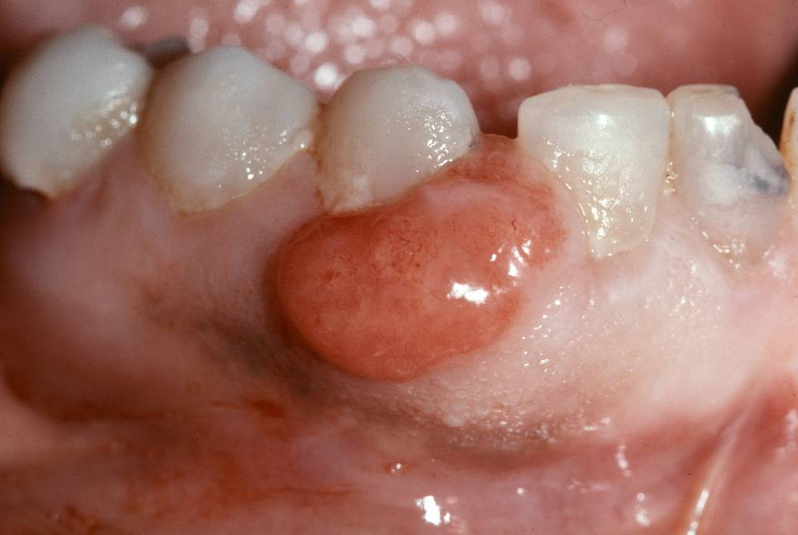
Pregnancy Granuloma
Symptoms
  Occur in 5% of pregnant women
  Non-painful, smooth or lobulated mass
  Erythematous, bleed easily when touched
  Usually develop on the gingiva
Etiology
  Develop in response to local irritation, poor hygiene, trauma, and hormonal changes
Treatment
  Observe unless lesions bleed excessively, interfere with eating, or do not resolve spontaneously after delivery
Photo: Brad Neville, DDS
Notes:
Pregnancy granuloma may be found in 5% of pregnant women. It is indistinguishable from pyogenic granuloma and is a rapidly growing, tumor-like lesion that develops as a response to local irritation such as poor hygiene, overhanging restorations, or trauma. Increasing estrogen and progesterone levels during pregnancy exacerbate the condition.
Symptoms
Erythematous, nonpainful, smooth, or lobulated mass
Bleeds easily when touched
Most frequently develops on the gingiva, but less common locations include the lip, tongue, or buccal mucosa
May vary in size from a few millimeters to several centimeters in diameter
Usually appears between 2nd to 8th month of pregnancy
Treatment
Offer reassurance.
Observe unless lesions are bleeding excessively, interfere with eating, or do not resolve spontaneously after delivery.
Can treat by conservative surgical excision.
Recurrence is uncommon unless the lesion is incompletely removed or the source of irritation remains.
Lesions excised during pregnancy recur more frequently.
References
Yara C, Coelho CMP, Brentegani LG, Vieira MLSO, de Oliveeria ML. Clinical and Histological Evaluation of Granuloma Gravidarum: Case Report. Brazilian Dental Journal 2000;11(2) 135-139.
Jafarzadeh H, Sanatkhani M, Mohtasham N, et al. Oral Pyogenic Granuloma: A Review. J Oral Sci. 2006; 48:167-175.

Slide 22
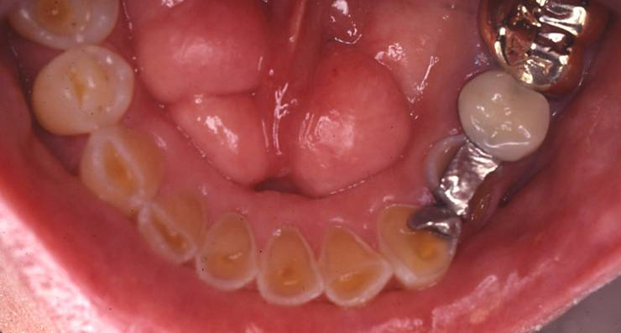
Hyperemesis Gravidarum
Gastroesophageal reflux and excessive vomiting (Hyperemesis gravidarum) are both common in pregnancy and cause enamel erosion
Management
  Rinse with water and bicarbonate to reduce acid in mouth immediately after vomiting
  Avoid brushing firmly and just following vomiting
Photo: John McDowell, DDS
Notes:
Gastroesophageal reflux or Excessive vomiting (Hyperemesis gravidarum) are both common in pregnancy and can cause enamel erosion.
Management
Rinse with water or better still bicarbonate to reduce acid in mouth immediately after vomiting.
Avoid brushing too firmly or just after emesis.
Calcium coating products can be applied daily to help protect teeth if chronic vomiting is an issue
Photo shows enamel erosions and mandibular tori.
References
American Dental Association Council on Access, Prevention and Interprofessional Relations. Women’s Oral Health Issues. 2006.
Hey-Hadavi JH. Women's Oral Health Issues: Sex differences and clinical implications. Women Health Primary Care. 2002;5(3):189-199.

Slide 23
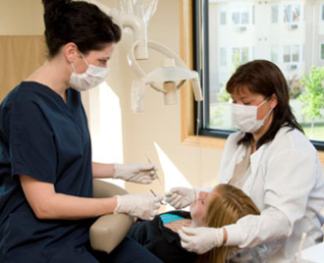
Dental Treatment in Pregnancy is Safe
Chapter Objectives
Counsel patients about the safety of common dental interventions in pregnancy
Acknowledge and address health inequity as it applies to pregnant women and oral health
Image: Vicki Reid/Photos.com
Notes:
Learning objective targeted in this chapter:
Understand and counsel patients regarding the safety of common dental interventions in pregnancy.

Slide 24
The Dental Disconnect
Women frequently do not see a dentist when pregnant
  Only 33-67% of all pregnant women visit the dentist in the U.S.
  Percentage is lower for Hispanic, low SES, non-English speaking, non-white, and women who are not aware of importance of oral health during pregnancy
  Only 50% of pregnant woman with a dental problem visit a dentist
  Even among women with dental insurance, dental care rated decline during pregnancy
Notes:
Women frequently do not go to the dentist when they are pregnant. Consider the following:
Recent study shows only 26% visit the dentist during pregnancy; a previous study showed 34% of pregnant women visit the dentist.
Percentage is even lower for Hispanic women, those of lower socioeconomic status (SES), and those not aware of the effect that the mouth can have on total body health.
Only 50% of pregnant woman with a dental problem (like dental pain or a cavity) visit a dentist.
Even among women with dental insurance, dental care rates decline during pregnancy.
References
Rocha JS, Arima LY, Werneck RI, Moysés SJ, Baldani MH: Determinants of Dental Care Attendance during Pregnancy: A Systematic Review. Caries Res. 2018; 52:139-152.

Slide 25
Barriers to Dental Care
Reasons pregnant women do not obtain dental care
  Obstetric and primary care providers do not routinely refer for dental care
    Uncertainty about safety of dental interventions
    Lack of training
    Competing health demands limits focus on this topic
  Dentists may be reluctant to manage pregnant patients
    Lack of practical training
    Dentists may fear malpractice repercussions
  Patients have competing health demands and may receive conflicting or unclear information about the importance of dental care during pregnancy
Notes:
Dentists, medical clinicians, and patients need to be aware of the importance of oral health and the safety of treatments during pregnancy. Clinicians need to take time during first prenatal visits to ask about oral health, examine the mouth, and refer. Studies show that few medical clinicians advise pregnant patients to see the dentist.
Why Don't Pregnant Women Obtain Dental Care?
Historically, a lack of national prenatal oral health guidelines focusing on this topic (this is changing)
Medical clinicians do not routinely refer patients for dental care because:
Uncertainty about safety of dental interventions
Lack of training
Competing health demands limit focus on the topic of oral health
Dentists may be unsure how to manage the pregnant patient:
Lack of training in dental school and few prenatal patients
Care may be postponed until after pregnancy
Wide variation in opinion about use of local anesthetics, radiographs, and treatment in pregnancy
Fear of malpractice
Dentists may under-treat pregnant patients for fear of litigation related to fetal health.
Litigation review from 1945 to 2001 showed only one lawsuit which was a coincidental stillbirth. Verdict found in favor of the health care provider.
Patients have competing health demands and may receive conflicting or unclear information about the importance of having a dental visit during pregnancy.
References
Al Habashneh R, Guthmiller JM, Levy S, et al. Factors related to utilization of dental services during pregnancy. J Clin Periodontol. 2005; 32(7): 815–821.
Lydon-Rochelle MT, Krakowiak P, Hujoel PP, Peters RM. Dental care use and self-reported dental problems in relation to pregnancy. Am J Public Health. 2004; 94(5): 765–771.
Hilgers KK, Douglass J, Mathieu GP. Adolescent pregnancy: a review of dental treatment guidelines. Pediatr Dent. 2003; 25(5): 459–467.
Gaffield, ML, Colley Gilbert BJ, Malvitz DM, Romaguera R. Oral health during pregnancy: An analysis of information collected by the Pregnancy Risk Assessment Monitoring System. JADA. 2001; 132(7): 1009-1016.
Pistorius J, Kraft J, Willershausen B. Dental treatment concepts for pregnant patients: results of a survey. Eur J Med Res. 2003; 8(6):241–246.
George A, Shamim S, Johnson M, et al. How do dental and prenatal care practitioners perceive dental care during pregnancy? Current evidence and implications. Birth. 2012; 39(3): 238-47.
Curtis M, Silk HJ, Savageau JA. Prenatal Oral Health Education in U.S. Dental Schools and Obstetrics and Gynecology Residencies. Journal of Dental Education. 2013; 77(11): 1461-1468.

Slide 26
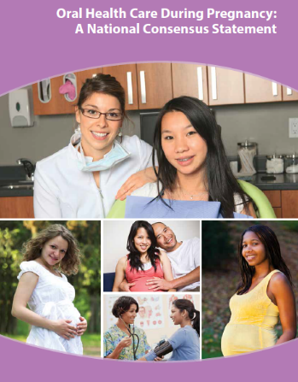
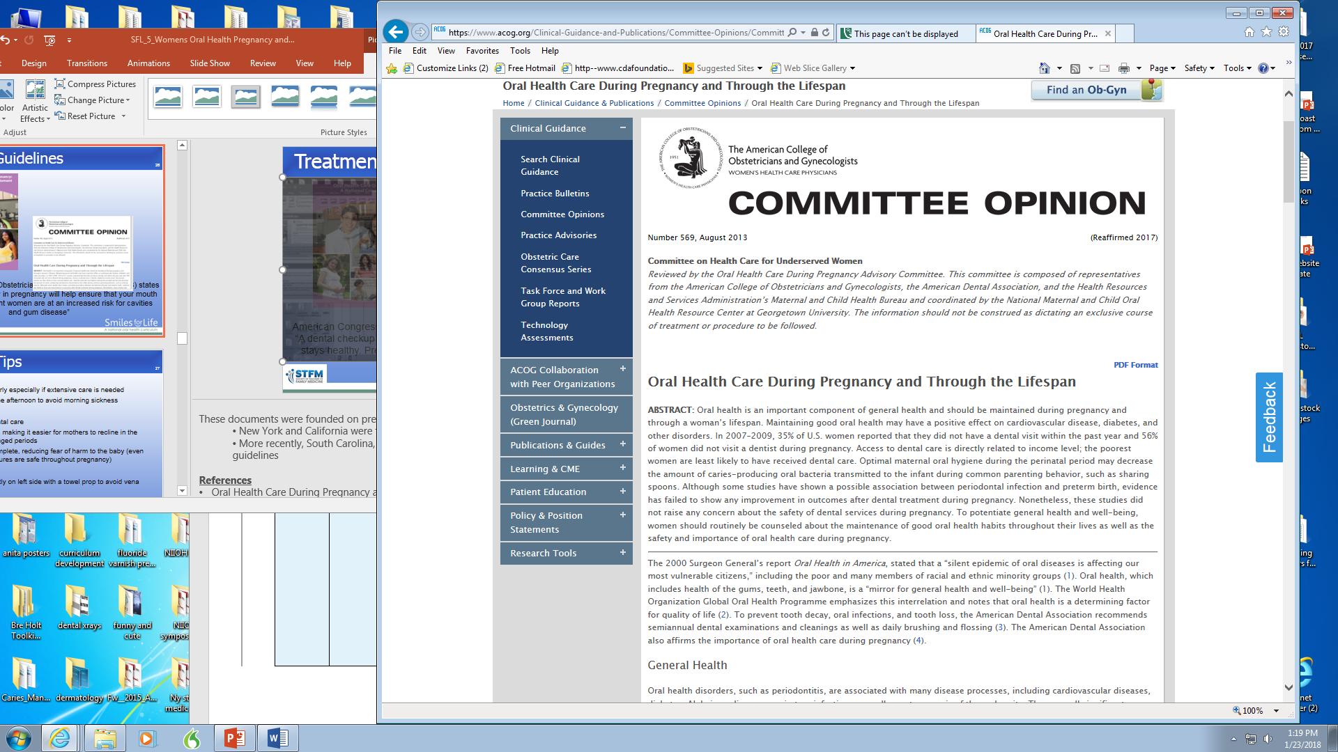
Treatment Guidelines
  American Congress of Obstetricians and Gynecologists (ACOG) states “A dental checkup early in pregnancy will help ensure that your mouth stays healthy. Pregnant women are at an increased risk for cavities and gum disease”
Notes:
There is clear national consensus on the approach to prenatal oral health, the importance of addressing it across the lifespan and especially in pregnancy, and clarity around the safety of dental procedures during pregnancy in two key documents:
The 2012 Oral Health Care During Pregnancy Expert Workgroup. Oral Health Care During Pregnancy: A National Consensus Statement—Summary of an Expert Workgroup which was endorsed by both the American Dental Association (ADA) and the American College of Obstetrics and Gynecology (ACOG).
The 2013 (Reaffirmed 2017) American College of Obstetrics and Gynecologists (ACOG) Committee Opinion Oral Health Care During Pregnancy and Through the Life Span.
These documents clarified that the vast majority of dental care is safe throughout pregnancy and important for women and their babies.
These documents were founded on previous state guidelines:
New York and California were the first to develop state treatment guidelines.
More recently, South Carolina, Oregon and Massachusetts also have state prenatal oral health guidelines
References
Oral Health Care During Pregnancy and Through the Life Span. Committee Opinion No 569. American College of Obstetrics and Gynecologists. Obstet Gynecol. 2013 (Reaffirmed 2017);122:417-22.
Massachusetts Department of Public Health. Oral Health Practice Guidelines for Pregnancy and Early Childhood. Boston, MA; March 2016.
Oral Health Care During Pregnancy Expert Workgroup. 2012. Oral Health Care During Pregnancy: A National Consensus Statement-Summary of an Expert Workgroup Meeting. Washington, DC: National Maternal and Child Oral Health Resource Center. http://www.mchoralhealth.org/materials/consensus_statement.html
Oral Health Care During Pregnancy and Early Childhood Practice Guidelines. New York Public Health Department. 2006. http://www.health.ny.gov/publications/0824.pdf
Oral Health During Pregnancy and Early Childhood: Evidence Guidelines for Health Professionals. California Dental Association Foundation. 2010.

Slide 27
Treatment Tips
First Trimester
  Care should begin early especially if extensive care is needed
  Schedule visits in the afternoon to avoid morning sickness
  Second Trimester
  Ideal time for dental care
  Fetus is not large, making it easier for mother to recline longer in the dental chair
  Organogenesis is complete, reducing fear of harm to the baby (even though dental procedures are safe throughout pregnancy)
Third Trimester
  Position woman slightly on left side with a towel prop to avoid vena cava compression
  Encourage standing and walking periodically
  Elevating the head helps avoid shortness of breath
Notes:
20% of all pregnancies end in miscarriage and 80% of those miscarriages occur in the first trimester. However, there is no association between dental procedures and the incidence of miscarriage. Despite this fact, elective treatments are often delayed during the first trimester because of fear that dental procedures will be associated with miscarriages that occur spontaneously more in the 1st trimester. Women should not be prevented from receiving needed dental care based on unfounded fears.
First Trimester
Especially in states where adult women have access to dental insurance only while pregnant, care should begin early (more so if extensive treatment will be needed).
Scheduling visits in the afternoon can avoid morning sickness nausea that many women experience.
Second Trimester
The fetus is not large, making it easier for expectant mothers to recline in the dental chair for prolong periods.
Organogenesis is complete, thereby reducing the fear of any necessary medication exposures.
Third Trimester
Late in term, position woman slightly on left side with a towel prop to avoid vena cava syndrome.
Encourage her to stand and walk periodically during long appointments.
Elevating the head helps avoid shortness of breath induced by abdominal contents pushing up on already compressed lungs.
References
Oral Health Care During Pregnancy and Through the Life Span. Committee Opinion No 569. American College of Obstetrics and Gynecologists. Obstet Gynecol. 2013;122:417-22.
Oral Health Care During Pregnancy Expert Workgroup. 2012. Oral Health Care During Pregnancy: A National Consensus Statement—Summary of an Expert Workgroup Meeting. Washington, DC: National Maternal and Child Oral Health Resource Center.
Oral Health Care During Pregnancy and Early Childhood Practice Guidelines. New York Public Health Department. 2006. http://www.health.ny.gov/publications/0824.pdf
Oral Health During Pregnancy and Early Childhood: Evidence Guidelines for Health Professionals. California Dental Association Foundation. 2010.
VT H, T M, T S, Nisha V A, A A. Dental Considerations in Pregnancy-A Critical Review on the Oral Care. Journal of Clinical and Diagnostic Research : JCDR. 2013;7(5): 948-953.

Slide 28
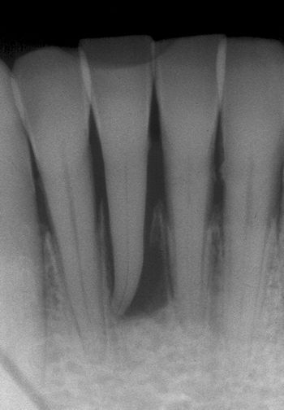
Dental Radiographs
Risks
  Radiation exposure to the fetus from dental x-rays is so low, it cannot be measured by conventional techniques
Procedures
  X-ray as necessary to make diagnosis
  Proper radiographic techniques to minimize radiation exposure
    Utilize lead apron shielding
    Avoid retakes when possible
    Use a long cone to focus radiation only on mouth
    Newer digital X-rays (80% less radiation)
Photo: ICOHP
Notes:
Radiation exposure is extremely low during dental radiographs. Patients and their unborn children are generally at higher risk from the oral disease affecting the pregnancy than they are from radiation exposure.
According to the American Dental Association (1), the radiation you receive from oral X-rays are scant and even less for the fetus. Using a millisievert (mSv) scale to measure doses, you could expect 0.038 from Bitewing X-rays. Compare this to Chest x-ray - .080 and to a person who lives in Denver CO with a background radiation rate of 0.510 (per year).
Risks
Radiation exposure to the fetus from dental x-rays is so low that it cannot be measured by conventional techniques
Procedures
X-ray as necessary to make diagnosis (i.e. root canal therapy, trauma, caries); consider delaying elective X-rays until after the pregnancy.
Proper radiographic techniques can minimize radiation exposure.
Utilize lead apron shielding (abdominal and thyroid)
Limit/avoid retakes when possible
Use a long cone to focus radiation only on mouth
New digital X-rays expose patients to 80% less radiation
References
Oral Health Care During Pregnancy Expert Workgroup. 2012. Oral Health Care During Pregnancy: A National Consensus Statement—Summary of an Expert Workgroup Meeting. Washington, DC: National Maternal and Child Oral Health Resource Center.
Oral Health Care During Pregnancy and Early Childhood Practice Guidelines. New York Public Health Department. 2006. http://www.health.ny.gov/publications/0824.pdf
Abbott P. Are dental radiographs safe? Aust Dent J. 2000; 45: 208-213. www.motherisk.org/prof/commonDetail.jsp?content_id=208
CDC Radiation and Pregnancy Fact Sheet https://emergency.cdc.gov/radiation/prenatalphysician.asp

Slide 29
Common Antibiotics
The following antibiotics are appropriate for use during pregnancy:
  Penicillin
  Amoxicillin
  Cephalexin
  Erythromycin base *
  Clindamycin *
  Metronidazole **
    * Appropriate alternative for non-type I penicillin allergic patients
Notes:
Common Antibiotics
Oral infections commonly require treatment during pregnancy. The antibiotics listed below are generally considered safe to take during pregnancy with the caveats listed below.
Penicillin
Amoxicillin
Cephalexin:
• Appropriate alternative for non-type I penicillin allergic patients (risk of allergic cross-reaction is approximately 2%).
Erythromycin base:
Appropriate choice in a penicillin type I reaction allergic patient.
Erythromycin estolate (no longer available in U.S.) is relatively contraindicated as it is associated with cholestatic hepatitis in pregnancy.
Clindamycin:
Appropriate choice in a penicillin type I reaction allergic patient.
Metronidazole:
** May use during pregnancy as needed. Caution advised while breastfeeding.
.
FDA rating system was updated in 2015 to eliminate the A,B,C system. For additional information: www.fda.gov/Drugs/DevelopmentApprovalProcess/DevelopmentResources/Labeling/ucm093307.htm
References
Motherisk. Toronto, Ontario, Canada at www.motherisk.org (which included referencing National Collaborative Perinatal Project, 1959-1974, Record Group 443, National Institutes of Health.)
Hilgers KK, Douglass JM, Mathieu GP. Adolescent Pregnancy: A Review of Dental Treatment Guidelines. Pediatr Dent 2003; 25: 459-467.
Oral Health During Pregnancy and Early Childhood: Evidence Guidelines for Health Professionals. California Dental Association Foundation. February 2010.
US Food and Drug Administration Pregnancy and Lactation Labeling Final Rule: www.fda.gov/Drugs/DevelopmentApprovalProcess/DevelopmentResources/Labeling/ucm093307.htm
Oral Health Care During Pregnancy Expert Workgroup. 2012. Oral Health Care During Pregnancy: A National Consensus Statement—Summary of an Expert Workgroup Meeting. Washington, DC: National Maternal and Child Oral Health Resource Center.
Briggs GC, Freeman RK, Yaffe SJ. Drugs in Pregnancy and Lactation, Ninth Edition. Lippincott Williams and Wilkins, Philadelphia, PA 2011.

Slide 30
Common Analgesics
The following analgesics are appropriate to use during pregnancy:
  Acetaminophen
  Ibuprofen #
  Oxycodone, Hydrocodone & Codeine *
# Caution in 1st trimester; Avoid after 30 weeks
* Weigh risk/benefit especially if prolonged use; neonatal withdrawal
Notes:
Dental pain originating from infections or extensive carious lesions can be severe. Definitive dental care should be arranged as soon as possible, but short term interim pain management may be needed. Clinicians can use the following analgesics with several caveats.
Acetaminophen
Drug of choice for pain management during pregnancy
Ibuprofen
Caution advised in 1st trimester
Avoid in third trimester because of the risk of premature closure of the ductus arteriosus and oligohydramnios
Oxycodone, Hydrocodone and Codeine
In the third trimester, there is risk of fetal dependency/withdrawal with codeine, hydrocodone and oxycodone if continuous use and respiratory suppression if given near delivery. Avoid or limit dose and duration.
Opioid analgesics should be used for moderate to severe pain at the lowest dose and for the shortest period of time possible.
References
Hilgers KK, Douglass JM, Mathieu GP. Adolescent Pregnancy: A Review of Dental Treatment Guidelines. Pediatr Dent 2003;25:459-467.
Care During Pregnancy and Early Childhood Practice Guidelines. New York Public Health Department 2006. http://www.health.state.ny.us/publications/0824.pdf
Oral Health During Pregnancy and Early Childhood: Evidence Guidelines for Health Professionals. California Dental Association Foundation. February 2010.
FDA rating system 2015: www.fda.gov/Drugs/DevelopmentApprovalProcess/DevelopmentResources/Labeling/ucm093307.htm
Oral Health Care During Pregnancy Expert Workgroup. 2012. Oral Health Care During Pregnancy: A National Consensus Statement—Summary of an Expert Workgroup Meeting. Washington, DC: National Maternal and Child Oral Health Resource Center.
Briggs GC, Freeman RK, Yaffe SJ. Drugs in Pregnancy and Lactation, Ninth Edition. Lippincott Williams and Wilkins, Philadelphia, PA 2011.

Slide 31
Common Anesthetics
The following anesthetics are appropriate for use during pregnancy at standard dental doses:
  Lidocaine with or without epinephrine
  Procaine
  Nitrous Oxide
    Controversy based on studies of chronic exposure in operating room nurses leading to B12 deficiency before the advent of scavenger systems
    Dental use of nitrous oxide delivers much smaller, shorter exposures which have not been associated with these problems
Notes:
The following anesthetics are safe for use in pregnant women at standard dental doses. Be aware that sedatives such as benzodiazepines should be avoided.
Lidocaine with or without Epinephrine
Procaine
Nitrous Oxide
Controversy based on studies of chronic exposure in operating room nurses leading to B12 deficiency before the advent of scavenger systems.
Dental use of nitrous oxide delivers uses smaller, shorter exposures which have not been associated with the problems found in chronic exposure studies.
Hospitals do safely use nitrous oxide for pain control in labor.
California and New York guidelines indicate that nitrous oxide can be used in pregnancy with appropriate care and it is the sedation agent of choice for pregnant patients with fear and anxiety.
References
Oral Health During Pregnancy and Early Childhood: Evidence Guidelines for Health Professionals. California Dental Association Foundation. 2010.
Motherisk. Toronto, Ontario, Canada at www.motherisk.org (which included referencing National Collaborative Perinatal Project, 1959-1974, Record Group 443, National Institutes of Health.)
Hilgers KK, Douglass JM, Mathieu GP. Adolescent Pregnancy: A Review of Dental Treatment Guidelines. Pediatr Dent 2003; 25: 459-467.
Care During Pregnancy and Early Childhood Practice Guidelines. New York Public Health Department 2006. http://www.health.state.ny.us/publications/0824.pdf
Oral Health During Pregnancy and Early Childhood: Evidence Guidelines for Health Professionals. California Dental Association Foundation. February 2010.
FDA rating system, 2015: www.fda.gov/Drugs/DevelopmentApprovalProcess/DevelopmentResources/Labeling/ucm093307.htm
Oral Health Care During Pregnancy Expert Workgroup. 2012. Oral Health Care During Pregnancy: A National Consensus Statement—Summary of an Expert Workgroup Meeting. Washington, DC: National Maternal and Child Oral Health Resource Center.
Briggs GC, Freeman RK, Yaffe SJ. Drugs in Pregnancy and Lactation, Ninth Edition. Lippincott Williams and Wilkins, Philadelphia, PA 2011.

Slide 32
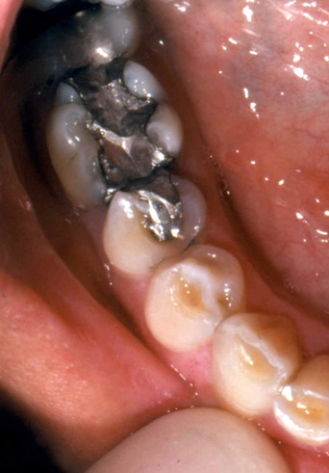
Amalgam Safety
  Amalgam, the silver colored restoration material used to fill cavities, has received attention as it contains small amounts of mercury
  Mercury is bound in a stable matrix and the amount released is minimal
  According to the FDA, the level is "not high enough to cause harm in patients"
  Studies of amalgam exposure during pregnancy have not documented toxicity, including birth defects, spontaneous abortions, or reductions in fertility
Photo: Ellen Eisenberg, DMD
Notes:
The FDA states the following:
“FDA has reviewed the best available scientific evidence to determine whether the low levels of mercury vapor associated with dental amalgam fillings are a cause for concern. Based on this evidence, FDA considers dental amalgam fillings safe for adults and children ages 6 and above. The amount of mercury measured in the bodies of people with dental amalgam fillings is well below levels associated with adverse health effects. Even in adults and children ages 6 and above who have fifteen or more amalgam surfaces, mercury exposure due to dental amalgam fillings has been found to be far below the lowest levels associated with harm. Clinical studies in adults and children ages 6 and above have also found no link between dental amalgam fillings and health problems.
There is limited clinical information about the potential effects of dental amalgam fillings on pregnant women and their developing fetuses, and on children under the age of 6, including breastfed infants. However, the estimated amount of mercury in breast milk attributable to dental amalgam is low and falls well below general levels for oral intake that the Environmental Protection Agency (EPA) considers safe. FDA concludes that the existing data support a finding that infants are not at risk for adverse health effects from the breast milk of women exposed to mercury vapor from dental amalgam. The estimated daily dose of mercury vapor in children under age 6 with dental amalgams is also expected to be at or below levels that the EPA and the Centers for Disease Control and Prevention (CDC) consider safe.”
References
Hujoel PP, Lydon-Rochelle M, Bollen AM, et al. Mercury exposure from dental filling placement during pregnancy and low birth weight risk. Am J Epidemiol. 2005 Apr 15; 161(8): 734-40.
Bates MN, Fawcett J, Garrett N, et al. Health effects of dental amalgam exposure: a retrospective cohort study. Int J Epidemiol. 2004; 33(4): 894–902.
Oral Health Care During Pregnancy and Through the Life Span. Committee Opinion No 569. American College of Obstetrics and Gynecologists. Obstet Gynecol. 2013; 122: 417-22.
FDA rating system, 2015: www.fda.gov/Drugs/DevelopmentApprovalProcess/DevelopmentResources/Labeling/ucm093307.htm
American Academy of Pediatric Dentistry. Guideline on Perinatal Oral Health Care. Revised 2011. 33(6): 118-123.
World Health Organization. Exposure to mercury: a major public health concern. Geneva, Switz: World Health Organization; 2007. Accessed Mar 31, 2009.

Slide 33
Preventive Agents
Fluoride
  Inhibits bacteria growth and strengthens enamel
  Used topically to prevent dental caries
  AAP and ACOG recommend pregnant women & children drink fluoridated water
Xylitol Gum
  Decreases level of bacteria in saliva and plaque
  Selects for less virulent strains of mutans streptococci
Chlorhexidine
  Used as mouthwash to decrease bacteria
  Reduces gingivitis and plaque
Notes:
Fluoride
Large studies demonstrate safe use in pregnancy.
The American Academy of Pediatrics (AAP) and the American College of Obstetrics and Gynecology (ACOG) recommendations state that it is safe for pregnant women and children to drink fluoridated water.
Fluoride acts to:
Inhibit bacteria growth and strengthen enamel
Used topically to prevent dental caries
Dietary fluoride supplements are not recommended for pregnant women as there is not added benefit for the fetus; topical fluoride toothpastes and mouthrinses provide the stated benefits
Xylitol
No direct studies in pregnancy have been performed, but studies where it has been used as an intervention have not demonstrated harm.
Used in gum, xylitol:
Decreases level of mutans streptococci in saliva and plaque by interfering with cellular metabolism
Selects for less virulent strains of mutans streptococci
In addition, chewing sugarless gum stimulates saliva which assists with neutralization of acids and re-mineralization of tooth enamel.
Chlorhexidine
Vaginal application studies have shown no harm to the fetus. No studies of oral use are available, but exposure would be similar when used as a mouthwash. Absorption from the gastrointestinal tract is poor.
Used as mouthwash to decrease periodontal and cariogenic bacteria
Reduces gingivitis and plaque deposition
References
Jenco M. AAP continues to recommend fluoride following new study on maternal intake and child IQ. AAP News. August 19, 2019. https://www.aappublications.org/news/2019/08/19/fluoride081919
Ly KA, Milgrom P, Rothen M. Xylitol, sweeteners, and dental caries. Pediatric Dentristry 2006;28:154-163.
American Dental Association Council on Access, Prevention and Interprofessional Relations. Women’s Oral Health Issues. 2006. Available at: www.ada.org/sections/professionalResources/pdfs/healthcare_womens.pdf
Motherisk. Toronto, Ontario, Canada at www.motherisk.org (including reference of the National Collaborative Perinatal Project, 1959-1974, Record Group 443, National Institutes of Health.)
Briggs GC, Freeman RK, Yaffe SJ. Drugs in Pregnancy and Lactation, Ninth Edition. Lippincott Williams and Wilkins, Philadelphia, PA 2011.
Epocrates Athena Health www.epocrates.com

Slide 34

What Can We Do?
Chapter Objectives
Promote oral health in pregnant women and newborns
Acknowledge and address health inequity as it applies to pregnant women and oral health
Improve dental care access for pregnant women through interprofessional collaboration
Image: Image Source/Punchstock
Notes:
Learning objectives targeted in this chapter:
Promote oral health in pregnant women and newborn children
Improve dental care access for pregnant women through interprofessional collaboration

Slide 35
Providing Optimal Care
Screening
  Evaluate oral health risk history
  Perform an oral exam
  Document findings in prenatal record and share with dentist
Anticipatory Guidance
  Brush with soft toothbrush twice daily with fluoride toothpaste
  Floss daily
  Limit sugary snacks and drinks to meal times only
  Chew xylitol gum four to five times per day after eating
  Establish a dental home for the family
  Regular dental visits q 6 months (or at dental discretion)
  Reassure regarding safety of dental treatment during pregnancy
Notes:
Stategies for providing optimal care:
Patient Screening
When screening patients follow these steps:
Evaluate oral health risk history.
Perform an oral exam.
Document findings in prenatal record and share with dentist.
Patient Anticipatory Guidance
Encourage patients to maintain the following good oral hygiene habits and healthy dietary practices:
Brush teeth with soft toothbrush twice daily with fluoridated toothpaste.
Floss daily.
Limit sugary snacks and drinks to meal times only.
Chew xylitol gum 4 to 5 times per day after eating (xylitol must be listed as first ingredient to be effective).
Establish a dental home for the family.
Visit the dental home every 6 months – more or less often based on dental team’s advice.
Proactively inform dentists of the safety of dental treatment during pregnancy.
Inform patients how to manage oral complications of vomiting:
Rinse with water and baking soda after vomiting.
Do not brush immediately after vomiting to decrease potential erosion.
References
American College of Obstetricians and Gynecologists. Planning your pregnancy and birth. (3rd ed.). Washington, DC, 2000.
Brambilla, E., Felloni, A., Gagliani, M., Malerba, A., García-Godoy, F., Strohmenger, L. Caries prevention during pregnancy: Results of a 30-month study. Journal of the American Dental Association 1998;129:871-877.
American Academy of Pediatric Dentistry. Guideline on Perinatal Oral Health Care. Revised 2011. 33(6): 118-123.

Slide 36
Providing Optimal Care
Standardize Office Processes
  Modify prenatal flowchart to include dental screening, advice, and referral
  Develop a role for office staff in taking risk history, offering advice, and providing referral information
  Be mindful of barriers to care (cultural, language, literacy) and engage office staff, case managers, and social workers assist in overcoming barriers to dental care
  Maintain an up-to-date list of local dental providers that see pregnant patients, accept all insurances
  Use a referral form to improve communication
  Follow up to ensure dental care occurred
  Include oral handouts in prenatal packets
Notes:
Standardize Office Processes
Implement the following procedures:
Modify prenatal chart to include dental screening, advice, and referral.
Develop a role for office staff in taking risk history, offering advice, and providing referral information.
Be mindful of barriers to care (cultural, language, literacy) and engage office staff, case managers, and social workers assist in overcoming barriers to dental care
Maintain an up-to-date list of local dental providers that see pregnant patients and if needed take insurances such as Medicaid.
Use a referral form to improve communication with dental providers (see next slide).
Follow up to ensure dental care occurred (you check to see that patients had ultrasounds and labs; be sure you check to see if they saw the dentist).
Include handouts on oral health and dental care in pregnancy in the patient informational packets

Slide 37
A Simple 2 Question Screen
Standardize Screening
  At a minimum, screen patients with this process:
    1) Do you have any oral health issues currently?
      If yes => make urgent referral
    2) When was the last time you saw a dentist?
      If > 6 months => make routine referral
      If < 6 months => advise to see dentist at 6 months
Notes:
Standardize Office Screening
ALL pregnant patients need to see the dentist at some point during pregnancy because ALL patients should see the dentist every 6 months (or sooner depending on risk and dental advice)
Implement the following screen:
1) Do you have any oral health issues currently?
If yes => make urgent referral
2) When was the last time you saw a dentist?
If > 6 months => make routine referral
If < 6 months => advise to see dentist at 6 months

Slide 38
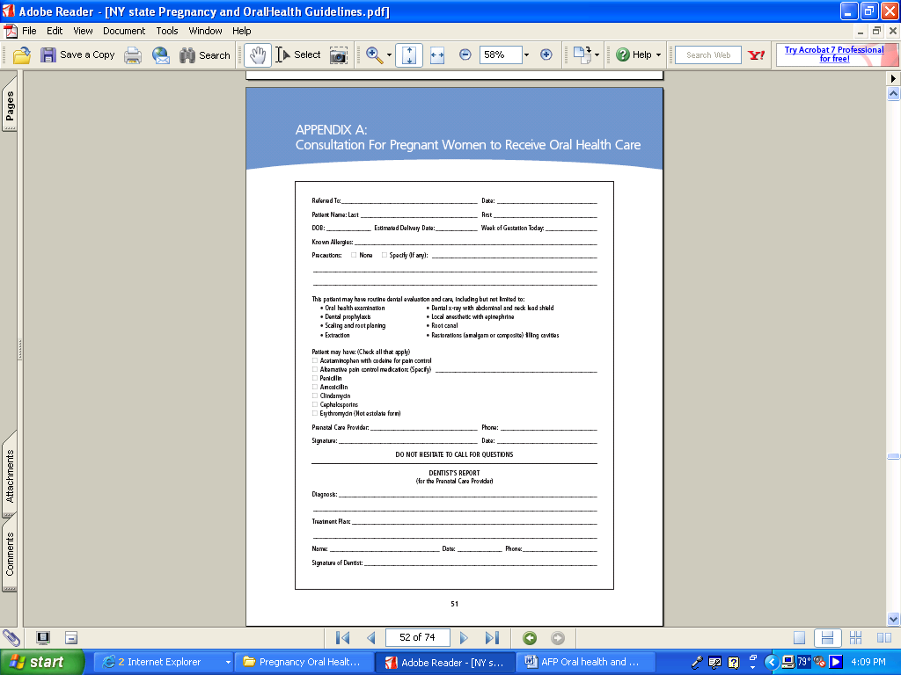
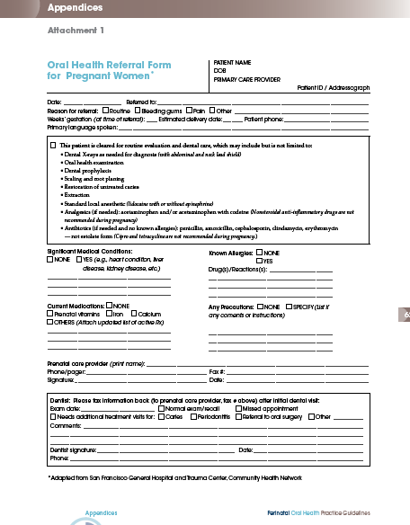
Sample Referral Forms
Notes:
38
Using a dental referral form allows you to recommend treatments that you know are safe and promote two way communication with the dental health professional. You can also refer the dental health professional to the National Consensus Statement and ACOG Committee Opinion.
References
Oral Health Care During Pregnancy and Early Childhood Practice Guidelines. New York Public Health Department 2006. http://www.health.state.ny.us/publications/0824.pdf
Oral Health During Pregnancy and Early Childhood: Evidence Guidelines for Health Professionals. California Dental Association Foundation. February 2010. https://www.cdafoundation.org/Portals/0/pdfs/poh_guidelines.pdf

Slide 39
Resources
Additional training and patient resources:
Prenatal Oral Health Program (pOHP) website:
www.prenataloralhealth.org/index.php/site/index
Centering Pregnancy, Centering Parenting
www.centeringhealthcare.org/what-we-do
Patient Handouts:
National Maternal Child Oral Health Resource Center
English: www.mchoralhealth.org/publications/list.php
Other languages: www.mchoralhealth.org/materials/non-english.php
Notes:
Prenatal Oral Health Program (pOHP) is a program fro providers and patients. It has resources for both.
www.prenataloralhealth.org/index.php/site/index
Centering is a movement to involve patients more in their own care and focuses on group visits with theme discussions. Oral health is covered within the curriculum and is an easy way for obstetrical providers to work the topic into prenatal care.
https://www.centeringhealthcare.org/what-we-do
National Maternal Child Oral Health Resource Center has many handouts for patients or for providers to use with their patients on oral health topics during pregnancy and for new parents and children. You do not have to reinvent the wheel!
English
https://www.mchoralhealth.org/publications/list.php
Other languages
https://www.mchoralhealth.org/materials/non-english.php
Other organizations have materials for prenatal patients too:
American Dental Association (ADA)
American Association of Pediatric Dentistry (AAPD)
American Academy of Pediatrics (AAP)
Smiles for Life does not endorse any specific messages of any one of these groups.

Slide 40
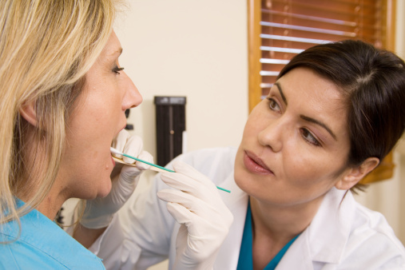
Oral Health Issues Across the Life Span for Women
Chapter Objective
Promote and address oral health issues across the life span for women
Image: Image Source/Punchstock
Notes:
Learning objective targeted in this chapter:
Understand and promote oral health issues across the life span for women.

Slide 41
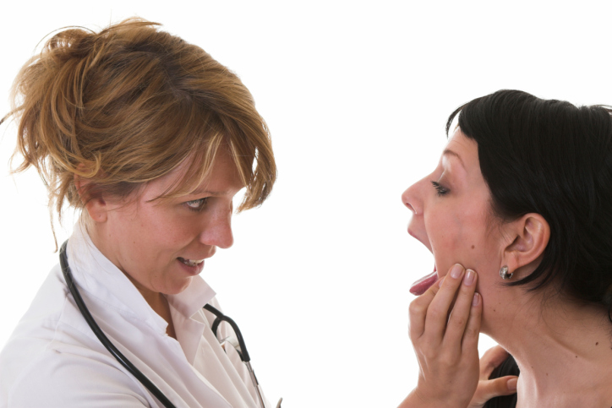
Hormonal Changes and the Mouth
  Onset of puberty, menses, and oral contraceptives:
  Can all lead to gingivitis, bleeding gums and discomfort
  Treatment: Proper hygiene and regular dental visits
Image: Simone van den Berg/Photos.com
  Menopause
  Gingival atrophy; increased dry mouth; altered taste
  HRT may improve symptoms, but is not an indication for HRT
  Treatment: Maintain oral hygiene, saliva substitutes, routine dental visits (every 6 months)
Notes:
Gingivitis can worsen during different phases of the life cycle:
• The onset of puberty
• During monthly menses
• With use of oral contraceptives
Hormones have an effect on the mouth throughout the life cycle. In puberty, women may experience inflammation of the gums, hyperplasia of the gums and pain. The same symptoms may occur monthly during menses or with birth control use, although modern lower dose OCPs result in less oral symptoms.
Treatment includes good oral hygiene including brushing twice daily and flossing daily. Regular check-ups with a dental provider to rule out other issues and cleanings can also help symptoms. Visits are usually every 6 months – more or less often based on dental recommendation based on acute issues, risks, etc.
Menopause cause the gums to atrophy. They may appear dry and shiny and bleed more easily. For some women they may have less saliva production which results in xerostomia (dry mouth) which is a risk for caries. Taste can be altered.
Women should be encouraged to attend to oral hygiene during this phase of their life and continue regular visits with their dentist. While hormone replacement therapy (HRT) may improve these symptoms, oral symptoms are not an indication for HRT due to the many potential risks of HRT. Any consideration of HRT should take into account a women’s other risk factors and menopause symptoms.
References
American Dental Association Council on Access, Prevention and Interprofessional Relations. Women’s Oral Health Issues. 2006.
Buencamino MCA, et al. How menopause affects oral health and what we can do about it. Cleveland Clinic Journal of Medicine. 2009; 76(8): 467-475.

Slide 42

Mouth Pain
  Oral pain can result from causes other than caries and periodontitis
  Burning Mouth Syndrome (more prevalent in women)
    Causes: Medications (ACE inhibitors), candidiasis, B12 deficiency, dry mouth
    Screen for underlying conditions and correct
    Tricyclic antidepressants and gabapentin can ease symptoms
  Tooth Erosion
    GERD and eating disorders should be considered and addressed
  Temporomandibular Joint (TMJ) pain
    Evaluate and consider dental referral for a mouth guard fitting
  Oral Trauma: Screen for domestic violence with tooth/lip trauma
Image: Jaimie Duplass/Photos.com
Notes:
Mouth pain can result from a wide range of pathology. Caries and periodontitis are the most common causes. Other causes can include aphthous ulcers or herpetic lesions. Issues that are more prevalent in women include:
Burning mouth syndrome: occurs in 1-2% of women and up to 40% of women in menopause. Underlying causes that should be ruled out and treated include medications (ACE inhibitors), candidiasis, B12 deficiency, and dry mouth. If no cause is found, pain may be idiopathic and medications that treat neurologic pain may be helpful, including low dose tricyclic antidepressants and gabapentin.
The presence of eroded teeth should prompt the clinician to consider either severe GERD and/or eating disorders such as bulimia. The former requiring life style changes +/- histamine 2 blockers or proton pump inhibitors and the latter requires more extensive interventions involving behavioral and psychological health specialists.
TMJ is more common in women at a 5:1 ratio. Triggers include hormonal changes and teeth grinding. A referral to a dental provider is indicated with consideration for a nocturnal mouth guard.
Lastly- trauma of the mouth or teeth should prompt a provider to consider and ask about violence in the home. Oral trauma may be the only presenting sign of domestic violence.
References
American Dental Association Council on Access, Prevention and Interprofessional Relations. Women’s Oral Health Issues. 2006.
Grushka M, Epstein JB, Gorsky M. Burning Mouth Syndrome. American Family Physician. 2002; 65(4): 615-20.

Slide 43
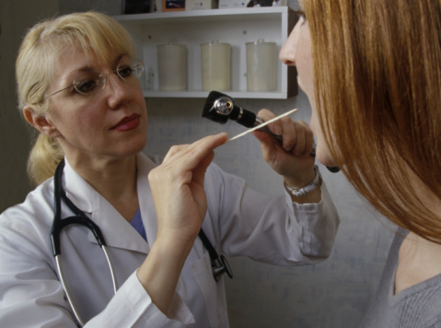
Oral Health and Annual Visits
  Ask about oral health when you are examining the mouth
  Discuss oral health habits, proper diet, and referrals to dental providers
  Provide oral health promotion handouts
  Maintain a list of local dentists that you trust, can communicate with, and who are culturally sensitive
Image: Design Pics/Punchstock
  Know which local dental providers accept Medicaid and resources for those without dental insurance (e.g. FQHC)
Notes:
Make addressing oral health a regular part of annual/preventive visits. One reminder strategy is to ask about oral symptoms, oral hygiene, diet and dental visits just before examining the mouth.
Include oral health among the documents print out with other health handouts at the conclusion of an annual visit, such as the After Visit Summary and/or keep handouts in the waiting room or on your office web site.
Keep an updated list of local dentists that you know and trust; often patients can help providers with those names. Know which dentists take Medicaid in your community or how to access such a list. Usually the state Medicaid office will have 1-800 numbers or links on their web site. Be aware of resources for those without dental insurance (note Medicare does not include dental care so most seniors do not have coverage). Examples include Federally Qualified Health Centers (reduced fees based on income), dental hygiene and dental schools, and dental care mobiles or dentists who have payment plans.

Slide 44
Expanding Your Oral Health Knowledge
  Comprehensive care of women mandates a broader understanding of oral health issues. Consider reviewing other Smiles for Life Modules.
  Based on the population you serve, the following may be of value in your clinical practice:
  Module 1: Relationship of Oral to Systemic Health
  Module 3: Adult Oral Health, including oral lesions and the oral cancer-HPV link
  Module 4: Acute Dental Problems, including oral infections and trauma
  Module 7: Oral Examination
  Module 8: Geriatric Oral Health, including how medications affect the mouth
Notes:
Comprehensive care of women mandates a broader understanding of oral health issues. Consider reviewing other Smiles for Life Modules.
Based on the population you serve, the following may be of value in your clinical practice:
Module 1: The Relationship of Oral to Systemic Health
Module 3: Adult Oral Health, including oral lesions and the oral cancer-HPV link
Module 4: Acute Dental Problems, including how to manage oral infections and trauma
Module 7: The Oral Examination
Module 8: Geriatric Oral Health, including how medications affect the mouth
Additional training can also be found at the prenatal oral health program pOHP website. This training program educates prenatal primary health care providers and dental care teams about principles of oral health during pregnancy and assist providers in implementing and delivering preventive oral health services to all women of reproductive age: www.prenataloralhealth.org/index.php/site/index

Slide 45
Take Home Messages
Periodontal disease is associated with preterm birth and low birth weight
Decreased levels of cariogenic bacteria in mothers is associated with improved child oral health
Periodontal therapy during pregnancy does not improve pregnancy outcomes, but is safe in pregnancy
Routine dental interventions are safe during pregnancy
Health professionals should promote good oral health during pregnancy and throughout the life cycle to improve overall health
Notes:
45
Key messages to take away from this course:
Periodontal disease is associated with preterm birth and low birth weight.
Periodontal therapy has not yet been shown to improve pregnancy outcomes, but is safe in pregnancy.
Decreased maternal cariogenic bacteria levels is associated with improved child oral health.
Routine dental interventions are safe during pregnancy.
Health care professionals should promote oral health throughout the life cycle for all women as oral health affects overall health.

Slide 46

Questions?
Image: Stockebyte/Photos.com
Notes:
The End

