Slide 1
Image: Wojciech Gajda/Photos.com
Image: Jupiterimages/Photos.com
Image: Christoph Hähnel/Photos.com
Image: Getty
Fourth Edition 2020
www.smilesforlifeoralhealth.org
Last Modified: September 2023
Copyright STFM 2005-2023
Notes:
This oral health module is intended to educate all types of front line health workers who work under different titles and in many settings who:
Have shared culture and are trusted members of the communities they serve
Provide outreach, advocacy, patient education, care coordination, health care navigation, and social support
This workforce includes those with the following titles: community health workers and representatives, promotores de salud, health educators, case managers, care coordinators, public health or community health workers or community health advocates, health advisors or advocates, patient navigators, outreach workers, family resource workers, and peer health promoters.
This slide deck provides a basic introduction to Adult Oral Health.
Additional clinical content on adult oral health can be found in the Pregnancy and Women’s Oral Health module as well as at Smiles for Life: www.smilesforlifeoralhealth.org.
This slide deck may benefit from the use of interactive activities described in detail in the first FLHW module (Introductory Module) or in the FLHW Handbook.
The activities can be used individually or collectively to support deeper personal engagement and reflection.
Smiles for Life, 4th Edition
Copyright STFM 2005-2023
You may elect to hide slides if you have time constraints or feel they do not add value to your presentation. Simply right-click and select the “Hide Slide” feature at the bottom or click the Slide Show tab and select “Hide Slide”.

Slide 2
Course Authors
Smiles for Life Steering Committee
Anita Glicken, MSW
Melinda Clark, MD, MJ
Smiles for Life Editor
Karlynn Sievers, MD
Funded By
The images in this presentation are not to be reproduced/downloaded for purposes other than personal use. Republication, retransmission, reproduction, or other use of the Licensed Material is prohibited.
Notes:
Welcome to the Front Line Health Worker Adult Oral Health Course
Acknowledgements:
Course Authors
Smiles for Life Steering Committee created the original content, from which these slides were adapted.
Anita Glicken, MSW
Melinda Clark, MD, MJ
Portions of this project were created in collaboration with Southwestern Connecticut AHEC, with funding support from the Connecticut Department of Public Health (CT DPH). Smiles for Life is grateful for these partners in this work.
Smiles for Life Editor
Karlynn Sievers, MD
Funding Note:
Smiles for Life is made possible through the generous support of National Interprofessional Initiative on Oral Health (NIIOH) - a collaborative network of funders who share a common commitment to promoting oral health.
Portions of this project were supported by the Connecticut Department of Public Health (CT DPH) with funding through the Health Resources and Services Administration (HRSA) of the U.S. Department of Health and Human Services (HHS) under T12HP28885 Oral Health Workforce Grant for $1,200,000. This information or content and conclusions are those of the author and should not be construed as the official position or policy of, nor should any endorsements be inferred by CT DPH, HRSA, HHS or the U.S. Government.

Slide 3
Educational Objectives
Discuss prevalence, causes, and consequences of adult tooth decay and gum disease
Describe how socioeconomic issues affect adult and senior oral health
Understand the oral effects of common medications, alcohol, and tobacco
Consider how chronic medical conditions influence oral health
Notes:
The overall goal of this module is to engage FLHW as active contributors to an expanding primary care oral health network that works in partnership with dental providers to improve oral health and prevent adult dental disease.
We will address educational objectives listed on this slide. Many are a continuation of the issues addressed in other modules, but with a clear focus on the adult oral health.
This module addresses several educational objectives:
Discuss the prevalence, causes, and consequences of adult tooth decay and periodontal disease
Describe how socioeconomic issues affect adult and older adult oral health
Understand the oral effects of common medications, alcohol and tobacco
Consider how chronic medical conditions influence oral health

Slide 4
Fill in the blank…
32
A full set of adult teeth is a total of teeth.
____% of working aged adults report untreated tooth decay.
Risk factors for tooth decay that adults share with children include: ________________, ______, ________, ________, _________.
26
Insufficient Fluoride
Diet
Family Hx
Lower SES
Bacteria
Notes:
************************************
Speaker: Ask participants if they can fill in the blanks related to adult oral health.
To achieve good overall health, patients need their teeth and mouths in good shape because of the many links between oral and systemic disease.
Oral health is essential to general health and quality of life. It is a state of being free from mouth and facial pain, oral and throat cancer, oral infection and sores, periodontal (gum) disease, tooth decay, tooth loss, and other diseases and disorders that limit an individual's biting, chewing, smiling, speaking, and psychosocial wellbeing.
Risk factors for tooth decay that adults share with children include:
Insufficient fluoride exposure on the teeth increases risk of decay
Diet/Nutrition certainly affects tooth decay risk of both adults and children
Family health history – higher tooth decay rates in childhood increases risk of future tooth decay
Lower Socioeconomic status (SES) is associated with higher rates of tooth decay
High levels of bacterial on the teeth increases risk of tooth decay
Based on data from 2011–2016, more than 1 in 4 working-age adults had untreated tooth decay (26%), with significant disparities by race/ethnicity and income (Centers for Disease Control and Prevention. Oral Health Surveillance Report: Trends in Dental Caries and Sealants, Tooth Retention, and Edentulism, United States, 1999–2004 to 2011–2016).
Reference
US Department of Health and Human Services. Oral health in America. A Report of the Surgeon General. Rockville, MD: US Department of Health and Human Services, National Institute of Dental and Craniofacial Research, National Institutes of Health; 2000. http://www.nidcr.nih.gov/AboutNIDCR/SurgeonGeneral/
Centers for Disease Control and Prevention. Oral Health Surveillance Report: Trends in Dental Caries and Sealants, Tooth Retention, and Edentulism, United States, 1999–2004 to 2011–2016. Atlanta, GA: CDC, USDHHS; 2019a. www​.cdc.gov/oralhealth​/pdfs_and_other_files​/Oral-Health-Surveillance-Report-2019-h.pdf.

Slide 5
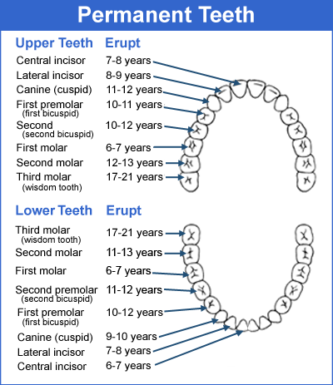
Adult Teeth
Permanent teeth begin to come in around 6 years of age
Most adults have a full set of 32 teeth by age 21
Courtesy of the ADA
Notes:
Permanent teeth begin to erupt around age 6 years and are all in by 21 years.
Some adults had their third molars (wisdom teeth) or premolars extracted (removed) to relieve crowding, or they may not have erupted, so there may be only 24 to 28 teeth in intact appearing dentition.
However, most adults have 32 teeth, which include:
8 incisors
4 canines
8 premolars
12 molars

Slide 6
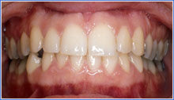
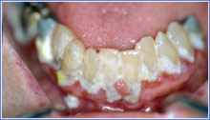
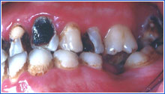
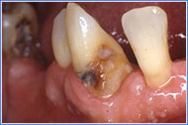
Gums and Teeth
Normal
Photo: UKCD
Extensive Plaque and Periodontal Disease
Severe Tooth Decay
Root Cavities
Photo: UKCD
Photo: UKCD
Photo: Robert Henry DMD, MPH
Notes:
Healthy gums are pink, moist, and smooth, and do not bleed when touched.
A routine oral exam will:
Remove dentures
Check hygiene status
Assess for:
Caries
Root caries
Gingivitis
Periodontal disease
Common abnormalities in adult teeth consist of:
Cracked or missing teeth
Tooth decay
Signs of gum disease, such as:
Exposed roots
Erythema
Inflammation
Bleeding

Slide 7
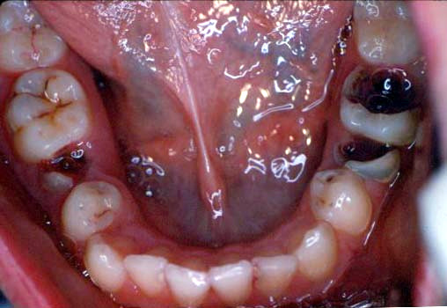
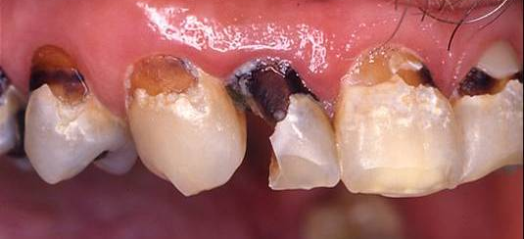
Adult Tooth Decay
Children and Adults Share
Risk Factors for Decay
Family history of tooth decay
High amounts of bacteria in the mouth
Frequent eating of sugary foods
Inadequate fluoride
Low socioeconomic status
Photo: Joanna Douglass, BDS, DDS
Photo: John McDowell, DDS
Notes:
Risk factors shared by adults and children include:
High bacterial counts
Family history of caries
Frequent eating of sugar containing foods
Inadequate fluoride
Low socio-economic status

Slide 8
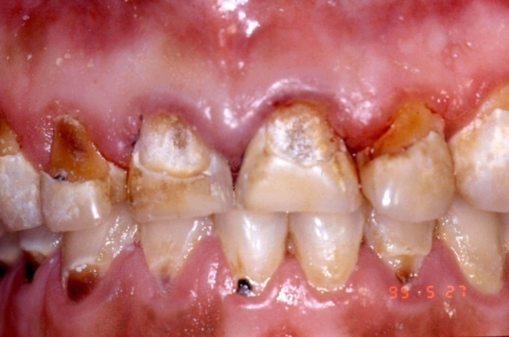
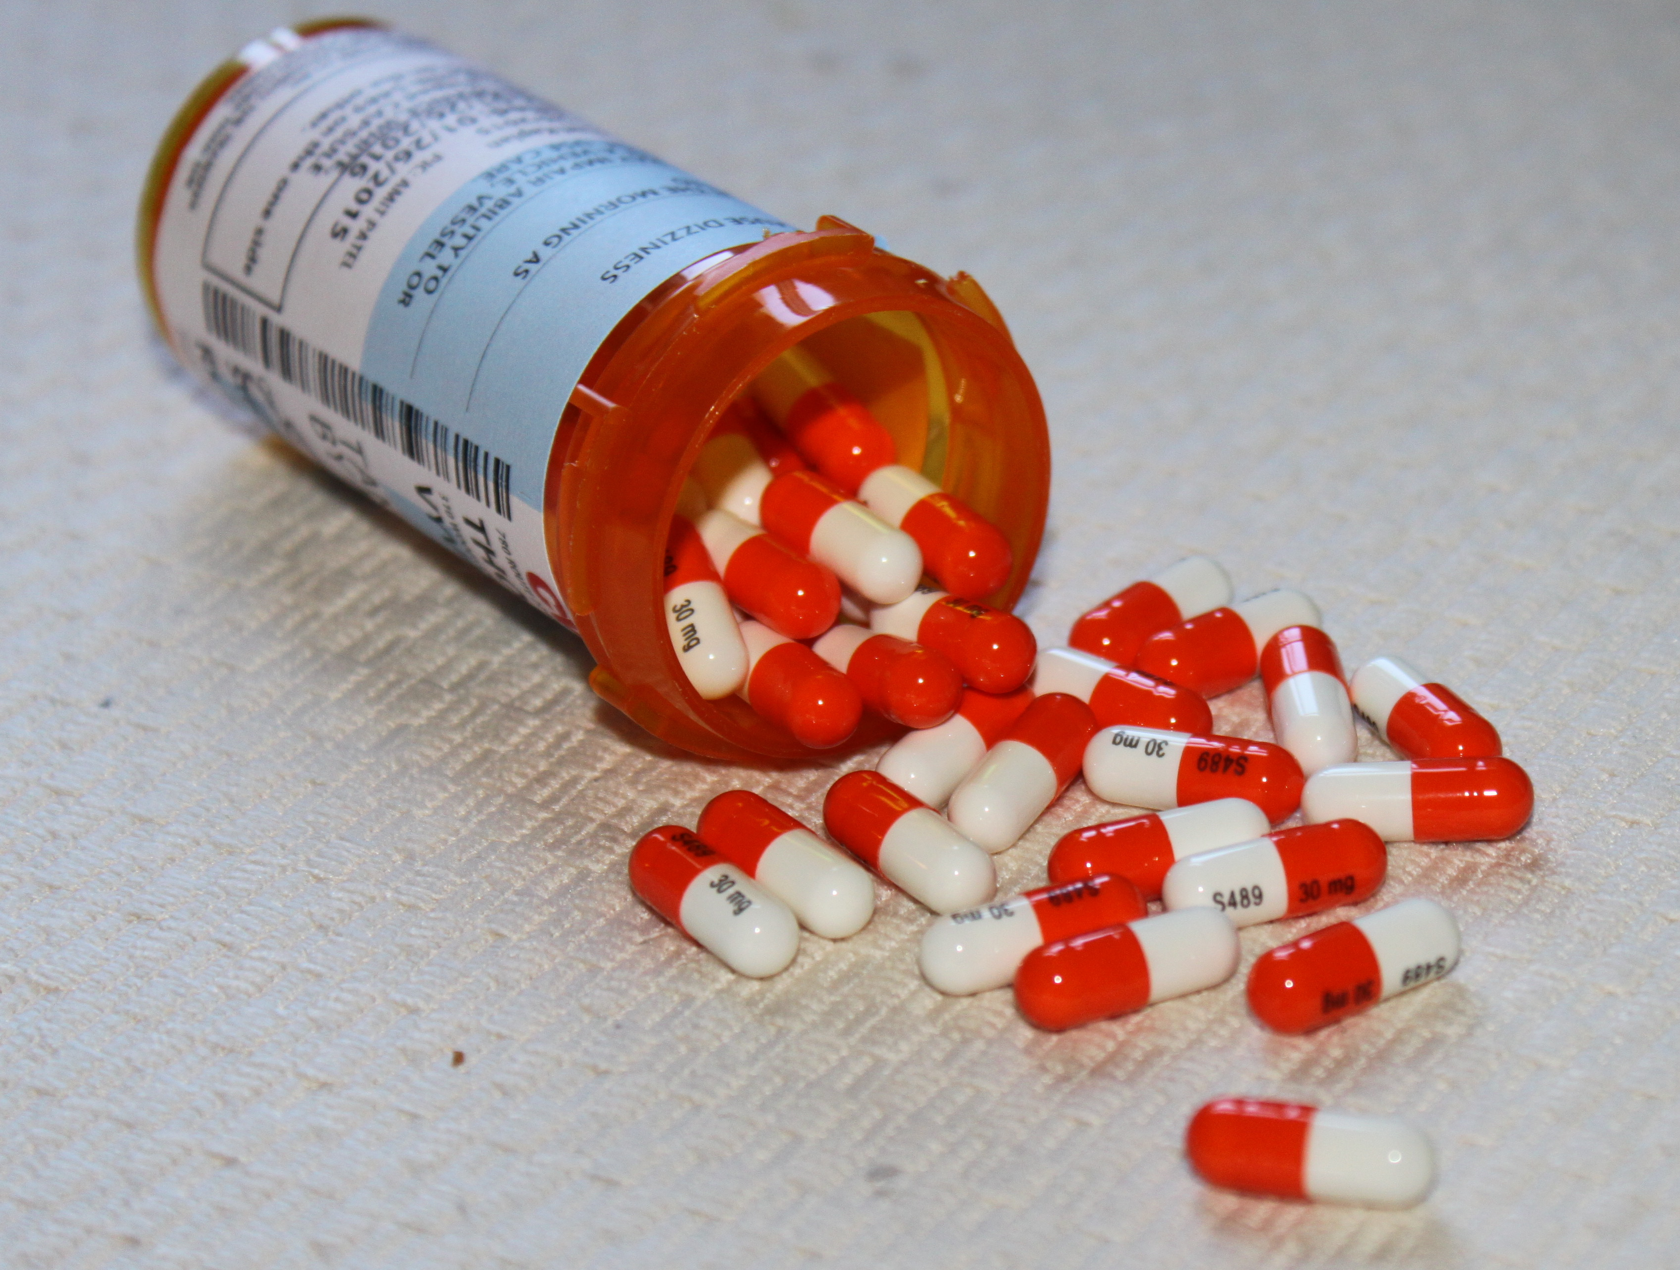
Additional Adult Risk Factors
Physical disabilities
Brushing/flossing are more difficult
Existing restoration or appliances
Trap food
Most likely site of cavities in adults
Decreased saliva in the mouth
Due to disease or medication
Much higher risk of tooth decay
Photo: Steven Lepowsky, DDS
Image: Thinkstock
Notes:
Adult tooth decay is also caused by the burdens of the aging process, disease, and its treatments.
1. Physical Disabilities
Makes brushing and other oral hygiene activities more difficult
2. Existing Restorations or Appliances
Are markers for previous caries, a risk factor for future caries
Can also trap food
Most likely site of caries in an adult
3. Decreased Salivary Flow
Caused by disease or medication places a patient at much higher caries risk
4. Medications can increase tooth decay risk by:
Decreasing saliva flow
High levels of sugar
According to the Surgeon General's Report on Oral Health in 2000:
• Dental care is the most common unmet health need.
• Oral disease can severely affect systemic health.
• Much oral disease is preventable or at least controllable.
• Profound disparities in oral health and access to care exist for all ages.
• Interdisciplinary care is necessary to achieve optimal oral and general health.
References:
U.S. Department of Health and Human Services. (2000). Oral health in America: A report of the Surgeon General. Retrieved from https://www.nidcr.nih.gov/sites/default/files/2017-10/hck1ocv.%40www.surgeon.fullrpt.pdf
National Institutes of Health. Oral Health in America: Advances and Challenges. Bethesda, MD: US Department of Health and Human Services, National Institutes of Health, National Institute of Dental and Craniofacial Research, 2021.

Slide 9
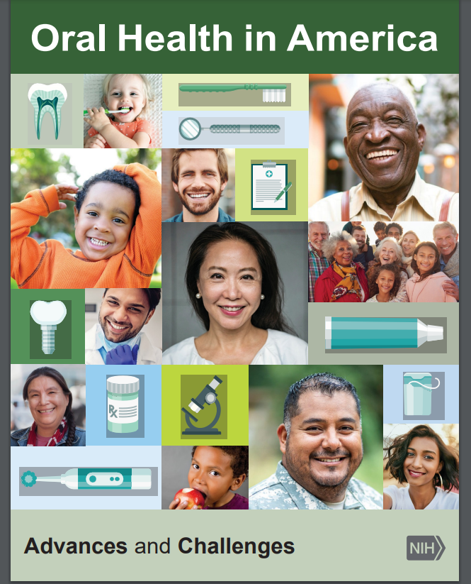
Adult Tooth Decay
Oral disease is most among children living in poverty, racial and ethnic minorities, frail elderly, and socially marginalized groups.
. Marginalized includes groups defined by race, religion, age, gender, financial status, culture, and immigrant populations.
Notes:
Incidence of oral diseases, like many chronic disease conditions, is socially patterned, with the largest burden of disease occurring among children living in poverty, racial and ethnic minorities, frail elderly, and other socially marginalized groups, such as immigrant populations.
Marginalized groups include groups defined by race, religion, age, gender, financial status, politics, and culture.
Others not defined by sociodemographic characteristics, but who have special health care needs (SHCNs), also can be marginalized. Not only do these groups suffer the highest burden of oral disease, they also face the greatest barriers to accessing routine preventive and other dental services.
References:
National Institutes of Health. Oral Health in America: Advances and Challenges. Bethesda, MD: US Department of Health and Human Services, National Institutes of Health, National Institute of Dental and Craniofacial Research, 2021.

Slide 10
When people are unemployed or don’t have insurance, where do they go? What do they do? People end up dying, and these are the most treatable, preventable diseases in the world. - Dr. Irvin Silverstein
Notes:
So what happens to adults when they do not have access to a dental provider - those who cannot afford necessary dental care or find a dentist to care for them in their area?
This story is one of dozens that make national news, highlighting a death from untreated tooth decay.
In this case it was a 24 year old Cincinnati father who died from a tooth infection in 2011.
Kyle Willis' wisdom tooth started hurting and the dentist told him it needed to be pulled, he decided to forgo the procedure, because he was unemployed and had no health insurance.
His face started swelling and he developed headache, so Willis went to the emergency room, where he received prescriptions for antibiotics and pain medications.
Willis couldn't afford both, so he chose the pain medications.
The tooth infection spread, causing his brain to swell and he died within 2 weeks of the first report of pain.
Fortunately, death is uncommon, but many people suffer persistent and serious consequences from tooth decay.

Slide 11
Growing Population of Older Adults
Population in thousands
Older Adults in U.S. Population
2015-2060
Notes:
We have a growing population of older adults. There are currently more than 43 million elderly in the U.S. Those over age 65 make up nearly 14% of the population, with 6% over age 75.
By 2050, the number of elderly will double to over 80 million, more than 20% of the population. The 85 and older age group will dramatically rise, nearly 300%.
Why might this be important when considering adult oral health?
References
Kaiser Family Foundation State Health Facts. Demographics and the Economy:(2009 data). Accessed on 3/7/2014 at www.statehealthfacts.kff.org.Table 2. Projections of the Population by Selected Age Groups and Sex for the United States: 2015-2060 (NP2012-T2). Population Division, U.S. Census Bureau; Release Date: December 2012 Accessed on 3/7/2014 at www.census.gov/population/projections
Werner CA, The Older Population, U.S. Census Bureau, 2010 Census Briefs. Accessed on 3/7/2014 at www.census.gov/prod/cen2010/briefs/c2010br-09.pdf

Slide 12
Dental Care
% of older adults who visit the dentist decreases with age
Fixed income
High cost of dental care
Poor older adults are less likely to have a dental visit (42.7%) compared with not poor adults (74.4%)
No dental insurance = over 70%
Mobility and transportation
Disabled
Rural (less medical and dental access)
Language barrier
Few dentists who specialize in older adult care
Notes:
Encourage regular dental visits for your client, however, recognize they may face many challenges such as those on this slide.
Accessing health care can be difficult for older adults, especially access to the oral health care system
In 2022, 64.1% of adults aged 18-64 had a dental exam or cleaning in the past year.
Percentage of adults aged 65 and over who had a dental visit in the past 12 months decreases with age, from 67.7% among adults aged 65–74 to 64.1% among those aged 75–84 to 57.9% among those aged 85 and over.
Poor and near-poor older adults were less likely to have had a dental visit in the past year (42.7% and 42.8%, respectively) compared with adults who were not poor (74.4%).
One reason for this lack of dental insurances = < 1/3 (29.2%) of adults aged 65+ have dental insurance. Rate higher among those aged 65–74 (34.3%) compared with older age groups, and lower among Hispanic adults (17.5%) compared with other race and Hispanic-origin groups.
Medicare excludes routine preventive and outpatient treatment.
Medicare will allow for treatment in the hospital for dental care if hospitalization is necessary for medical treatment (ie. radiation treatment, jaw fracture) or if dental treatment is deemed complicated enough to warrant inpatient management.
Medicare Part C or Medicare Advantage plans may include dental coverage, similar to private insurance.
Dental coverage was also less likely for minorities, those without college or high school degrees, those living in rural areas, and, as expected, those without teeth. Lack of dental insurance plays a huge role in whether elderly individuals go to the dentist.
AARP does have a dental insurance option for its members. Information can be found by typing AARP Dental Insurance into an internet search engine then following the prompts to the web site.
Beyond insurance there are other barriers to accessing oral health care also including:
• Living on a fixed income
10.3% of those over 65 live in poverty (2021 Census Bureau)
Minority elders tend to have lower income.
• Cost of oral health care
• A limited number of oral health programs that offer affordable services
• Mobility limitations and lack of transportation
46% of Americans ages 75 and older and 24% of those ages 65 to 74 have a disability (2021 Census Bureau)
17.5% of those over 65 live in rural areas with less access to medical and dental care
• Translation for immigrant older adults
• Limited number of dental providers that feel comfortable providing care to medically compromised and older adults
FLHWs can assist clients in accessing care.
References
National Center for Health Statistics, National Health Interview Survey. See Sources and Definitions, National Health Interview Survey (NHIS) and Health, United States, 2020–2021
U.S. Census Bureau. (n.d.). U.S. Department of Commerce. from https://data.census.gov/
Medicare Dental Services, U. S. Department of Health and Human Services, Center for Medicare and Medicaid Services. https://www.cms.gov/MedicareDentalCoverage

Slide 13
Medicare Oral Health Coverage
Medicare covers little oral health
Medicare excludes routine preventive dental treatment
Will cover treatment or diagnosis needed to address another medical need (e.g. tooth extraction prior to radiation treatment of the jaw)
Some Medicare Advantage plans cover more
Advocates are talking to HHS and Congress about the need for oral health coverage in Medicare
FamiliesUSA.org
Notes:
What about Medicare?
Why can adults not receive the dental care they need?
The federal government has not prioritized dental health in the health care spending.
Medicare covers little oral health.
Advocates are talking to Health and Human Services and Congress about the need for adult oral health coverage in Medicare.
For additional information or to find out how you can help, contact Families USA.

Slide 14
Does Medicaid Cover Adult Oral Health?
Maybe
AK, CA, CT, IA, MA, MT, NJ, NM, NY, NC, ND, OH, OR, RI, WA, and WI provide the most coverage (as of 2017).
State governments can choose to cover extensive, limited, or no adult dental care in Medicaid.
Notes:
Why can adults not receive the dental care they need? Though most people (certainly not all) have medical insurance, dental insurance is still viewed as “elective” and, therefore, may not be offered by an employer or employees may not choose to pay the fees.
Also, dental coverage is limited in the scope of procedures it will cover and the cap for spending can be reached very quickly, meaning that any future work that year must be paid out-of-pocket.
The federal government has not prioritized dental health in the health care spending. Though children in most states receiving Medicaid or Medicaid-Managed care automatically also have dental insurance (which is not a guarantee of access), Medicaid often does not cover adult dental care to the same extent, only for certain populations (such as pregnant women), or provides no dental coverage at all.
Individuals under 21 who are covered by Medicaid will have dental coverage.
Those over 21 with Medicaid, may or may not, depending in which state they live. Some states cover routine preventive care whereas others may cover only emergency dental needs.

Slide 15
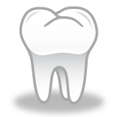
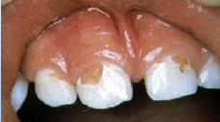
Tooth Decay – A Review
15
Teeth
Bacteria
Carbohydrate
Oral bacteria
+ Sugar
_____________
= Acid
Cavities
Time
Tooth Decay
Decay
Notes:
***********************************
Speaker: This slide may be hidden if content has already been covered in the Child and/or Pregnancy Oral Health Module. To unhide, right click the slide and select “Unhide Slide”.
Let’s review what causes tooth decay, so that we can consider ways to prevent it.
What Causes Dental Decay?
Tooth decay is a multi-step process that results in destruction of the tooth structure.
The bacteria in the mouth (mutans streptococci) convert the sugar from carbohydrates in our diet to acid. The acid takes away the minerals in the tooth enamel.
Not all carbohydrates are bad, but things to avoid or limit are sugary cereals, stick foods, cakes, jams, jellies, sugary drinks.
If the cycle of acid production and demineralization continues, the enamel will weaken and break down into a cavity.
References
Fisher-Owens SA, Gansky SA , Platt LJ et al. Influences on Children's Oral Health: A Conceptual Model. Pediatrics. 2007. Vol. 120(3): pp. e510 -e520.
Colak H, Dülgergil CT, Dalli M, Hamidi MM. Early childhood caries update: A review of causes, diagnoses, and treatments. J Nat Sci Biol Med. 2013;4(1):29-38.

Slide 16
Prevalence of Tooth Decay
> 1 in 4 (26%) of all adults in the U.S. have untreated tooth decay
Over age 65, ~ 1 in 5 have untreated tooth decay
1 in 6 older adults (17%) has complete tooth loss
With advances in oral health care, more older adults are retaining their natural teeth than in past decades
Notes:
Of all adults (above age 18) in the U.S., 26% has untreated tooth decay
Over age 65, ~ 1 in 5 has untreated tooth decay
1 in 6 older adults (17%) has complete tooth loss
With advances in oral health are, more older adults are retaining their natural teeth than in past decades, however, many have high levels of disease.
Reference
NCHS, National Health and Nutrition Examination Survey, 2015–2016.
Centers for Disease Control and Prevention. Oral Health Surveillance Report: Trends in Dental Caries and Sealants, Tooth Retention, and Edentulism, United States, 1999–2004 to 2011–2016. Atlanta, GA: Centers for Disease Control and Prevention, US Dept of Health and Human Services; 2019.

Slide 17
Growing Oral Health Needs
Complete tooth loss declined from 50% to 17% in the past 60 years
Older adults now retain more of their teeth, yet have high levels of disease
Competing health priorities are often present
86% have > 1 chronic disease, 23% have 3 or more (above age 65)
Limited mobility or disability or institutionalized
1 in 4 have difficulty performing at least one activity of daily living
Notes:
Older adults have increasingly complicated dental needs because they retain more of their teeth, often with high levels of disease. Complete tooth loss declined from 50% to 17% in the past 60 years due to:
Water fluoridation
Improved dental care
Increased emphasis on prevention
BUT:
Many are homebound or institutionalized:
1 million older adults receive homecare
1.3 million older adults live in nursing facilities
25% of older adults have difficulty performing at least one activity of daily living (ADL)
1.3 million older adults reside in nursing facilities. Medicare and Medicaid require oral health assessment and care for residents.
However, studies show oral care is not consistently delivered.
70-90% of residents cannot brush their own teeth or care for dentures.
Only 16% receive any oral care and average brushing time in one study was 16 seconds.
A majority have medical conditions that compete for time, attention, and finances:
80% of older adults have one or more chronic diseases.
30% of older adults have three or more chronic diseases.
Mobility limitations
46% of Americans ages 75 and older and 24% of those ages 65 to 74 have a disability (2021 Census Bureau)
References
National Center for Health Statistics, National Health Interview Survey. See Sources and Definitions, National Health Interview Survey (NHIS) and Health, United States, 2020–2021
U.S. Census Bureau. (n.d.). U.S. Department of Commerce. from https://data.census.gov/
Centers for Disease Control and Prevention. Oral Health Surveillance Report: Trends in Dental Caries and Sealants, Tooth Retention, and Edentulism, United States, 1999–2004 to 2011–2016. Atlanta, GA: Centers for Disease Control and Prevention, US Dept of Health and Human Services; 2019.

Slide 18
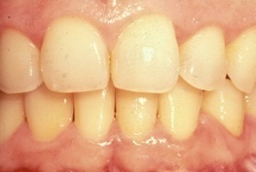
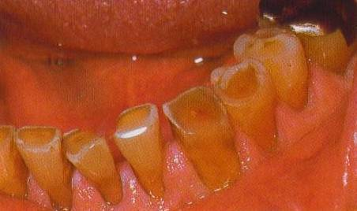
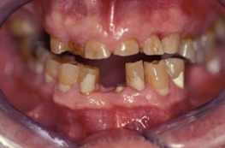
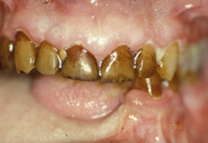
Teeth Change With Age
Normal Teeth and Gingiva (age 53)
Worn, Yellowing Teeth (age 83)
Yellow, Worn Teeth (age 90)
Tobacco Staining (age 76)
Photos: Robert Henry, DMD, MPH
Notes:
Let’s look at how teeth may change with age.
With age, teeth can become darker or more yellow in appearance. Enamel thins allowing the naturally darker dentin layer to show through more prominently.
Teeth may stain when exposed to nicotine and coffee.
However, with diligent oral care, older adults can maintain a nice smile.

Slide 19
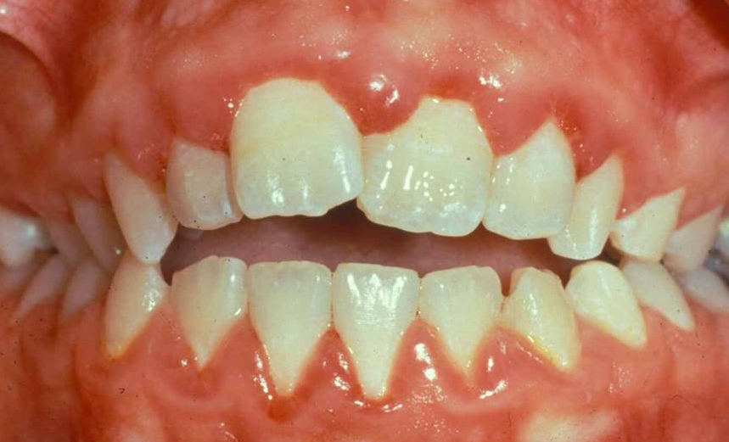
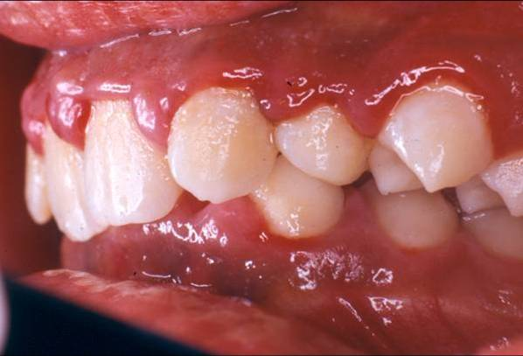
Gingivitis – Gum Inflammation
Gum inflammation but no underlying tissue or bone destruction
Review:
Symptoms
Causes
Treatment
Photo: John McDowell, DDS
Photo: Joanna Douglass, BDS, DDS
Notes:
Speaker Note: Gingivitis and Periodontitis were both reviewed in depth in the pregnancy module. This and the following periodontitis slide can be used as a review/reinforcement that these conditions are very common and cause significant health issues in all adults (not just pregnant women) or may be hidden if time is a concern.
In addition to tooth decay, adults may also have other gum and teeth issues.
Clients may complain about redness, pain or swelling in their gums.
This may be related to gingivitis - characterized by inflammation of the gums (gingiva) without destruction of the fibers that connect the tooth to the bone (periodontal ligament) or bone, which distinguishes it from periodontitis.
In the early stage of gingivitis, bacteria in plaque build up, causing the gums to become inflamed and to easily bleed during tooth brushing.
Symptoms
Mild gum swelling
Tenderness of gums
Bleeding gums when brushing
Bad breath or bad taste in the mouth
Causes of gingivitis
Plaque buildup from poor oral hygiene.
Changes in hormone levels in puberty, pregnancy, and diabetes can modify the body’s response to plaque, resulting in increased gingivitis.
Oral foreign bodies such as popcorn kernels are a frequent culprit in acute gum inflammation
Preventive Measures and Treatment
Good home hygiene including frequent brushing and flossing
Regular dental visits to remove plaque accumulation and reinforce appropriate home care
Gingivitis (gum inflammation) usually precedes periodontitis (gum disease). However, it is important to know that not all gingivitis progresses to periodontitis.
Reference
Novak MJ. Classification of diseases and conditions affecting the periodontium. In: Clinical Periodontology. M.G. Newman, H. H Takei, F. A. Carranza Eds. Philadelphia: W.B. Saunders, 2002.

Slide 20
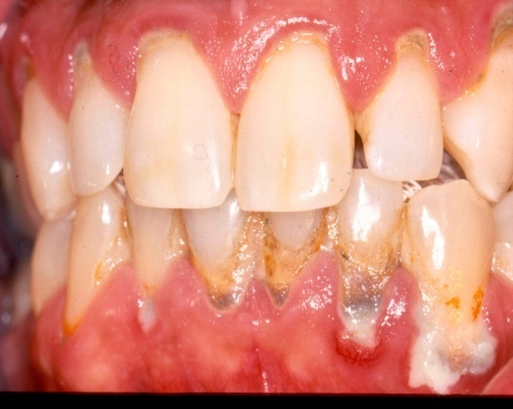
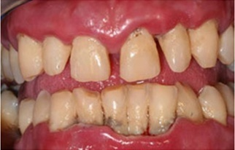
Periodontitis – Gum Disease
Leading cause of tooth loss in adults
Review:
Causes
Recommendations
16
Photo: Efthimia Ioannidou DDS, MDS
Photo: John McDowell, DDS
Notes:
Periodontitis is the leading cause of tooth loss in adults. Most adults are affected to some degree.
Causes
Chronic exposure of the periodontal tissues to bacterial plaque cause a chronic inflammation.
Chronic inflammations leads to destruction of the tissue fibers that connect the tooth to the bone (periodontal ligament), loss of supporting bone, tooth loosening, and eventual tooth loss.
The body's host response to the bacteria, magnifying or suppressing the inflammatory response, helps determine the manifestation and progression of the disease.
Smoking, diabetes, HIV, pregnancy, xerostomia, and poor oral hygiene can all contribute to the development of periodontitis
Recommendations
Good oral hygiene and regular dental visits help remove plaque, preventing or controlling inflammation.
Tobacco and other irritants, such as cannabis, must be avoided.
Dental referral for deep root scaling (cleaning below the gum surface).
Oral antibiotics and solutions such as chlorhexidine may also be used.
Additional background:
Do you have gingivitis or periodontitis? Here are some tips for how to tell the difference.
Age: Periodontitis is rare in teenagers, but they can develop gingivitis.
Pain: Pain when chewing can be a sign that your periodontal disease has progressed from gingivitis to periodontitis.
Tooth Condition: If you have gingivitis, your teeth should be firmly in place, although your gums may be irritated, red, and swollen. If a tooth or teeth are loose, you are more likely to have periodontitis.
Breath: If your gingivitis has progressed to periodontitis, you may notice that you have persistent unpleasant breath due to the presence of excess bacteria in your mouth. (1), (2), (3)
References
Novak MJ. Classification of diseases and conditions affecting the periodontium. In: Clinical Periodontology. M.G. Newman, H. H Takei, F. A. Carranza Eds. Philadelphia: W.B. Saunders, 2002.
Murray W, et al, Cannabis Smoking and Periodontal Disease Among Young Adults, JAMA. 2008;299(5):525-531.
Eberhard J, Jepsen S, Jervøe-Storm P-M, Needleman I, Worthington HV. Full-mouth disinfection for the treatment of adult chronic periodontitis. Cochrane Database of Systematic Reviews 2008, Issue 1.
Periodontal (Gum) Disease: Causes, Symptoms, and Treatments. National Institute of Dental and Craniofacial Research consumer brochure. Bethesda, MD. Reprinted January 2006.

Slide 21
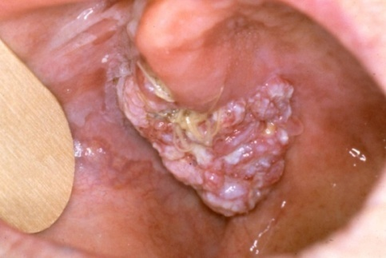
Oral Sores or Wounds
Oral wounds that persist for more than 2 weeks should be evaluated by a dentist or doctor
Concern for oral cancer
9th most common cancer
5 year survival rate = 50%
60% are advanced by the time they are detected
Causes of oral cancer:
Alcohol and tobacco are primary risk factors
HPV (human papilloma virus), especially in young men
Sunlight (lip cancer)
Betel nuts
Photo: Ellen Eisenberg, DMD
Notes:
The prevalence of oral cancers increases with age.
Consider the following:
Oral cancer is the 9th most common cancer
The overall five-year survival rate for oral cancer is 50–55%.
There is a strong association between HPV and oropharyngeal cancers.
Human Papilloma Virus (HPV) positive cancers are more frequent in white men, younger populations (52-56 years), and people who do not use tobacco or alcohol.
References
Smith RA, Cokkinides V, von Eschenbach AC, Levin B, Cohen C, Runowicz CD, et al. American Cancer Society guidelines for the early detection of cancer. Ca: a Cancer Journal for Clinicians. 2002;52(1):8-22.
Special Section: Cancers with Increasing Trends in the US: 1999-2008: Cancer Facts and Figures 2012, American Cancer Society. http://www.cancer.org/acs/groups/content/@research/documents/document/acspc-038827.pdf Accessed 3/17/2014.
Cleveland JL, Junger ML, Saraiya M, et al. The connection between human papillomavirus and oropharyngeal squamous cell carcinomas in the United States: implications for dentistry. JADA. 2011; 142(8):915-24.

Slide 22
Oral Disease Impacts Overall Health
Poor oral hygiene can increase incidence of aspiration pneumonia
Poor oral health can affect nutrition & weight
Many medications cause dry mouth that can increase risk of tooth decay
Severe gum disease
Increases risk of heart disease
Worsens blood sugar levels in diabetic patients
Notes:
Senior oral and systemic health are tightly interconnected:
Poor oral hygiene is associated with increased incidence of pneumonias.
Poor oral health is a potential cause of weight loss and failure to thrive.
Many medications cause dry mouth, increasing risk of dental caries.
Diabetic glucose control is worse in the presence of periodontal disease and periodontal disease is worse in diabetic patients, especially in those with poor glycemic control.
FLHWs can play an important role in improving the overall health of their patients by addressing oral issues.
References:
Azarpazhooh, A., Leake, J.L. Systematic review of the association between respiratory diseases and oral health. J Periodontology. 2006; 77: 1465-1482.
Scannapieco, F.A. Pneumonia in nonambulatory patients. JADA. 2006; 137(10 supplement): 21S-25S.
Guggenheimer, J., Moore, P.A. Xerostomia: etiology, recognition and treatment. JADA. 2003; 134(1):61-9.
Mealey, B. L., Periodontal disease and diabetes: A two-way street. JADA. 2006; 137:26-31.
Moynihan, P.J. The Relationship Between Nutrition and Systemic and Oral Well-being in Older People. JADA. 2007; 138(4): 493-497.
Ishikawa, A., Yoneyama, T., Hirota, K., Miyake, Y., Miyatake, K. Professional oral health care reduces the number of orophayngeal bacteria. Journal of Dental Res, 2008; 87: 594-598.
Bassim, C.W., Gibson, G., Ward, T., Paphides, B.M., DeNucci, D.J. Modification of risk of mortality from pneumonia with oral hygiene care, J of the Am Geriatric Society, 2008; 56: 1601-1607.
Sjogren, P. Nilsson, E., Forsell, M., Johansson, O., Hoogstraate, J. A systematic review of preventive effect of oral hygiene on pneumonia and respiratory infections in elderly people in hospitals and nursing homes. J of the Am Geriatric Society. 2008; 56: 2124-2130.
Arpin S. Oral hygiene in elderly people in hospitals and nursing homes. Evidenced Based Dentistry. 2009; 10: 46.

Slide 23
Diabetes
Severe Periodontal Disease
Gum disease worsens diabetes control
Severe gum disease increases risk of developing diabetes
Poor diabetes control increases risk of severe gum disease
Photo: UKCD
Treat gum disease and improve diabetes control
Notes:
Diabetes is one example of the relationship of oral health to chronic diseases.
Patients with periodontal disease are twice as likely to develop diabetes
Poor sugar (glycemic) control is associated with threefold increase of periodontal disease
Periodontal disease worsens glycemic control
Treatment of periodontal disease results in 10-20% improvement in sugar control (lower HgbA1C)
References
Mealey, B. L., Periodontal disease and diabetes: A two-way street. J Am Dent Assoc 2006; 137:26-31.
Demmer, R.T., Jacobs, D.R., Desvarieux, M. Periodontal disease and incident type 2 diabetes mellitus: Results from the first National Health and Nutrition Examination Survey and its epidemiologic follow up study. Diabetes Care 2008; 31(7):1373-9.
Promsudth, A., et al. The effect of periodontal therapy on uncontrolled type 2 diabetes mellitus in older subjects. Oral Dis 2005; 11:293-8.
Saremi, A., et al. Periodontal disease and mortality in Type 2 diabetes. Diabetes Care 2005; 28:27-32.

Slide 24
Be Alert to Client Concerns!
Common Concerns:
Oral pain
Dry mouth
Dentures
Diet/Nutrition
Finding a dentist and scheduling appointments
Dental insurance
Other concerns?
Image: Jupiterimages/Photos.com
Notes:
This slide lists common oral health concerns expressed by adult clients.
The next several slides will address each of these items.
Please ask participants to identify any additional oral health concerns their clients experience.

Slide 25
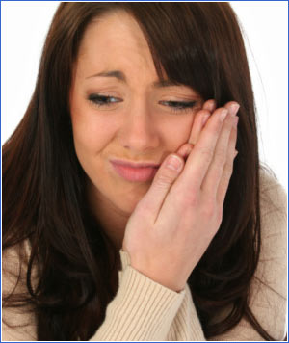
Oral Pain
Oral pain is common
Over 40% of adults report having mouth pain within the last year
Communicating pain is often difficult for those with disabilities, young children and non-verbal adults
May be agitated, refuse to eat, pull at the face
Consider oral pain could be the result of domestic violence or other trauma
Image: Jaimie Duplass/Photos.com
Notes:
We need to be alert to the fact that often oral pain is one of the first signs that makes people recognize they have a problem.
Oral pain is common, with 22% of adults reporting oral pain in the past six months.
Oral pain can be difficult to localize. For example, a person may feel mouth pain from a sinus infection or pain coming from a cavity may be felt in the ear.
Oral pain is often vague. Communicating pain is often difficult for those with disabilities, children and the elderly.
Behavioral signs of pain include:
Pulling at face
Not eating
Agitation
Lastly- any trauma of the mouth or teeth should prompt a provider to consider and ask about violence in the home. Oral trauma may be the only presenting sign of domestic violence.
References
Centers for Disease Control and Prevention. Oral Health Surveillance Report: Trends in Dental Caries and Sealants, Tooth Retention, and Edentulism, United States, 1999–2004 to 2011–2016. Atlanta, GA: Centers for Disease Control and Prevention, US Dept of Health and Human Services; 2019

Slide 26
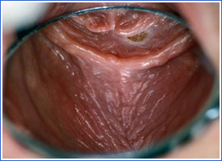
Dry Mouth
Dry Mouth
Often caused by medications
A positive response to one or more of the following questions indicates dry mouth:
Does your mouth feel dry?
Does your mouth feel dry when eating?
Do you have difficulty swallowing dry foods?
Do you sip liquids to aid swallowing?
Is the amount of saliva in your mouth too little most of the time?
Photo: Robert Henry, DMD, MPH
Notes:
A positive response any of the following questions indicates xerostomia:
Does your mouth feel dry?
Does your mouth feel dry when eating?
Do you have difficulty swallowing dry foods?
Do you sip liquids to aid swallowing?
Is the amount of saliva in your mouth too little most of the time?
Pink parts of the mouth should appear wet and glistening.
Dry mouth interferes with denture retention and increases risk of caries.
References
Visvanathan, V., Nix, P. Managing the patient presenting with xerostomia: a review. Int J Clin Pract 2010; 64(3): 404–407.
Filshie, J., Rubens, C.N. Complementary and Alternative Medicine, Anesthesiology Clinics of North America 2006; 24(1):81-111.
Papas, A.S., Singh, M., Harrington, D. Stimulation of salivary flow with a powered toothbrush in a xerostomic population. Special Care in Dentistry 2006; 26(6): 241-246.
Turner, M.D., Ship, J.A. Dry mouth and its effects on the oral health of Elderly People. Journal of the American Dental Association 2007; 138(1)15s-20s.

Slide 27
Dentures
Tooth loss impacts
Eating and nutrition
Satisfaction with facial appearance
Dentures improve quality of life
Provide support
Improve appearance
Make eating easier
Without dentures
With dentures
Photos: Robert Henry, DMD, MPH
Notes:
Prevalence
Adults age of 65 have on average 18 remaining teeth.
25% are completely endentulous (no remaining teeth)
Negative impacts of not having teeth:
Patients with dentures often have problems with fit and comfort.
Difficulty eating
Inadequate nutritional intake
Dissatisfaction with facial appearance
Dentures improve quality of life:
Provide support for lips and face
Improve appearance
Make eating easier
References
Tsakos G, Herrick K, Shelham A, Watt RG. Edentulism and fruit and vegetable intake in low income adults. J of Dental Research. 2010; 89:462-467.
Ervin RB, Dye BA. The effect of functional dentition on Healthy Eating Index scores and nutrient intakes in a nationally representative sample of older adults. J Public Health Dentistry. 2009; 69: 207-216.

Slide 28
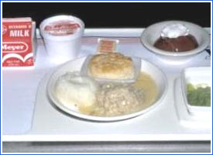
Nutrition Concerns
Tooth loss, dentures, and decreased saliva can alter diet
Changed eating sensations (texture and taste)
Lowered chewing efficiency
Less raw vegetables, salads and fresh fruit in the diet
Sucking mints or consuming sweetened beverages for dry mouth
Soft Diet
Photo: Robert Henry, DMD, MPH
Photo: Michelle Wrightson, MD
Notes:
Tooth loss, dentures, and decreased saliva can lead to alteration in diet.
Elders may experience the following:
Changed sensory perception of eating (texture and taste)
Longer times to chew and swallow foods
Decreased intake of important nutrients due to chewing and swallowing challenges:
Less fruits, raw vegetables, salads
Decreased intake of Vitamin C, beta carotene, and fiber
Compensatory habits such as sucking mints or consuming sweetened beverages to mitigate dry mouth, which may result in:
"Empty calories"
Increased caries risk
References
Nowjack-Raymer, R.E., Sheiham, A. Association of Edentulism and Diet and Nutrition in US Adults. Journal of Dental Research 2003; 82:123-126.
Tsakos, G., et al. Edentulism and Fruit and Vegetable Intake in Low income Adults. Journal of Dental Research 2010; 89(5):462-467.
Moynihan, P.J. The Relationship Between Nutrition and Systemic and Oral Well-being in Older People. Journal of the American Dental Association 2007; 138(4):493-497.

Slide 29
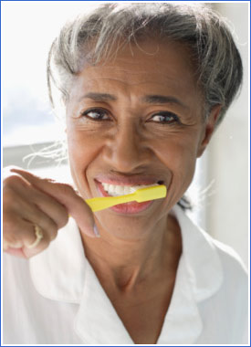
Client Self-Care
Tooth brushing
Denture care
Fluoride
Healthy diet
Avoid alcohol and tobacco
Tips for dry mouth
Visit dentist regularly
Image: Photodisc/Punchstock
Notes:
Prevention matters! Tooth decay and gum disease are preventable diseases and the support you provide your clients can help them stay healthy.
We will now take some time to discuss each of these topics that will help you support your client’s ability to achieve good oral health.
Reference
Featherstone JD, Adair SM, Anderson MH et al., Caries management by risk assessment: Consensus statement, April 2002. J Calif Dent Assoc. 2003;31(3);257-69

Slide 30
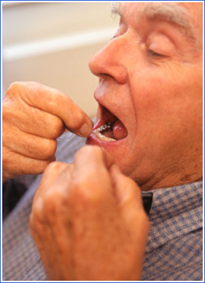
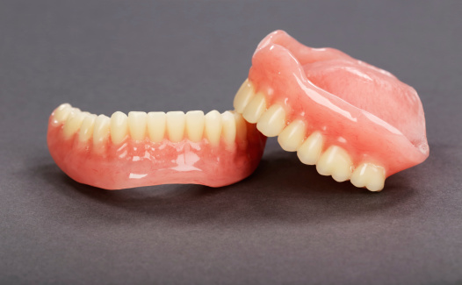
Oral Hygiene and Denture Care
Brush twice daily and floss daily
Use fluoride containing toothpaste
Denture Care
Remove dentures at night
Brush with denture brush or soft toothbrush
Place in denture cleanser solution or water overnight
Rinse with water after soaking over night
Some clients will need a caregiver to manage this aspect of oral hygiene
Image: Valueline/Punchstock
Image: Thinkstock
Notes:
30
All clients should maintain good oral hygiene. Clients must keep their dentures clean.
Denture care:
Remove dentures at night
Brush with denture brush or soft toothbrush to remove debris. Denture paste or mild dish soap can be used.
Place dentures in denture cleanser soaking solution or in water overnight. Rinse thoroughly before replacing in mouth.
Be aware that patients who cannot care for themselves adequately need their caregiver to manage this aspect of their oral hygiene.
Reference
MacDonald DE, Principles of Geriatric Dentistry and their Application to the Older Adult with Physical Disability, Clinics of Geriatric Medicine, 2006;22:413-434.

Slide 31
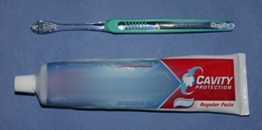
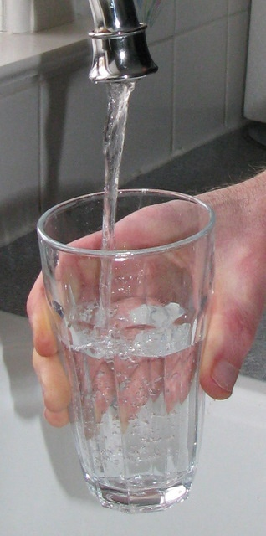
Fluoride
Fluoride is very important in preventing tooth decay
Sources of fluoride:
Tap water
Toothpaste
Mouthwash
Fluoride varnish, gel, foam
All professionally applied
Photos: Joanna Douglass, BDS, DDS
Notes:
Fluoride is probably the most important method of preventing tooth decay. Use fluoride containing toothpaste and fluoride products as directed by dental health professional
The use of fluoride, both through dietary and topical applications, has led to dramatic drops in caries rates.
The topical effect of fluoride is the most important. It needs to be placed on the surfaces of the teeth, in appropriate amounts, on a regular basis, to prevent tooth decay.
Caregivers should brush the teeth using fluoridated toothpaste twice daily starting from first tooth eruption.
Use fluoride toothpaste as soon as the first tooth erupts.
Drink community water that contains fluoride. Drinking fluoridated water allows fluoride to strengthen the developing teeth, as well as the important topical effect of teeth already in the mouth
Topical fluoride is especially effective for people at high risk for tooth decay who lack fluoridated water, have a history of tooth decay, snack frequently on foods containing sugar, or have a medical condition that makes them susceptible to decay.
Topical fluoride works best when ingested in very small amounts many times a day through water, foods containing fluoride, and fluoridated toothpaste.
What are the primary sources of fluoride?
Water fluoridation
Dietary fluoride supplements
Fluoride toothpastes
Fluoride varnish
Gels, foams, mouthwashes
Fluoride can also be professionally applied (including gels, foams, and varnish to renew fluoride levels in the enamel. Only a dentist, dental hygienist, physician, or other qualified health professional should apply topical fluoride.
References
Weyant RJ, Tracy SL, Anselmo TT et al. Topical fluoride for caries prevention: executive summary of the updated clinical recommendations and supporting systematic review. American Dental Association Council on Scientific Affairs Expert Panel on Topical Fluoride Caries Preventive Agents. J Am Dent Assoc. 2013. 144(11):1279-91.
American Dental Association Council on Scientific Affairs. Fluoride toothpaste use for young children. JADA 2014; 145(2):190-191.
Krol D. Maintaining and Improving the Oral Health of Young Children. Section on Oral Health Policy Statement. Pediatrics. 2014; 134:1224–1229.

Slide 32
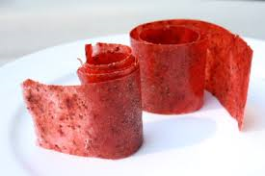
Healthy Diet
Tips for a healthy teeth and mouth
Drink fluoridated tap water
Choose healthy, lower-sugar foods and drinks
Snacking less. Avoid:
Juice and soft drink
Candy, cookies, or sweetened breakfast cereals
Eat few sticky and slow dissolving snacks
Raisins, dried fruit, fruit rolls, caramels, jelly beans, peanut butter and jelly sandwiches
Notes:
It is important to maintain a health diet and focus on nutrition. Maximizing the interval between food intake allows time for teeth to remineralize after exposure to acids. Salivary pH remains low between meals which makes frequent snacking inadvisable.
Follow these tips to lower caries risk:
Avoid frequent snacking (2 or more times between meals), especially on foods like:
Juice or soft drinks
Candy, cookies, or sweetened breakfast cereals
Refrain from eating sticky, retentive snacks and slow dissolving :
Raisins, dried fruit, fruit rolls, bananas, caramels, jelly beans, peanut butter and jelly sandwich
Do not eat or drink before bed after toothbrushing
Avoid alcohol and tobacco

Slide 33
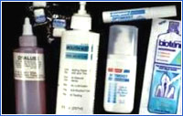
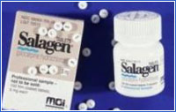
Managing Dry Mouth
Suggest
Sips of water, especially during eating
Sugarless gum and mints that contain xylitol
Saliva substitutes
Avoid
Alcohol, caffeine and tobacco
Sugary drinks and candies
Read medication labels to check for side effects
Prevent tooth decay and gum disease
Excellent oral hygiene
Fluoride on the teeth as recommended by health professionals
Saliva Substitutes
Saliva Stimulants
Sugarless Gum and Mints
Photos: Robert Henry, DMD, MPH
Notes:
33
To manage dry mouth, avoid using these products:
Irritants such as alcohol, caffeine, and tobacco
Sugar-containing drinks and candies
Talk to your pharmacist to identify possible medication side effects
Clients should be encouraged to do the following:
Take sips of water, especially during eating.
Chew sugarless gum and mints.
Use saliva substitutes.
Try salivary stimulants such as pilocarpine.
Prevent tooth decay and periodontal disease by:
Maintaining meticulous oral hygiene
Using increased strength topical fluorides such as 1.1% sodium fluoride
Reference
Visvanathan, V., Nix, P. Managing the patient presenting with xerostomia: a review. Int J Clin Pract 2010; 64(3): 404–407.

Slide 34
Case #1
Mrs. Pederson is a 74 year old whom you have regularly visited at home for 3 years. You help to assist with her complicated medication regimen. She reports dry mouth that has worsened over the past 2 months. She has been drinking more water than usual, but it only improves her symptoms for a few minutes. She drinks wine with dinner and sometimes before bed to help with falling asleep.
What are likely factors that contribute to her sensation of dry mouth?
What advice can be given to address this concern?
Notes:
**********************************
Speaker: Cases may be appropriate for certain audiences and are intended to provide the speaker options on how to best reinforce the material learned. Cases can be presented by the speaker in the large group forum with audience members offering opinions, or small groups can meet for 3-5 minutes with their table members or in groups of 3 prior to a large group discussion. Select the option best suited for your forum, audience, and allotted time.
*Speakers should feel free to edit the characteristics of the clients or setting in each case to align more closely with the population that the attendees serve.
Sample responses are on the next slide.

Slide 35
Case #1 Questions
What factors are likely contributing to her sensation of dry mouth?
Medications, especially to treat blood pressure, kidney, allergy, and depression
Alcohol use
Sedative medications for sleep
NOT aging alone
What advice can be given to address this concern?
Don’t ignore! Dry mouth should be addressed due to discomfort, change in taste, difficulty swallowing and speaking, and increased risk of cavities
Speak to primary care or specialty doctor about medications, side effects, and medication interactions
Promote chewing of sugarless gums or candies to induce saliva flow
Encourage excellent oral hygiene and regular dental care
Notes:
References:
Ship JA. The oral cavity. In: Hazzard's Geriatric Medicine and Gerontology. 6th edition. New York: McGraw-Hill, Inc., 2009.
Papas A, Singh M, Harrington D, Stimulation of salivary flow with a powered toothbrush in a xerostomic population. Special Care in Dentistry 26(6) Nov 2006, 241-246.
Filshie, J, Rubens, CNJ, Complementary and Alternative Medicine, Anesthesiology Clinics of North America, 24 (2006) 81-111.
Messer LB, Till MJ. A landmark report on understanding the human dentition. JADA. 2013; 144:357-361.

Slide 36
Case #2
You are asked to evaluate Grace, a sweet 83 year old with moderate dementia and difficulty with motor tasks from a stroke at age 78. The family has listed “oral care” as one of three primary concerns, along with choking on solid foods and poor sleep.
What are personal, family, and community challenges or barriers clients may face to achieving good oral health?
What opportunities do you have to support this specific health need?
Notes:
Speakers should feel free to edit the characteristics of the clients or setting in each case to align more closely with the population that the attendees serve.
Sample responses are on the next slide.

Slide 37
Case #2 Questions
What are personal, family, and community challenges or barriers clients may face to achieving good oral health?
What opportunities do you have to support this specific health need?
Education (diet, oral hygiene, dental benefits)
Goal setting
Referral and insurance coverage
Transportation

Slide 38
Action Steps to Improve Adult OH
Small Group Activity
1. Client queries (check-list)
2. Preventive care
3. Oral health care supplies
4. Education
5. Service coordination
Notes:
**************************************
Speaker: This exercise can be modified to allow for more or less sharing, as time permits. See Educator Handbook Appendix Activity #2 for additional details. This is nearly identical to the brainstorming activity at the end of the pregnancy module, this should be performed as described below only once. If this activity was performed at the end of the women’s and pregnancy module, you may simply ask the audience to re-visit their original lists and add any new ideas the 5 categories or if they feel that the rank ordering should be altered. If the brainstorming activity was not completed in this manner in course 3 (pregnancy and women’s oral health), consider completing this activity entirely as described below. You will need to unhide the subsequent 3 slides if you wish to show the responses.
If you are not performing this activity here, leave the subsequent 3 slides hidden and move on to Take Home Messages and Final Thoughts (Slide 42 and 43).
Speaker: Inform the audience this is an opportunity to perform collective brainstorming. There are no “wrong” answers.
Ask the audience to break up into 5 smaller groups of roughly similar size.
Each small group will have one Action Step category to consider (5 categories listed below) which should written on the top of a flip chart (or on a large sheet of paper) and handed to each of the group.
Allow approximately 10 minutes for group members to consider their unique Action Step category and write down their ideas and suggestions
Bring all the groups back together and ask each group share aloud their ideas with the larger group OR, if time and space allow, to walk around as a group and spend another 5 minutes reading the headings and suggestions of the other groups, while marking on the other groups lists what they believe are the 2 most important ideas in each category. At the end, this will allow the entire group to have read or heard all the suggestions for all 5 categories and to have rank-ordered the 2 most important items.
Action Step to Improve Oral Health Categories:
Speaker – bullet points on the next two slides provide potential ideas that can be added to the group lists for completeness or shared with small groups to stimulate discussion.
Client queries
Do you have a dentist you see regularly?
When was the last time your teeth were cleaned?
Do you have any mouth pain? Swollen or bleeding gums? Problems eating or chewing food?
Home preventive care
Daily home care
Brushing twice daily with fluoride toothpaste
Flossing daily
Limit intake of sugary foods
Limit between meal snacks
Choose low sugar or sugar free snacks and drinks
Routine visit with dental professional
Oral health care supplies
Distribute oral care supplies (toothbrushes, paste, floss)
Ideas to consider: home delivery, local meal delivery, food pantry, WIC programs
Education (clients, colleagues, health professionals) and Training
Education for clients (category 2 above)
Education for peers
Education for health professionals/health care team members
Service coordination
Obtaining dental insurance coverage and locating offices that accept that insurance
Appointment scheduling, reminders, and transportation to dental office
Local dental and hygiene schools are often able to offer lower cost care while providing valuable educational opportunities for the students
Resource/Reference
Oral Health: An Essential Element of Healthy Aging. The Gerontological Society of America. 2017

Slide 39
Action Steps to Improve Adult OH
Client queries (check-list)
Do you have a dentist you see regularly? When was the last time your teeth were cleaned?
Do you have any mouth pain? Swollen or bleeding gums? Problems eating or chewing food?
Notes:
This slide and the next may be hidden or exposed as groups share their ideas.

Slide 40
Action Steps to Improve Adult OH
2. Preventive care
Daily home care
Brush twice daily with fluoride toothpaste
Floss daily
Denture cleaning
Limit intake of sugary foods
Limit snacks between meals
Choose low sugar or sugar free snacks and drinks
Routine visit with dental professional
Notes:
This slide and the next may be hidden or exposed as groups share their ideas.

Slide 41
Action Steps to Improve Adult OH
3. Oral health care supplies
Distribute oral care supplies (toothbrushes, paste, floss)
How? Home delivery, local meal delivery, food pantry
4. Education (clients, colleagues, professionals)
Educate clients
Educate peers, caregivers, staff long-term care facilities
Educate health professionals/health care team members
5. Service coordination
Obtaining dental insurance coverage and locating offices that accept that insurance
Appointment scheduling, reminders, transportation

Slide 42
Take Home Messages
Quality of life can be improved with better oral health
Older population is growing and has increased needs
Chronic diseases such as diabetes increase the burden of oral disease – the reverse is also true
Don’t assume clients are regularly seeing a dentist or can afford care
FLHWs can provide client education and referral
Ask about concerns related to the mouth, such as pain, dry mouth, oral sores, dentures, difficulty chewing, and diet
Provide oral health education and help them find a dental home
Notes:
Quality of life can be improved with better oral health!
Adults, and especially the senior population, is growing and has increasing oral needs.
Chronic disease increases the burden of oral disease. The reverse is also true.
Do not assume that clients are regularly seeing a dentist.
FLHWs should counsel patients on effective oral preventive measures including regular dental visits.
Effective inter-professional collaboration is often vital to successful outcomes. FLHWs can assist their clients and other care providers in support of adult oral health.
Remember, you can’t be healthy without good oral health and that quality of life can be improved with better oral health
.

Slide 43
How can I make a difference?
Final Thoughts
Never doubt that a small group of thoughtful, committed citizens can change the world. Indeed, it is the only thing that ever has.
- Margaret Meade
Notes:
**************************************
Consider this activity and slide optional, depending on time and extent to which the brainstorming activity was performed in this module.
Directions:
Participants may be asked to discuss specific actions they can take to integrate oral health into their work with clients. This can be done in pairs or individually.
May also ask then to consider how they might work with community organizations or leaders to integrate oral health prevention.
Participants could be asked to create a “compromiso” or promise and you can consider providing an opportunity for them to to read their promise aloud providing an opportunity for sharing their sense of engagement and commitment with others.

Slide 44
Questions?
44
Notes:
*********************************
Speaker: If time allows, allot a small amount of time for Q & A, may be of particular importance if interactive activities are eliminated from the deck.

