Slide 1
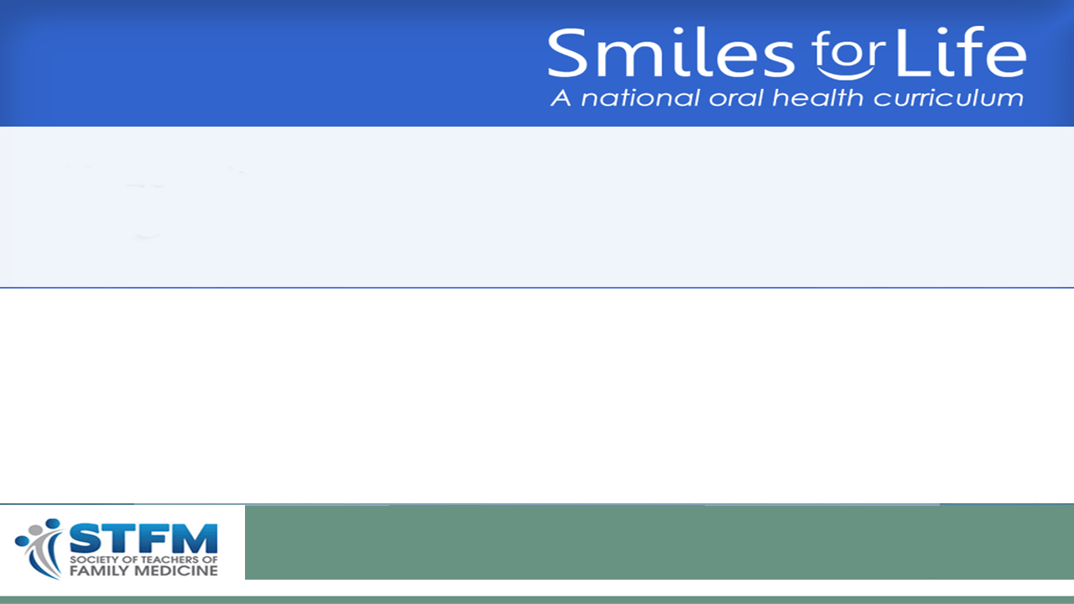
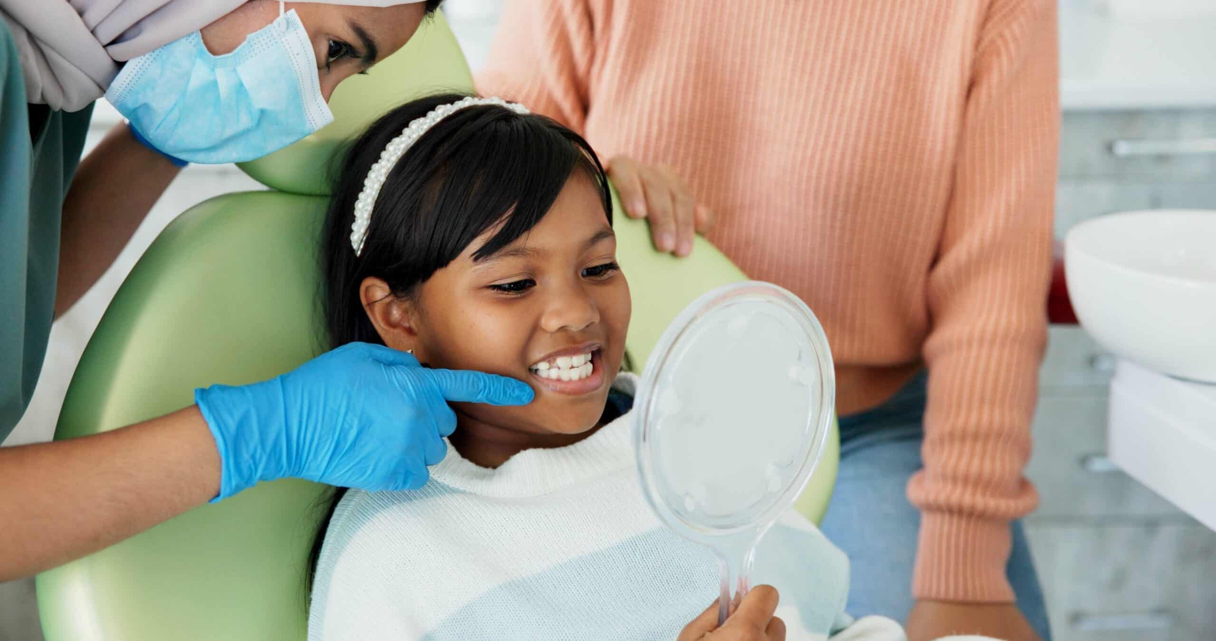
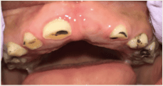
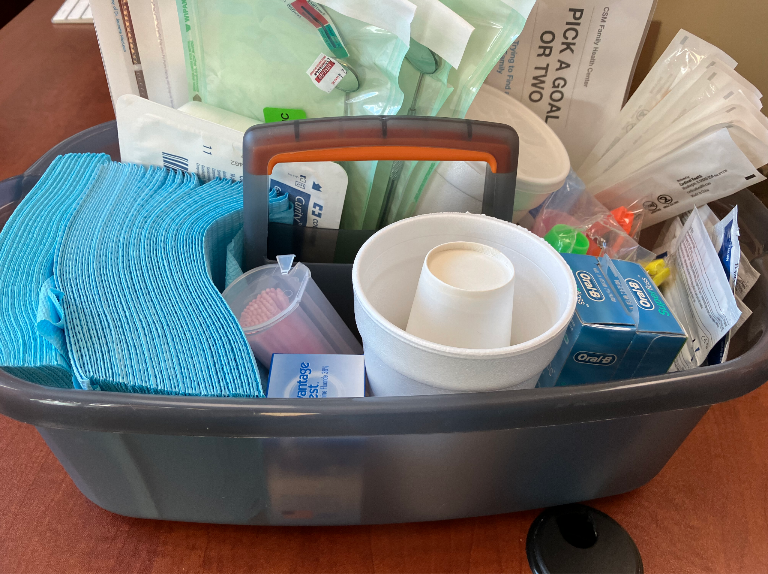
Silver Diamine Fluoride
Smiles for Life Oral Health
Module 9:
Silver Diamine Fluoride
Jeremy Horst Keeper DDS, PhD & Rebecca Bernstein, MD, MS
Image: Shutterstock
Image: J Horst Keeper, DDS
Image: R Bernstein, MD
Fourth Edition June 2010
www.smilesforlifeoralhealth.org
Last modified: December 2024
Copyright STFM 2005-2025

Slide 2
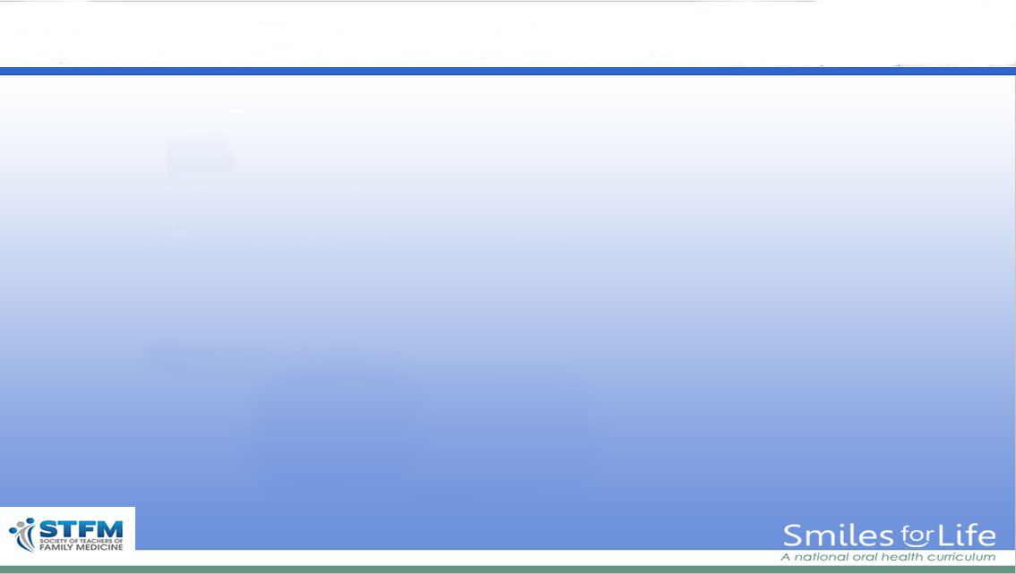
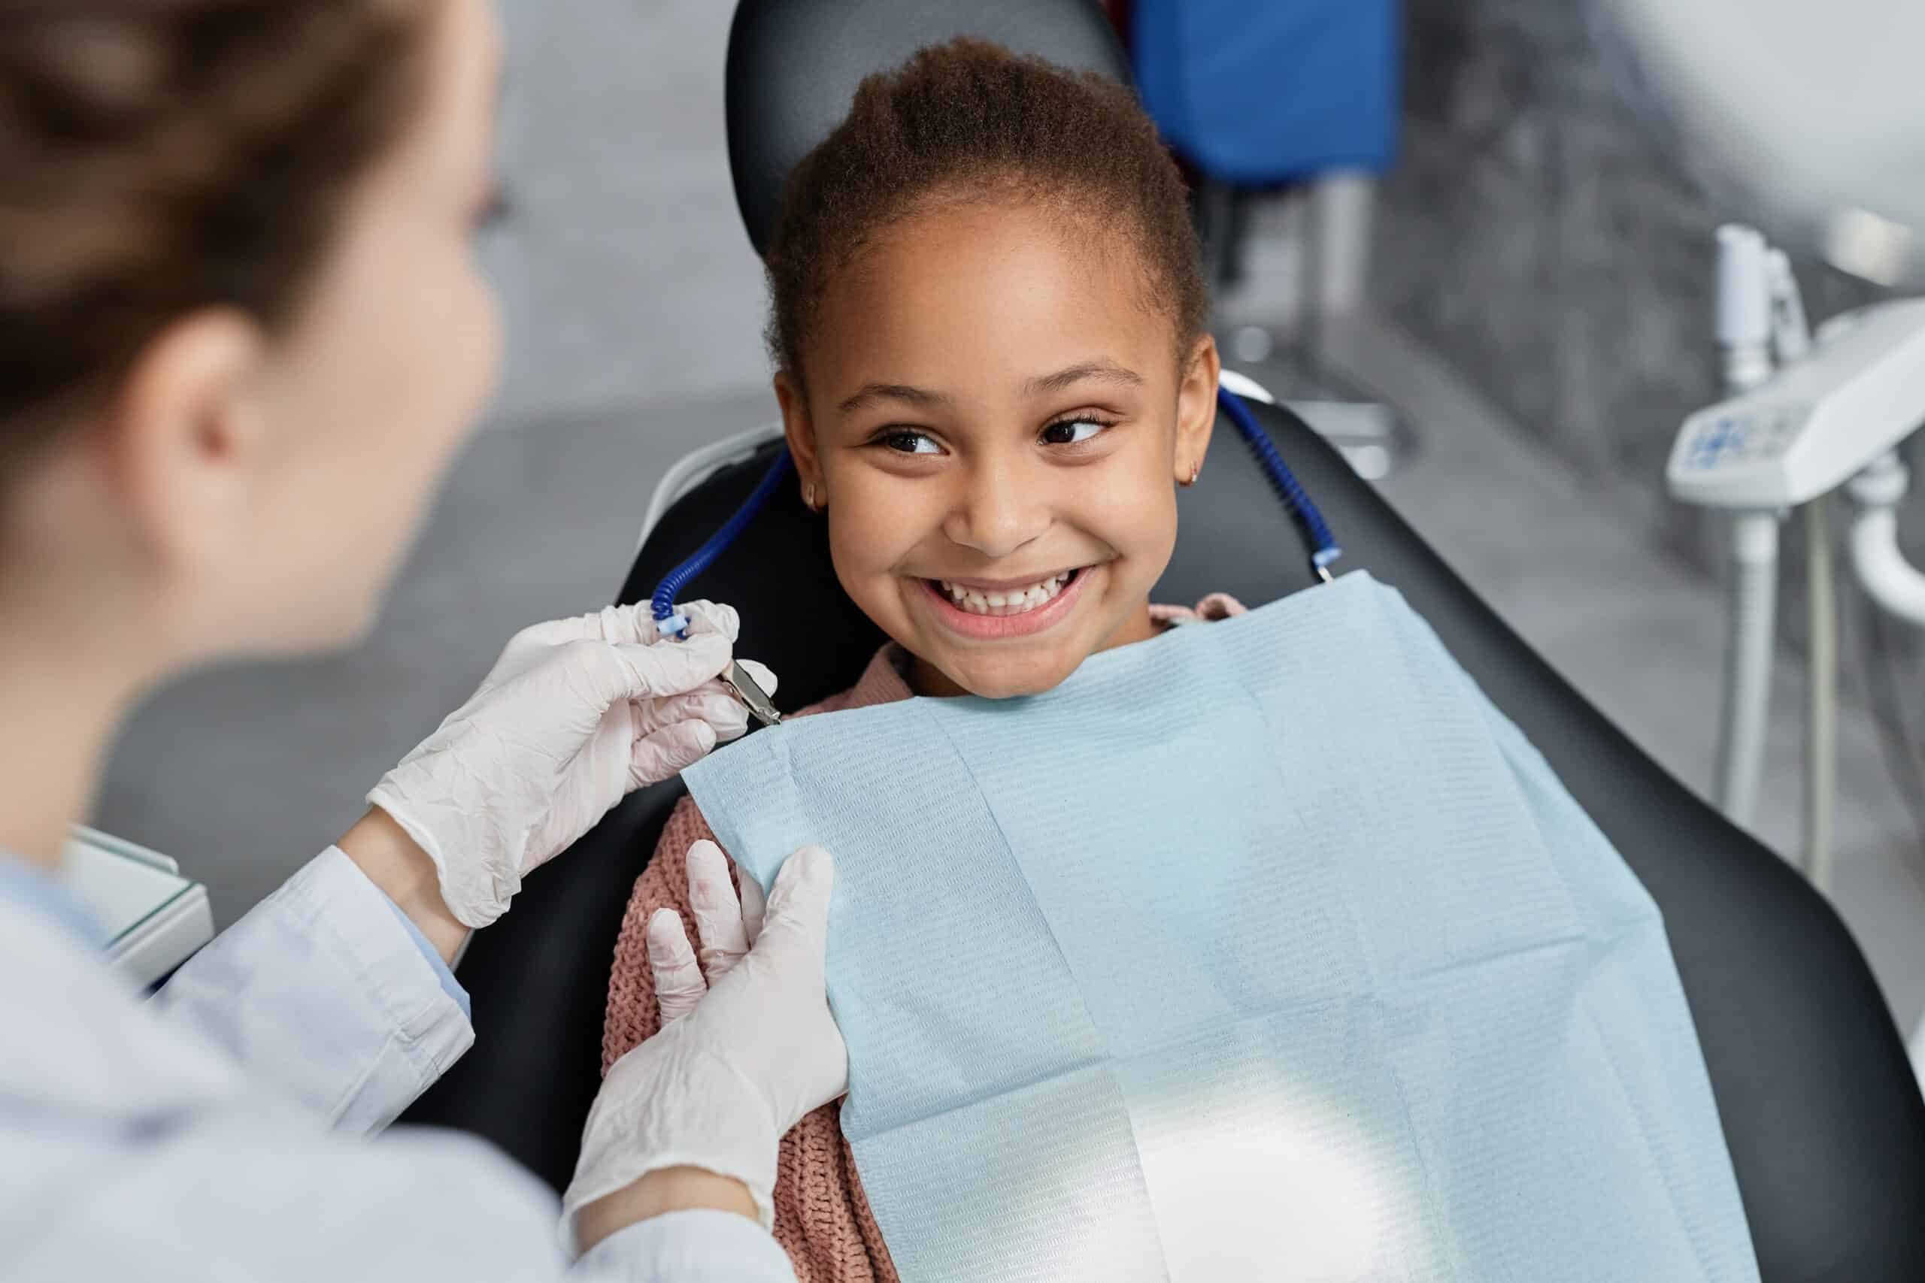

Module 9
Silver Diamine Fluoride
Course Steering Committee Authors
      Jeremy Horst Keeper, DDS, PhD
    Rebecca Bernstein, MD, MS
Smiles for Life Editor
  Karlynn Sievers, M.D.
Funded By

Slide 3
Educational Objectives
Module 9
Silver Diamine Fluoride
Recognize the presence and impact of dental professional access gaps on equitable access to oral healthcare, and where medical access can mitigate these gaps
Describe the prevalence of dental caries (cavities)
Explain the cause and basic mechanisms of dental caries
Describe how silver diamine fluoride acts to arrest dental caries
Compare the mechanism of action and clinical indications for fluoride varnish and silver diamine fluoride
Identify clinical indications and contraindications to silver diamine fluoride application
Summarize the risks, benefits, and alternatives to silver diamine fluoride to provide informed consent for patients
Demonstrate the application of silver diamine fluoride for treatment of dental caries (cavities)
Outline the follow up care and monitoring recommendations after silver diamine fluoride treatment
Notes:
The educational objectives for this course are:
Recognize the presence and impact of dental professional access gaps on equitable access to oral healthcare, and where medical access can mitigate these gaps
Describe the prevalence of dental caries (cavities)
Explain the cause and basic mechanisms of dental caries
Describe how silver diamine fluoride acts to arrest dental caries
Compare the mechanism of action and clinical indications for fluoride varnish and silver diamine fluoride
Identify clinical indications and contraindications to silver diamine fluoride application
Summarize the risks, benefits, and alternatives to silver diamine fluoride to provide informed consent for patients
Demonstrate the application of silver diamine fluoride for treatment of dental caries (cavities)
Outline the follow up care and monitoring recommendations after silver diamine fluoride treatment

Slide 4
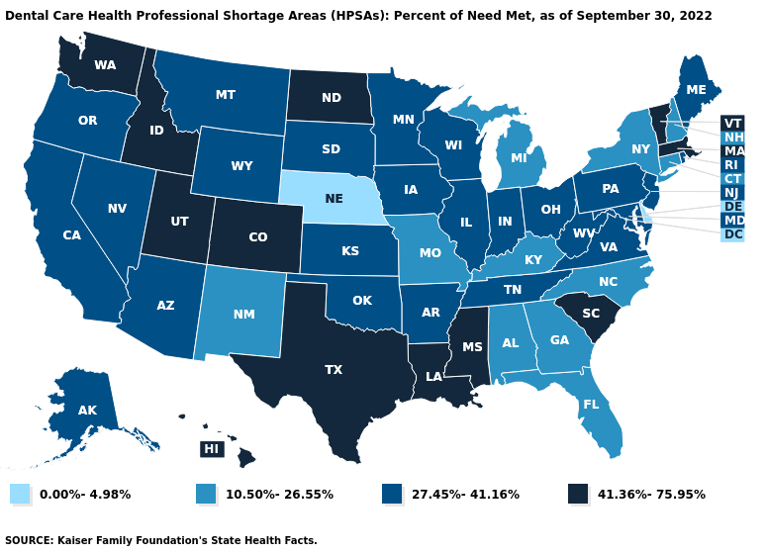
Module 9
Silver Diamine Fluoride
Overview of dental professional access gaps
Why should you learn about silver
diamine fluoride?
  Dental caries is a chronic progressive disease.
  Lack of access to care allows untreated disease
  to progress.
Notes:
This map illustrates the percent of dental need met, with darker colors indicating a higher percentage of people with dental needs met. In September 2022, only 12 states had the highest category, indicating more than 41% of dental needs met. We are not meeting the dental need.
70 million people live in dental health professional shortage areas
Only 38% of older adults have dental insurance, while 92% have health insurance
One in 50 adult Medicaid beneficiaries visits an emergency department for tooth decay every year
Only 2% of children under the age of 2 have seen a dental team, but the typical 2-year-old has seen a medical team 10 times.
112 million Americans see a medical team but not a dental team each year.
Reference:
https://www.kff.org/other/state-indicator/dental-care-health-professional-shortage-areas-hpsas

Slide 5
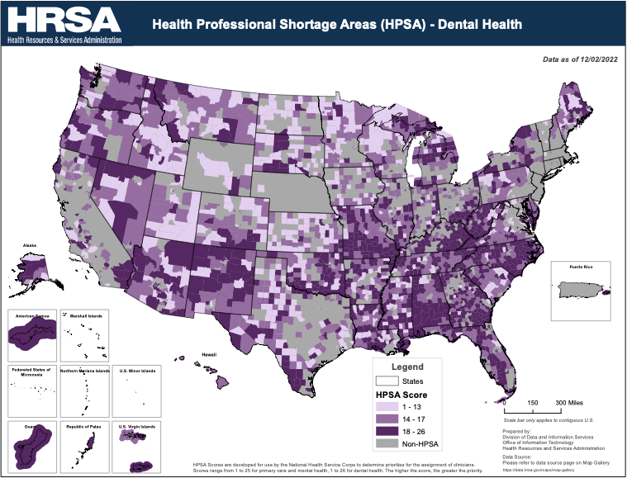
Module 9
Silver Diamine Fluoride
Overview of dental professional access gaps
Dental professional shortage gaps exist in both urban and rural areas.
Notes:
When mapped in more detail, we see that dental professional shortage gaps are seen in both urban and rural areas, and that some patients may need to travel long distances to obtain dental care.
Reference:
https://data.hrsa.gov/ExportedMaps/MapGallery/HPSADC.pdf

Slide 6
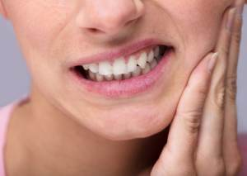
Module 9
Silver Diamine Fluoride
Impact of untreated dental caries
Untreated dental disease may result in:
  Pain
  Impaired chewing and nutrition
  Infection
  Increased caries in other teeth
  School/work absences
  Poorer school performance
  Difficulty sleeping
  Poor self-esteem
  Extensive and expensive dental work which often must be completed under general anesthesia
Notes:
Untreated dental disease may result in:
Pain
Impaired chewing and nutrition
Infection
Increased caries in other teeth
School/work absences
Poorer school performance:
Students with dental pain are 3x more likely to have a low grade point average
Difficulty sleeping
Poor self-esteem
Extensive and expensive dental work which often must be completed under general anesthesia
These sequalae are discussed in detail in the Smiles for Life Child, Adult, and Geriatric Oral Health modules.
References:
White, B. A., Monopoli, M. P., & Souza, B. S. Catalyst Institute. The Oral Health of Massachusetts' Children. January, 2008.
Jackson, S. L., et al. Impact of Poor Oral Health on Children's School Attendance and Performance. Am J Public Health. 2011;101(10):1900-6.
Seirawan, H., et al. The impact of oral health on the academic performance of disadvantaged children. Am J Public Health. 2012 102(9): 1729-34.
Martins-Júnior P. A., et al. Impact of early childhood caries on the oral health-related quality of life of preschool children and their parents. Caries Res. 2013; 47(3): 211-8.

Slide 7
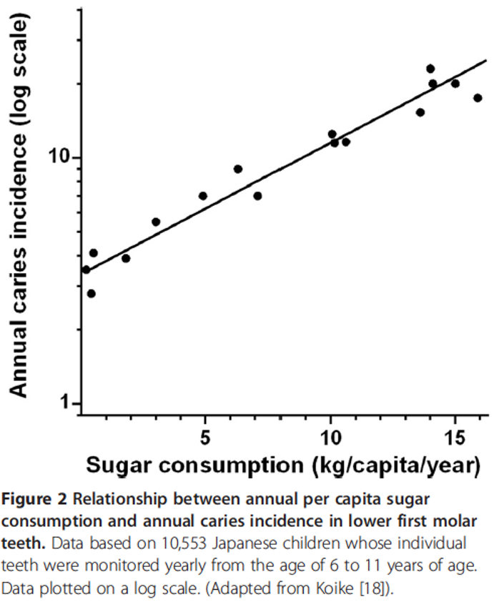
Module 9
Silver Diamine Fluoride
Cause of dental caries
It is important to understand the cause of dental caries in order to understand how silver diamine fluoride works
In addition to the total quantity of sugar and carbohydrates consumed, stickiness of food (such as chewy candy), frequency of consumption, and length of time in the mouth all contribute to higher cavity risk.
Figure 2 Relationship between annual per capita sugar comsumption and annual caries incidence in lower first molar teeth. Data based on 10,533 Japanese children whose individual teeth were monitored yearly from the age of 6 to 11 years of age. Data plotted on a log scale. (Adapted from Koike).
Notes:
It is important to understand the cause of dental caries in order to understand how silver diamine fluoride works.
This figure highlights the exponential impact of sugar and other processed carbohydrates on the development of dental caries.
In addition to the total quantity of sugar and carbohydrates consumed, stickiness of food (such as chewy candy), frequency of consumption, and length of time in the mouth all contribute to higher cavity risk.
Sugar and overprocessed carbohydrates cause cavities. Counsel on:
stickiness
frequency
duration
The Smiles for Life child oral health module section on cavity prevention provides detailed information on patient education about caries prevention. The overall important message is to reduce sugar intake.
Sugar + time on teeth = caries
References:
Sheiham A, James WP. A reappraisal of the quantitative relationship between sugar intake and dental caries: the need for new criteria for developing goals for sugar intake. BMC Public Health. 2014 Sep 16;14:863. https://doi: 10.1186/1471-2458-14-863. PMID: 25228012; PMCID: PMC4168053.
Stephan RM. Intra-Oral Hydrogen-Ion Concentrations Associated With Dental Caries Activity. Journal of Dental Research. 1944;23(4):257-266. https://doi:10.1177/00220345440230040401

Slide 8
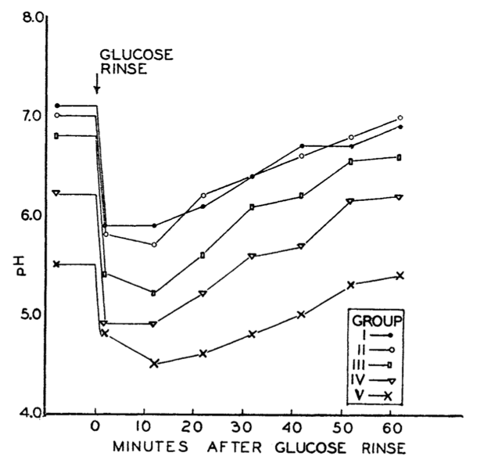
Module 9
Silver Diamine Fluoride
Cause of dental caries
      Dysbiosis is an imbalance in a person’s oral flora (biome) shifting toward cariogenic (cavity-causing) bacteria. This shift causes sensitivity to sugar
Dysbiosis can be partially reversed with SDF and other antimicrobials (Povidone iodine, Arginine, Xylitol, etc)
An oral biome shifted more towards cariogenic flora is more sensitive to sugar intake
Antimicrobials, including SDF, help reverse this dysbiosis and shift the oral microbiome back toward health, decreasing the risk for the development of future cavities.
Notes:
Groupings by oral flora
Dysbiosis is an imbalance in a person's oral flora (biome), shifting toward cariogenic (cavity-causing) bacteria. This shift creates sensitivity to sugar.
Dysbiosis can be partially reversed with SDF and other antimicrobials (Povidone iodine, Arginine, Xylitol, etc.)
Figure 2 highlights the impact of sugar on the pH of the mouth.
Whether or not a patient reaches a sufficiently acidic pH to dissolve tooth enamel and cause dental caries is variable. An oral biome shifted more towards cariogenic flora is more sensitive to sugar intake.
Antimicrobials, including silver diamine fluoride, help reverse this dysbiosis and shift the oral microbiome back toward health, decreasing the risk for the development of future cavities.
While the SDF works on the microbiome and the hypersensitivity to sugar, decreasing sugar intake is also very important.
References:
Sheiham A, James WP. A reappraisal of the quantitative relationship between sugar intake and dental caries: the need for new criteria for developing goals for sugar intake. BMC Public Health. 2014 Sep 16;14:863. https://doi: 10.1186/1471-2458-14-863. PMID: 25228012; PMCID: PMC4168053.
Stephan RM. Intra-Oral Hydrogen-Ion Concentrations Associated With Dental Caries Activity. Journal of Dental Research. 1944;23(4):257-266. https://doi:10.1177/00220345440230040401

Slide 9
The role of microbes and sugar in dental caries
Module 9
Silver Diamine Fluoride
The role of microbes and sugar in dental caries
Sugar or
overprocessed
carbs + time on teeth
Sugar or
overprocessed
carbs + time on teeth
Sugar or
overprocessed
carbs + time on teeth
Healthy
dental biofilm
Dysbiosis of
dental biofilm
Acid consolidated
at tooth surface
Caries
demineralization
microbial
selection
microbial
metabolism
more metabolism,
more selection
protective
factors
Microbial
environment
(e.g. caregivers)
Saliva
Antimicrobials
(Silver, etc.)
Hygiene
Fluoride
Nutrition
Horst Keeper & Bernstein 2024
Notes:
This figure shows additional elements in the pathway to demineralization and caries, while continuing to highlight the role of sugar, diet, and the oral microbiome.
SDF acts in 2 key places in this pathway highlighted in yellow text, with silver working to reverse dysbiosis of the dental biofilm and fluoride working to remineralize tooth enamel.
Patient and caregiver behavior is highlighted in blue text, emphasizing that diet, nutrition, and oral hygiene impact the pathway.
This pathway is dynamic as the biofilm, pH, and mineralization/demineralization shift back and forth with clinical treatment and behavior changes.

Slide 10
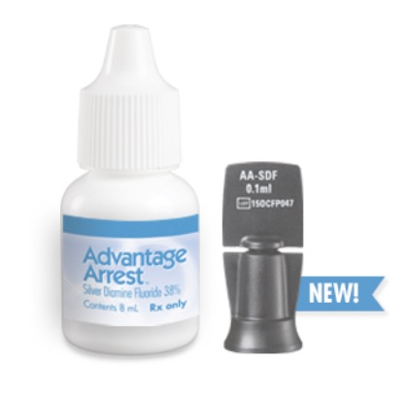
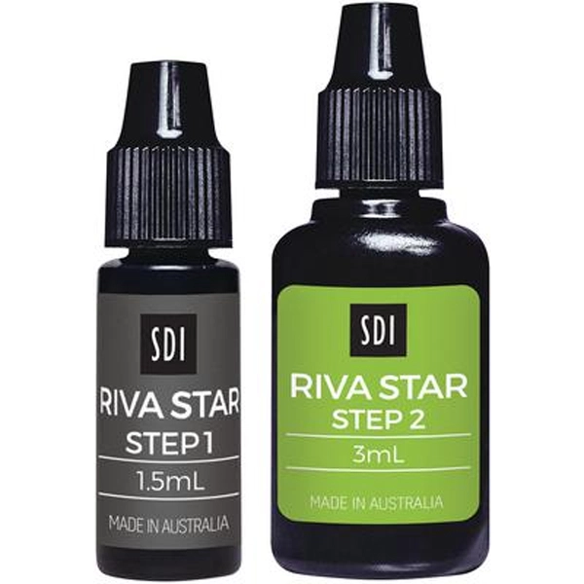
Module 9
Silver Diamine Fluoride
Silver Diamine Fluoride
Learning objectives:
Describe the prevalence of dental caries (cavities)
Explain the cause and basic mechanisms of dental caries
Describe how silver diamine fluoride acts to arrest dental caries
Compare the mechanism of action and clinical indications for fluoride varnish and silver diamine fluoride
Notes:
Ref for ADA: https://jada.ada.org/article/S0002-8177(18)30469-0/fulltext

Slide 11
Module 9
Silver Diamine Fluoride
Ingredients and their function
What is Silver Diamine Fluoride?
    25% Silver – antimicrobial
    5% Fluoride – remineralization
    8% Ammonia – stabilizes solution
    How Does Silver Diamine Fluoride Work?
Silver nitrate reacts with the biofilm and tooth organic material to produce calcium fluoride, silver oxides, and metallic silver
Calcium fluoride
  Long-lasting fluoride reservoir for mouth
Silver oxide and metallic silver
  Hardens and darkens tooth enamel
  Sustained antimicrobial effect on oral flora
Silver ions “cauterize” infected dentin in similar way to silver nitrate cauterizing bleeding
Provides an active reservoir of antimicrobial agent
Compatible with fillings that a dentist might place later
Notes:
Reference:
ADA. (2023, Sept 19). Silver Diamine Fluoride. https://www.ada.org/resources/ada-library/oral-health-topics/silver-diamine-fluoride

Slide 12
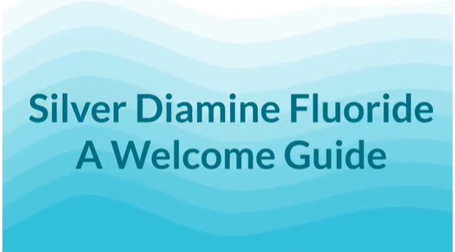
Module 9
Silver Diamine Fluoride
Notes:
Show video here if desired. https://youtu.be/0opp3jBpTPs

Slide 13
Module 9
Silver Diamine Fluoride
Approval and Use
Silver Diamine Fluoride has been used safely for years
Approved by the FDA in 2014 to treat tooth hypersensitivity
Currently approved for caries treatment in Canada and other countries
Off label use for caries treatment in the United States
Designated Breakthrough Therapy by FDA & currently in Phase III trials to become the first drug approved for caries treatment
Included on the WHO Lists of Essential Medicines (2021)
Notes:
Silver Diamine Fluoride has been used safely for years
Approved by the FDA in 2014 to treat tooth hypersensitivity
Currently approved for caries treatment in Canada and other countries
Off label use for caries treatment in the United States
Designated Breakthrough Therapy by FDA & currently in Phase III trials to become the first drug approved for caries treatment
Included on the WHO Lists of Essential Medicines (2021)
References:
ADA. (2023, September 19). Silver Diamine Fluoride. https://www.ada.org/resources/ada-library/oral-health-topics/silver-diamine-fluoride
Farmer, J. W., et al. (2018). Effectiveness, safety, and acceptance of silver diamine fluoride therapy and its implications for dental hygiene practice: Position paper and statement from the Canadian Dental Hygienists Association. Can J Dent Hyg 2018; 52(3): 192-207.
Cooper, L. H., Slashcheva, L., & Tomar, S. (2017). Silver Diamine Fluoride (SDF) Fact Sheet. ASTDD. https://www.astdd.org/docs/SDF-fact-sheet-upd-oct_23.pdf
Web Annex A. World Health Organization Model List of Essential Medicines - 22nd List, 2021. Geneva: World Health Organization; 2021 (WHO/MHP/HPS/EML/2021.02). Licence: CC BY-NC-SA 3.0 IGO.

Slide 14
Module 9
Silver Diamine Fluoride
Comparison of Silver Diamine Fluoride and Fluoride Varnish
Silver Diamine Fluoride for Caries Arrest
Fluoride Varnish
Apply to caries-affected surfaces (pre-cavitated lesions, cavities)
Treats cavities
Prevents cavities
Contains silver, cavity turns black permanently
Hardens cavity surface
Re-apply ~every 6 months
  More frequent application with worse caries activity.
Tastes metallic/unpleasant
Apply to all tooth surfaces
Doesn’t arrest cavities
Arrests pre-cavitated lesions
Prevents cavities
No silver, no tooth staining
Re-apply ~every 6 months
  More frequent application with worse caries activity.
Comes in tasty flavors
Texture unpleasant
Notes:
Both silver diamine fluoride and fluoride varnish contain fluoride, but they are not the same product and are used in different ways.

Slide 15
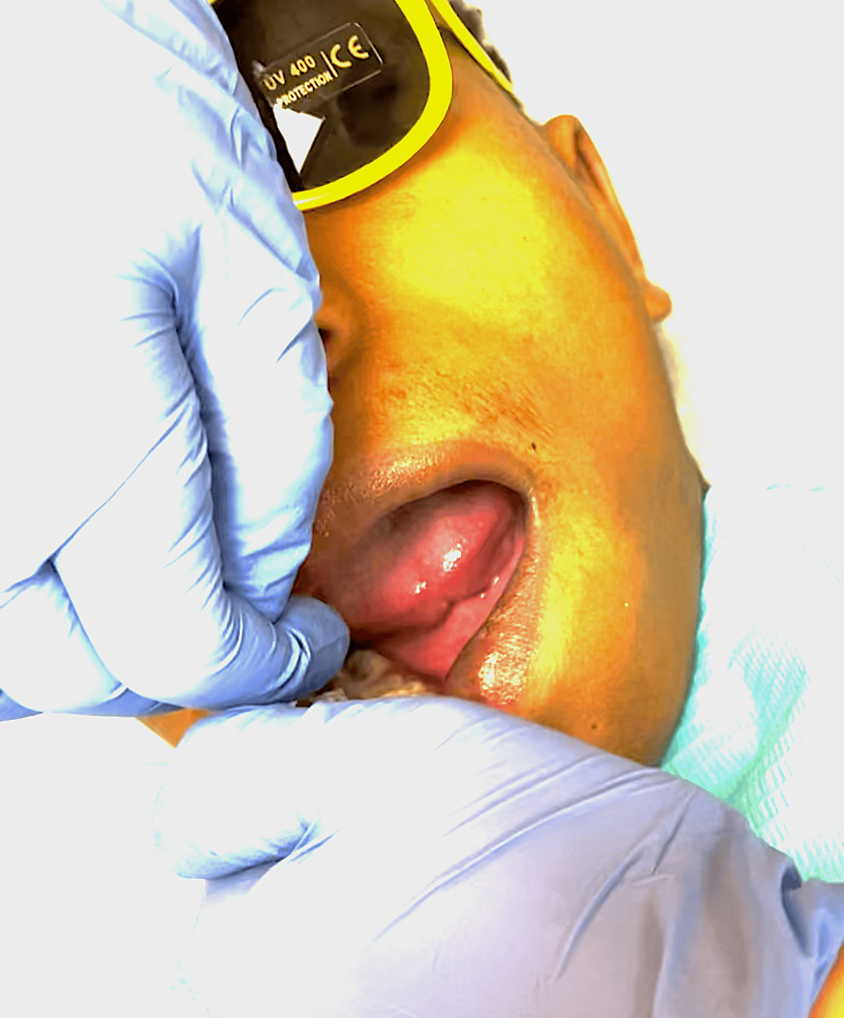
Module 9
Silver Diamine Fluoride
Efficacy of Silver Diamine Fluoride
Caries Arrest
Arrest is a stable condition where a cavity is no longer growing and the surface is hard
Many trials on SDF efficacy for caries arrest have been completed among different populations and with various protocols
Overall, SDF is 81% effective for caries arrest, based on a meta-analysis of multiple randomized trials.
Photo with permission, R Bernstein, MD
Application of SDF for caries treatment
Notes:
References:
Gao SS, Zhao IS, Hiraishi N, Duangthip D, Mei ML, Lo ECM, Chu CH. Clinical Trials of Silver Diamine Fluoride in Arresting Caries among Children: A Systematic Review. JDR Clin Trans Res. 2016 Oct;1(3):201-210. doi: 10.1177/2380084416661474. Epub 2016 Aug 20. PMID: 30931743.
Oliveira BH, Rajendra A, Veitz-Keenan A, Niederman R. The Effect of Silver Diamine Fluoride in Preventing Caries in the Primary Dentition: A Systematic Review and Meta-Analysis. Caries Res. 2019;53(1):24-32.
Duffin, S., (2012). Back to the future: the medical management of caries introduction. J Calif Dent Assoc. 2012 Nov;40(11): 852-8.

Slide 16
Module 9
Silver Diamine Fluoride
Efficacy of Silver Diamine Fluoride
Patients whose cavities are treated with SDF get approximately 77% fewer new cavities compared to placebo or no treatment control groups
SDF-treated caries lesions act as reservoirs for silver and fluoride, decreasing caries activity throughout the mouth
SDF has twice the fluoride concentration as fluoride varnish, and therefore 8 times higher fluoride absorption potential (diffusion coefficient)
Photo with permission: J Horst-Keeper, DDS
Example of a patient with severe early childhood caries, treated with SDF and never developed new decay
Notes:
References:
Gao SS, Zhao IS, Hiraishi N, Duangthip D, Mei ML, Lo ECM, Chu CH. Clinical Trials of Silver Diamine Fluoride in Arresting Caries among Children: A Systematic Review. JDR Clin Trans Res. 2016 Oct;1(3):201-210. doi: 10.1177/2380084416661474. Epub 2016 Aug 20. PMID: 30931743.
Oliveira BH, Rajendra A, Veitz-Keenan A, Niederman R. The Effect of Silver Diamine Fluoride in Preventing Caries in the Primary Dentition: A Systematic Review and Meta-Analysis. Caries Res. 2019;53(1):24-32.
Duffin, S., (2012). Back to the future: the medical management of caries introduction. J Calif Dent Assoc. 2012 Nov;40(11): 852-8.

Slide 17
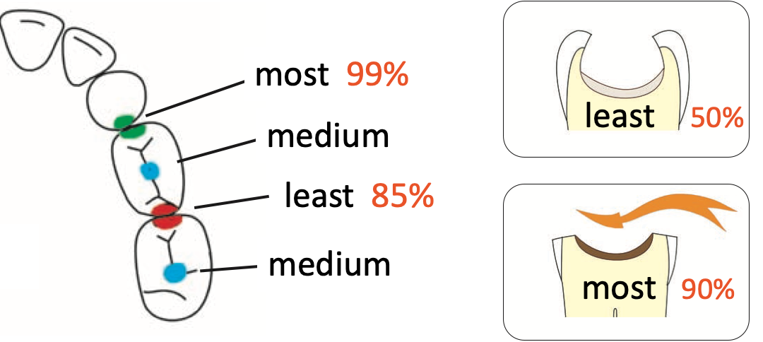
Module 9
Silver Diamine Fluoride
Likelihood of SDF caries arrest
Lesions that trap food and plaque may respond with more applications, e.g. 3-5 in 6 months
Smaller point of tooth-to-tooth contact
Wider point of tooth-to-tooth contact
Smaller tooth-to-tooth contacts have less
disease activity and respond better to SDF.
Areas that don’t trap food have less disease activity and respond better to SDF.
Craig & Powell, Dental Outlook. 2013
Notes:
Beyond application frequency, another factor impacting the likelihood of caries arrest is lesion shape and location.
Lesions that are shallow and shaped like plate are more easily cleaned by saliva and brushing. Lesions which are deeper and shaped like a bowl are less cleansible which decreases the chance of successful arrest.
Reference:
Craig G., & Powell K. (2013) A Handbook of Expanded Atraumatic Techniques for the Apprehensive Child Dental Patient. Dental Outlook Publications.

Slide 18
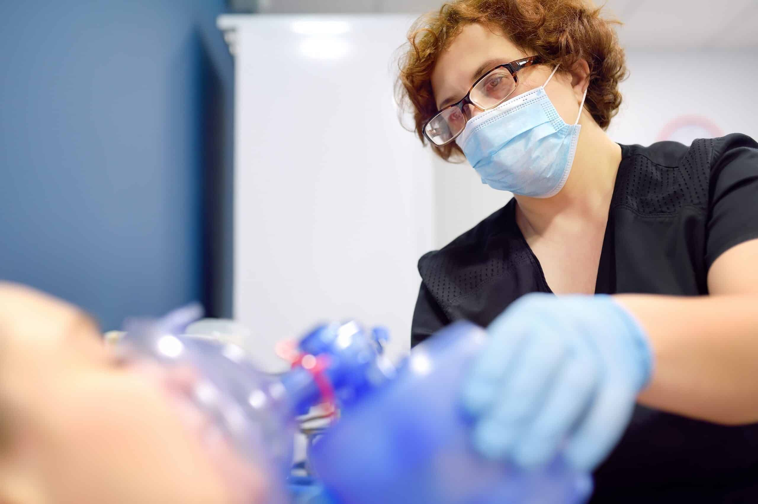
Module 9
Silver Diamine Fluoride
SDF Reduces the Need for More Invasive Treatment
Patient Outcomes with SDF Use
Reduced emergency visits
SDF reduced emergencies by 80% in young Floridian children waiting for treatment under general anesthesia
Decrease in need for treatment under general anesthesia
          SDF and prevention provided by hygienists in WICs and HeadStarts reduced general anesthesia referral by 67% across >100k Oregonian children
  SDF eliminated general anesthesia use in an Oregonian dental practice
  Offering SDF as an alternate to general anesthesia use decreased these referrals by 88% after 6 months in an Australian pediatric dentistry residency
Photo credit: Shutterstock
Notes:
References:
Thomas, M. L., et al. (2020). Silver Diamine Fluoride Helps Prevent Emergency Visits in Children with Early Childhood Caries. Pediatr Dent. 2020 May 15;42(3): 217-220.
Ludwig, S., et al. (2020). System level interventions to reduce utilization of general anesthesia to treat dental caries: a practice brief. J Public Health Dent. 2020 Sep: 80 Suppl 2:S122-S125. doi: 10.1111/jphd.12426.
Yawary, R., Hegde, S., (2022). Silver Diamine Fluoride Protocol for Reducing Preventable Dental Hospitalisations in Victorian Children. Int Dent J. 2022 Jun; 72(3): 322-330. doi: 10.1016/j.identj.2021.05.009. Epub 2021 Jul 14.

Slide 19
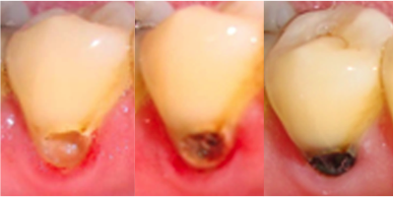
Module 9
Silver Diamine Fluoride
Pros and Cons of Silver Diamine Fluoride Application
Pros
No numbing or drilling needed
Stops cavity from progressing
Avoids sedation/ GA for young children and people with special healthcare needs
Enables access to care for adults by overcoming financial, logistical, and trust barriers
Helps prevent more cavities from forming
Gives profound control of tooth sensitivity
Enables primary care clinicians to help treat patients that do not have a dentist
Cost effective
Cons
Turns the cavity black
Needs to be reapplied
Doesn’t fill the cavity (hole)
Doesn’t restore form and function of the tooth (but can make restoration easier later)
Doesn’t prevent food impaction resulting from open contact areas that are cavitated
SDF alone does not comprise a dental home
before
24 hours
7 days
Illustration showing the progression of staining with SDF use
Notes:
References:
Castillo, J. L., et al., (2011). The short-term effects of diamine silver fluoride on tooth sensitivity: a randomized controlled trial. Journal of Dental Research, 90(2), 203-208.
Huebner, C. E., et al., (2020). Parents' Satisfaction with Silver Diamine Fluoride Treatment of Carious Lesions in Children. J Dent Child (Chic). 2020 Jan 15;87(1): 4-11.
Crystal, Y. O., et al., (2017). Parental perceptions and acceptance of silver diamine fluoride staining. J Am Dent Assoc. 148(7):510-518.e4. doi:10.1016/j.adaj.2017.03.013
Seifo, N., et al. (2021). "I guess it looks worse to me, it doesn't look like there's been a problem solved but obviously there is": a qualitative exploration of children's and their parents' views of silver diamine fluoride for the management of carious lesions in children. BMC Oral Health. 21(1):367. doi:10.1186/s12903-021-01730-w

Slide 20
Module 9
Silver Diamine Fluoride
How do you apply silver diamine fluoride?
  Preparation
            Identify caries lesions (pre-cavities and cavities)
        Assess for conditions that would not be treated by SDF
        Have consent discussion with patient/parent
        Application
    Apply the SDF
    Follow-up
    Ensure follow up with medical care and facilitate dental referral
Photo credit: Shutterstock

Slide 21
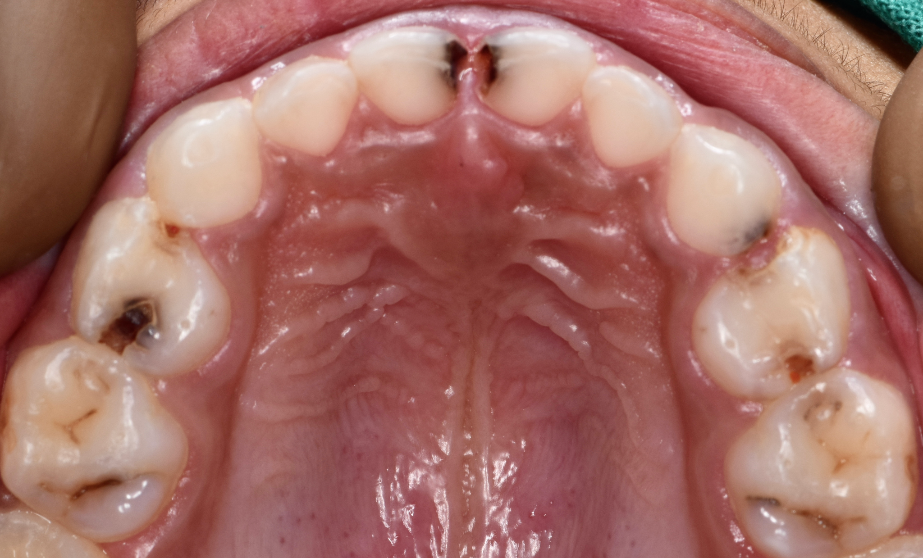
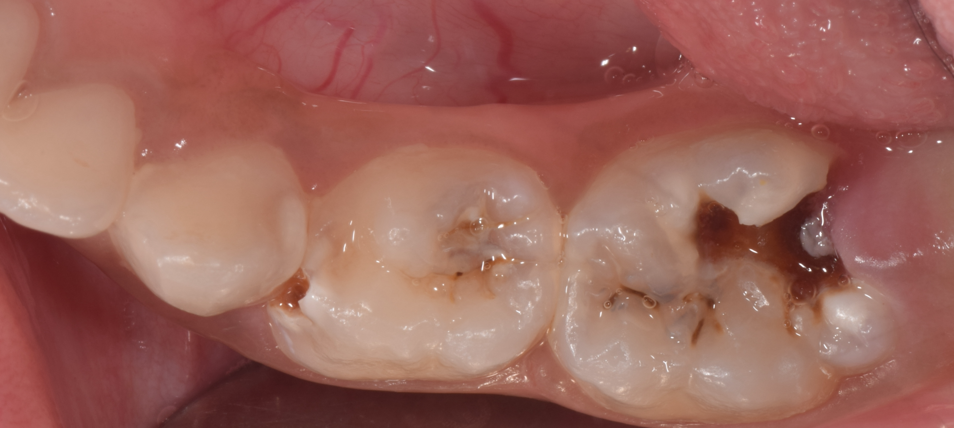
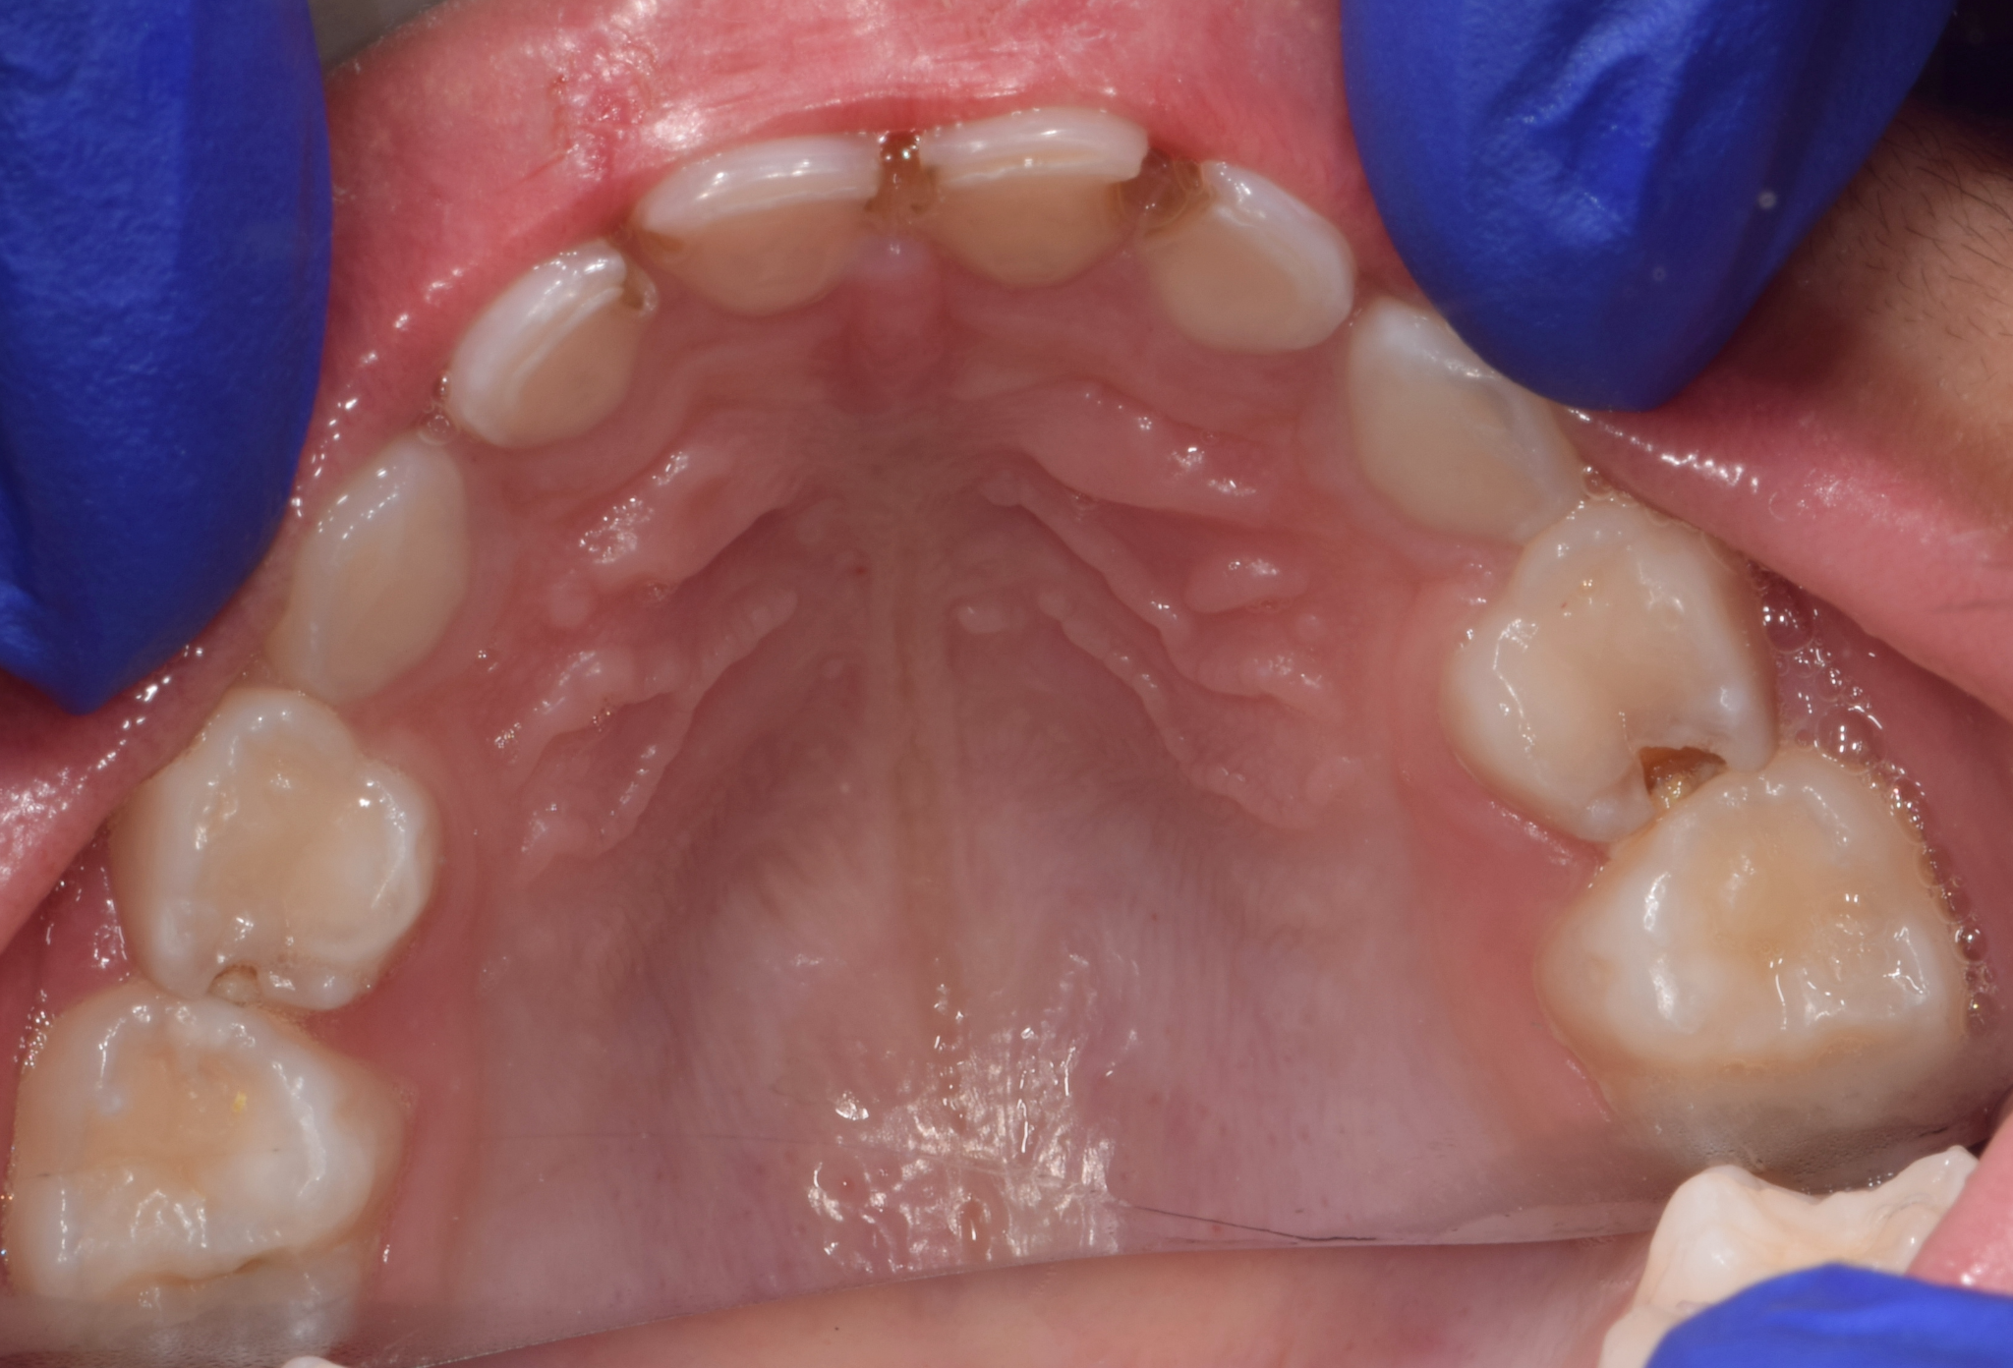
Module 9
Silver Diamine Fluoride
Review of Caries Identification
Identify caries lesions (cavities and pre-cavities)
Many cavities can be seen on visual inspection
Be sure to inspect all tooth surfaces, including back of front teeth, where early childhood caries often form.
Early lesions may be small defects in the enamel
Underlying dentin can be yellow, tan, or darker brown over time
Examples of dental caries
Photos (with permission): Meenakshi Kher, MDS
Notes:
The Smiles for Life Oral Health modules on Child Oral Health, Adult Oral Health, and Caries Risk Assessment, Fluoride Varnish, and Counseling all provide additional background on caries identification.

Slide 22
Module 9
Silver Diamine Fluoride
Assess for conditions not treatable by SDF
Silver Diamine Fluoride will not adequately treat the following conditions:
Dental abscesses (with or without fistula)
Abscesses with associated cellulitis
Irreversible pulpitis

Slide 23
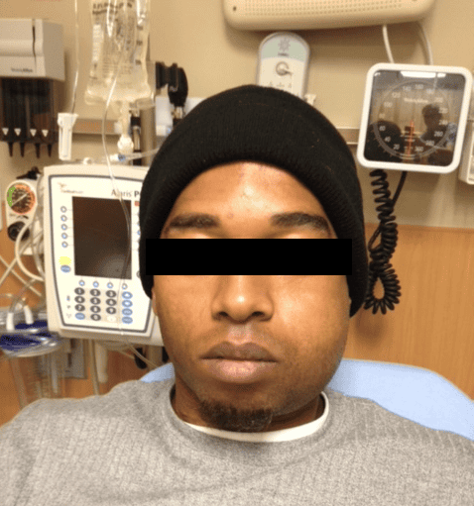
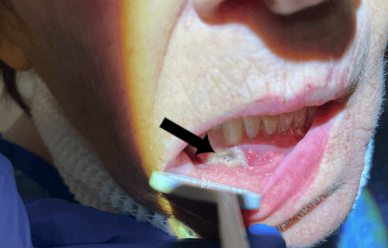
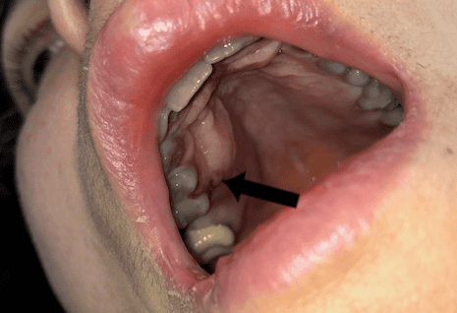
Module 9
Silver Diamine Fluoride
Assess for conditions not treatable by SDF
Dental Abscess
Dental abscesses, with or without fistula, require operative dental management with extraction or root canal therapy
Pain elicited by pushing down firmly on a tooth helps to identify non-draining abscess
Abscesses with associated cellulitis usually require antibiotics
Dental abscess with draining fistula
Dental abscess
Photos with permission, S. Stille, DMD
Dental abscess with associated cellulitis
Notes:
References:
Zaeneldin, A., Yu, O., & Chu, C. (2022). Effect of silver diamine fluoride on vital dental pulp: A systematic review. Journal of Dentistry. 2022 Apr:119:104066. doi:10.1016/j.jdent.2022.104066. Epub 2022 Feb 6.
Slayton, R. L., et al. (2018). Evidence-based clinical practice guideline on nonrestorative treatments for carious lesions: A report from the American Dental Association. J Am Dent Assoc.149(10):837-849.e19. doi:10.1016/j.adaj.2018.07.002.

Slide 24
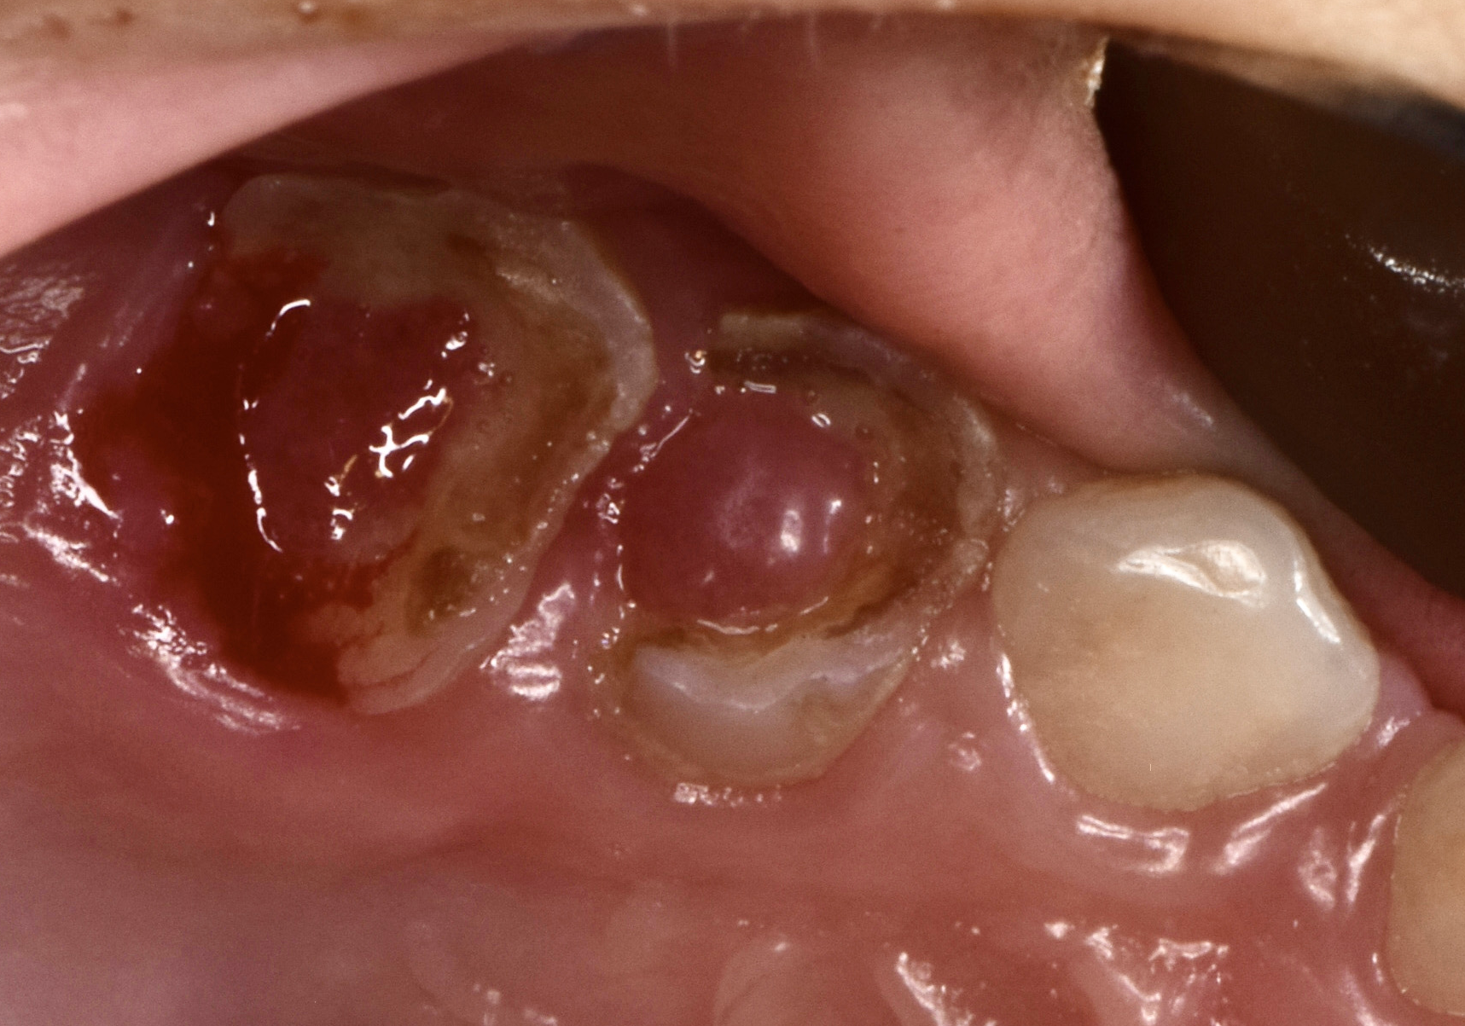
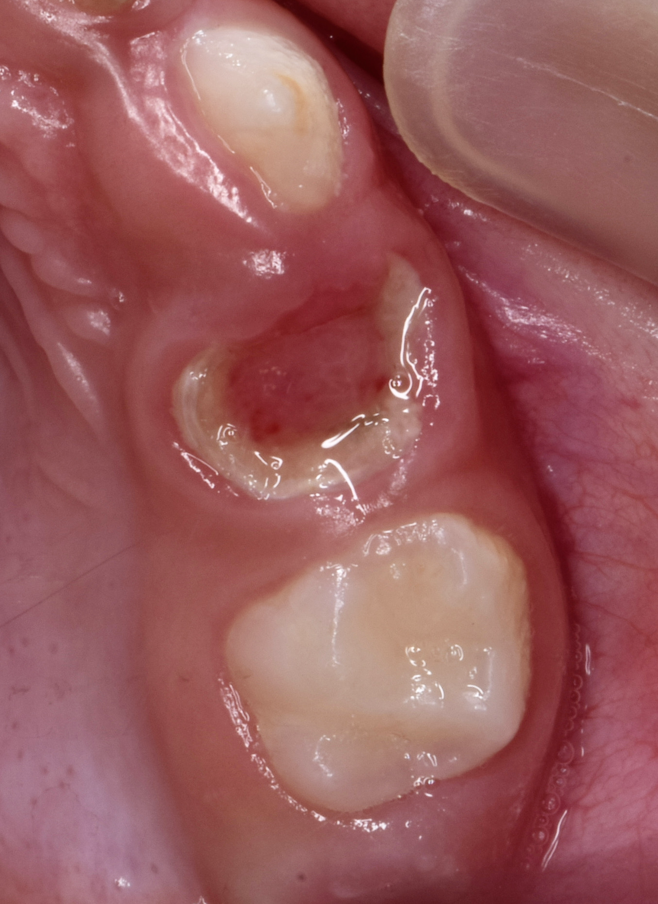
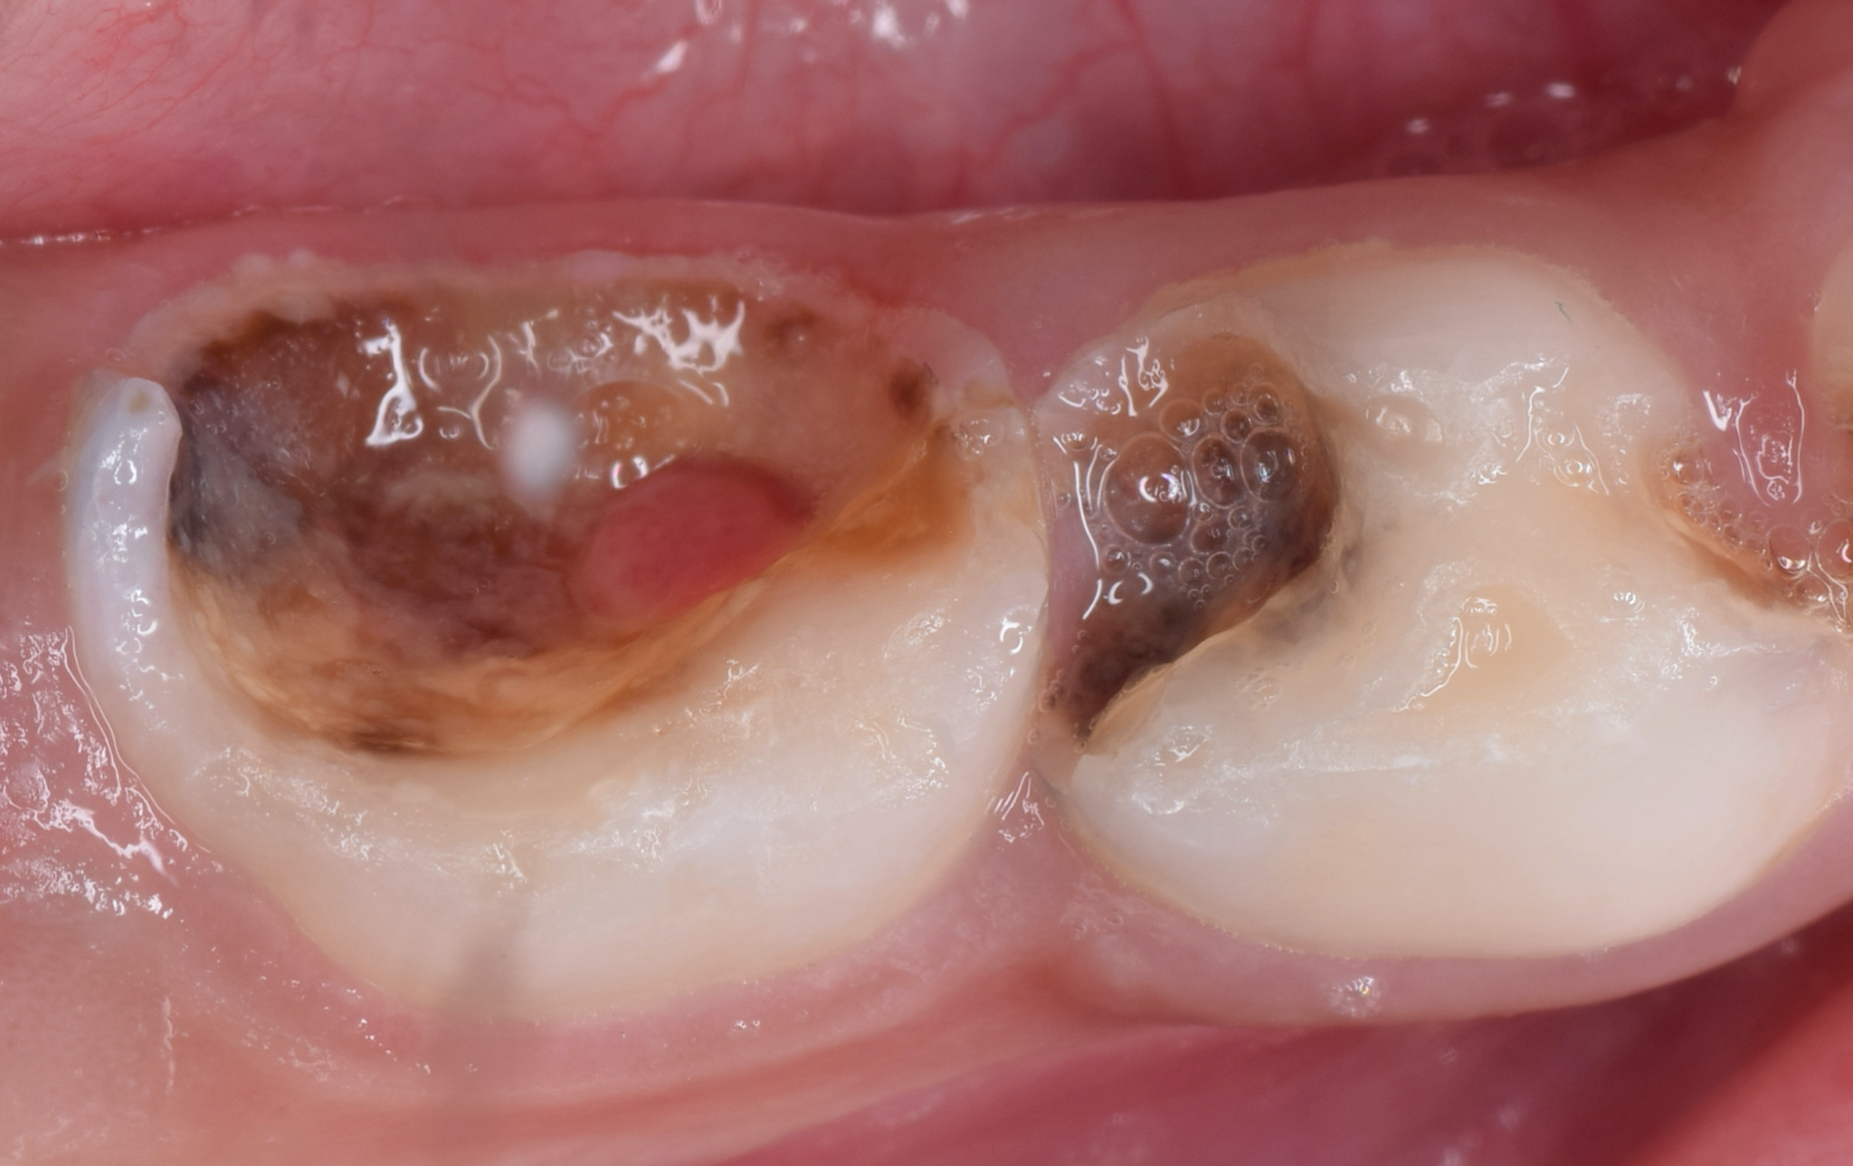
Module 9
Silver Diamine Fluoride
Assess for conditions not treatable by SDF
Irreversible pulpitis
Irreversible pulpitis requires operative dental management with extraction or root canal therapy
Silver diamine fluoride can cause irritation of directly exposed live pulp and teeth with irreversible pulpitis
If patient has clinical findings of irreversible pulpitis, avoid SDF application on that tooth, and attempt to facilitate timely dental referral
SDF will improve pain and sensitivity if there is no direct pulp exposures or irreversible pulpitis, and is cleared by the FDA for this indication
Application to necrotic teeth (with no live pulp) should cause no pain and may help improve surrounding gum health and prevent cavities on other teeth.
Examples of irreversible pulpitis
Photos (with permission): Meenakshi Kher, MDS
Notes:
References:
Zaeneldin, A., Yu, O., & Chu, C. (2022). Effect of silver diamine fluoride on vital dental pulp: A systematic review. Journal of Dentistry. 2022 Apr:119:104066. doi:10.1016/j.jdent.2022.104066. Epub 2022 Feb 6.
Slayton, R. L., et al. (2018). Evidence-based clinical practice guideline on nonrestorative treatments for carious lesions: A report from the American Dental Association. J Am Dent Assoc.149(10):837-849.e19. doi:10.1016/j.adaj.2018.07.002.

Slide 25

Module 9
Silver Diamine Fluoride
Discussing Silver Diamine Fluoride with patients/caregivers
Risks:
Dark stain to cavities
Three day to two week brown stain if applied to skin
One to two day light or dark stain if applied to gums
Strong metallic taste for 2-15 minutes
Cavities treated with SDF twice per year in clinical trials have increased risk of abscess (5%) or irreversible pulpitis (8%) compared to fillings (3%)
Benefits:
Most efficient treatment for cavities
Most effective disease control for cavities
Dental fillings are usually simpler and less painful after SDF treatment
Alternatives:
Dental fillings or other dental treatment
No cavity treatment
Photo credit: Shutterstock
Notes:
Have consent discussion with patient/guardian
Take extra care with consent for potential SDF treatment in cosmetic areas
Showing photographs are paramount
Consent forms are available in multiple languages
Consent forms can be modified for non-dental medical professional users
References:
Slayton, R. L., et al. (2018). Evidence-based clinical practice guideline on nonrestorative treatments for carious lesions: A report from the American Dental Association. J Am Dent Assoc.149(10):837-849.e19. doi:10.1016/j.adaj.2018.07.002.
Owais, A., et al., (2018). Silver Diamine Fluoride Chemical Mechanisms of Action as a Caries Arresting and Preventing Agent. Journal of the California Dental Association, 46:2, 113-120. doi: 10.1080/19424396.2018.12221992
Cleary, J., et al., (2022). A 12-Month Randomized Clinical Trial of 38% SDF vs. Restorative Treatment. JDR Clin Trans Res. 2022 Apr;7(2):135-144. doi: 10.1177/23800844211072741. Epub 2022 Feb 4.

Slide 26
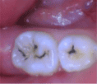

Module 9
Silver Diamine Fluoride
How to think/talk about staining
Patient/caregiver education and autonomy are key
Studies show high levels of comfort with staining in parents of children who were treated with SDF
Studies on hypothetical acceptability of staining from any parent show varied responses
  Treatment of back teeth is widely accepted by patients / caregivers
  Avoiding needles and surgical intervention often outweighs cosmetic concerns
  Treating baby teeth that will be lost may be more acceptable
  People who do not have regular dental encounters are more likely to accept SDF than surgical interventions
Blackening may start right away (depending on lighting) and is complete by 1 week
Standard restorative dental procedures can cover the stain (with opaquers and/or by removal of stain at the external part of the tooth).
Photo with permission, S Duffin
Photo with permission, J MacLean, DDS
Notes:
References:
Huebner, C. E., et al., (2020). Parents' Satisfaction with Silver Diamine Fluoride Treatment of Carious Lesions in Children. J Dent Child (Chic). 2020 Jan 15;87(1): 4-11.
Crystal, Y. O., et al., (2017). Parental perceptions and acceptance of silver diamine fluoride staining. J Am Dent Assoc. 148(7):510-518.e4. doi:10.1016/j.adaj.2017.03.013
Seifo, N., et al. (2021). "I guess it looks worse to me, it doesn't look like there's been a problem solved but obviously there is": a qualitative exploration of children's and their parents' views of silver diamine fluoride for the management of carious lesions in children. BMC Oral Health. 21(1):367. doi:10.1186/s12903-021-01730-w
Clemens, J., Gold, J., Chaffin, J., (2018). Effect and acceptance of silver diamine fluoride treatment on dental caries in primary teeth. J Public Health Dent. 2018 Dec;78(1):63-68. doi: 10.1111/jphd.12241. Epub 2017 Jul 27.

Slide 27
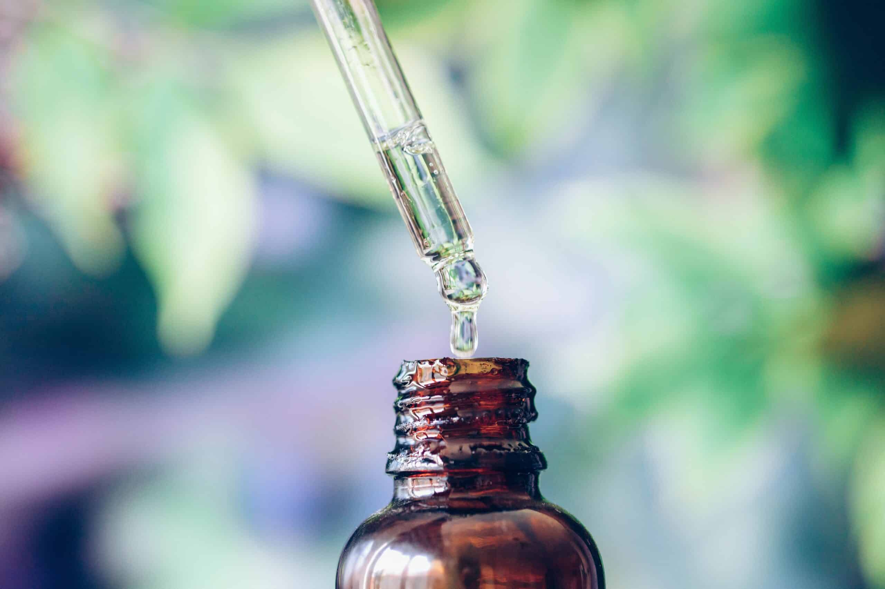
Module 9
Silver Diamine Fluoride
Dosing and Application Considerations
How much should you use?
Dosing: the maximum dose set by the FDA for the phase III drug trial in young children is 260 µL, or eight 32.5 µL drops, per visit
  1 to 4 drops per patient is almost always sufficient
Consider postponing if active mucositis/oral ulcers, viral disease
  If treating, cover ulcers well with petroleum jelly
Contraindications: silver allergy (rule out nickel sensitivity)
Avoid getting SDF in the eyes. Using glasses decreases risk. If SDF gets into eyes, immediately flush with copious water.
Photo credit: Shutterstock
Notes:
References:
Slayton, R. L., et al. (2018). Evidence-based clinical practice guideline on nonrestorative treatments for carious lesions: A report from the American Dental Association. JADA, 149(10): 837-849.E19.
Young, D. A., et al. (2021). Clinical Instructions for Using Silver Diamine Fluoride (SDF) in Dental Caries Management. Compend Contin Educ Dent. 2021 Jun;42(6):e5-e9.
Horst, J. A., Ellenikiotis, H., & Milgrom, P. L., (2016). UCSF Protocol for Caries Arrest Using Silver Diamine Fluoride: Rationale, Indications and Consent. J Calif Dent Assoc. 2016 Jan;44(1):16-28.

Slide 28
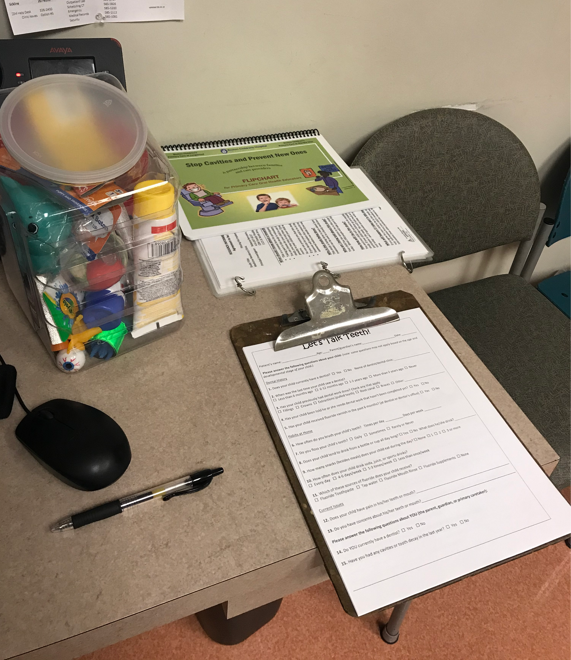
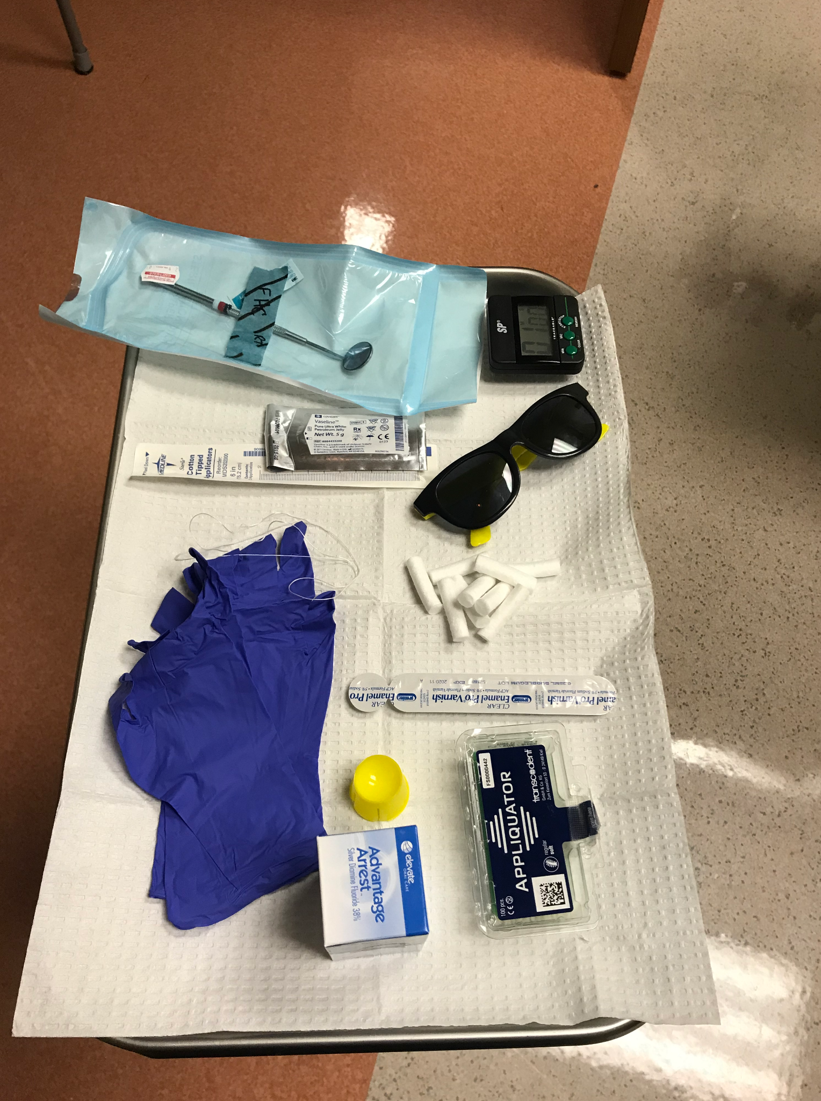
Module 9
Silver Diamine Fluoride
Equipment for Application of SDF
Items to include:
Patient education materials
Intake form
Consent form
Silver Diamine Fluoride
Fluoride varnish
Timer
Vaseline
Cotton swab (or gauze
Glasses/sunglasses for the patient
Microbrush (small brush to apply SDF)
Gloves
Tray cover
Bib for patient
Optional items:
Dental mirror
Cotton swabs
Dental floss
Dappen dish (yellow dish in picture above)
Toys (for young children)
Notes:
Tips for setup:
Gather and store all supplies and materials in a portable container to improve efficiency of clinical workflow and treatment in the exam room.
Set up “SDF kits” with the materials needed for each patient to further improve efficiency.

Slide 29
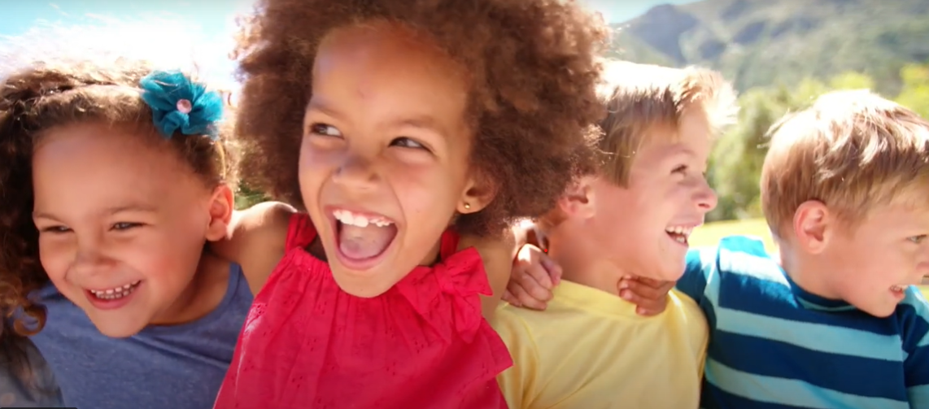
Module 9
Silver Diamine Fluoride
Procedure for Application of SDF
How do you apply Silver Diamine Fluoride?
Use gloves and plastic-lined tray cover! Be careful not to stain surfaces
Use safety glasses for yourself. Use safety glasses or sunglasses for the patient.
Carefully drop SDF into reservoir or use individual ampule
Remove any debris from cavity with cotton
Dry treatment surface with cotton
Protect oral mucosa with Vaseline to avoid staining
Dip applicator in SDF and remove excess inside container
Touch applicator onto affected area until it is moist with SDF
Leave mouth open for 60 seconds (use timer for timing)
Dab with cotton to dry
Cover with fluoride varnish (to mask taste)
Notes:
Show video here if desired: https://youtu.be/FI8E3gDx6_4

Slide 30
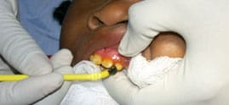
Module 9
Silver Diamine Fluoride
Use of Fluoride Varnish after SDF Application
Why apply fluoride varnish after SDF?
SDF is not tasty
        Applying fluoride varnish over SDF will help mask the taste of SDF
        The fluoride may also be helpful in preventing new cavities
        Toothpaste may also be used to mask the flavor of SDF
Application of fluoride varnish
Photo with permission: ICOHP and J Douglass, BDS, DDS

Slide 31
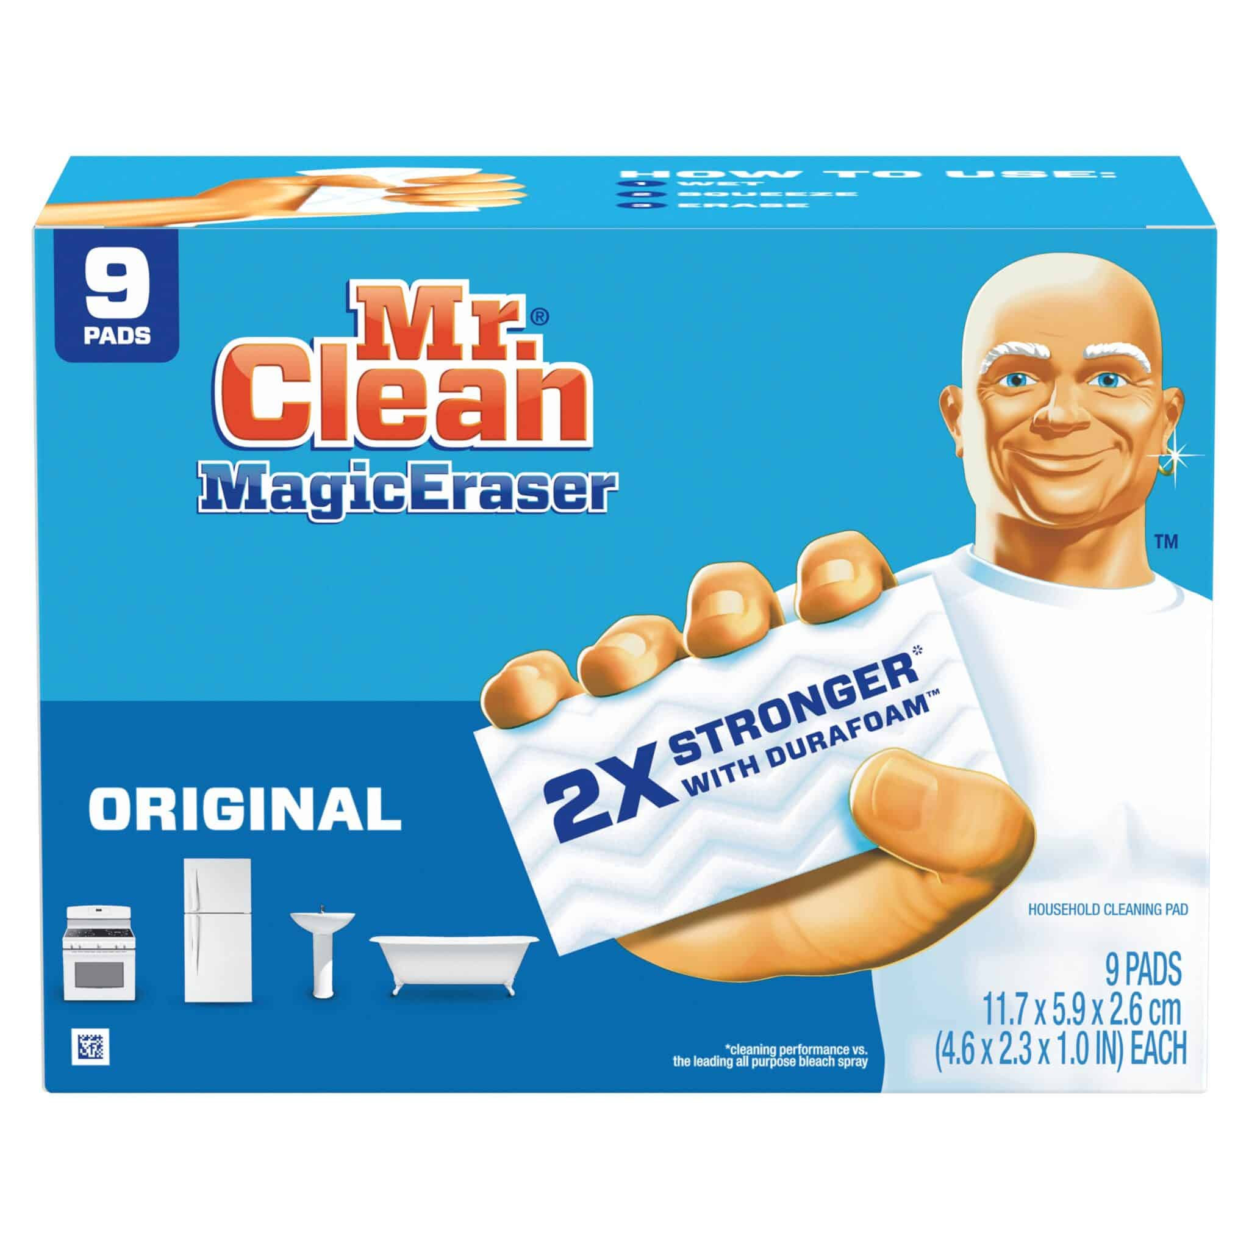
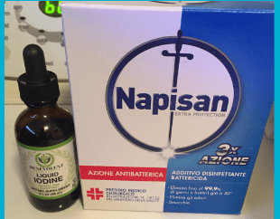
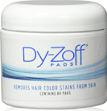
Module 9
Silver Diamine Fluoride
Cleanup after SDF application
SDF can stain clinic surfaces. Consider the following approaches to remove and minimize stains:
Fabrics
Iodine
Napisan
Surfaces
Bar Keeper’s Friend
Mr. Clean Magic Eraser
Comet
Bleach
Skin
Hydrogen Peroxide
Salt Slurry
Hair dye remover pads
Remember – prevention is the best stain remover!

Slide 32

Module 9
Silver Diamine Fluoride
Documenting SDF application
Be sure to include the following details in your visit note:
Current symptoms, if any
Oral health related history (risk factors, protective factors, dental history
Oral exam findings
Brief procedure note
Patient education summary, self-management plans/behavior goals
Care coordination/dental care referral process
Photo credit: Shutterstock
Notes:
Be sure to include the following details in your visit note:
Current symptoms, if any
Oral health related history (risk factors, protective factors, dental history)
Could use caries risk assessment tool, included in the Caries Risk Assessment, Fluoride Varnish, and Counseling course on our website, if desired
Oral exam findings
Brief procedure note
Patient education summary, self-management plans/behavior goals
Care coordination/dental care referral process

Slide 33
Module 9
Silver Diamine Fluoride
Use of SDF in Primary Care Settings
How do you incorporate silver diamine fluoride into your practice?
Primary Care Use
In practices with medical-dental integration (coordination, co-location, or integration of physicians, dental hygienists, dentists, and/or other medical professionals), SDF may be applied by medical providers, dental providers, or both
Shared information about timing of SDF application and whom will do re-application will help ensure appropriate follow up across medical-dental integration
Primary care settings may use SDF:
During preventive care visits when cavities are identified on screening oral exam
During acute care visits when patient seeks care specifically due to dental complaint
Opportunistically during other visits when cavities are noted
As a follow up/return visit after cavities noted during a visit for another reason

Slide 34
Module 9
Silver Diamine Fluoride
How to incorporate SDF into practice – Primary Care Use
Considerations for applying SDF on the day of an existing visit
There may be many barriers to healthcare access preventing patients from returning to the clinic
There is no delay in care with same-day SDF application
This creates less staff work for scheduling return, reminders, etc.
Most or all providers in the practice need to offer SDF for this to be practical
Will take additional time during visit even with limited patient education and care coordination
  SDF application itself should take no longer than 5 minutes (after learning curve).
Considerations for scheduling a return visit for SDF application
Patients may have barriers to return and be lost to follow up (staff time needed to optimize follow up success)
There will be a delay in care
An extra appointment allows more time for the patient visit, including patient education and care coordination
Reduces the burden of trying to “fit it in” at another visit
This model may be more feasible if not all providers in the practice offer SDF
Notes:
Reference:
MDI Colorado. Levels of Integration. http://medicaldentalintegration.org/what-is-this-toolkit/levels-of-integration/

Slide 35
Module 9
Silver Diamine Fluoride
How to incorporate SDF into practice
Ways to incorporate SDF application into non-primary care medical settings:
In urgent care or emergency department when patient seeks care specifically due to dental complaint
In specialty care settings when dental issues are commonly observed, for example:
  Otolaryngology clinic where oral exams are conducted for other reasons
  Radiation oncology where post-radiation xerostomia and dental disease are observed
  In inpatient settings when acute dental services are not available as a bridge to outpatient dental follow up
Ways to incorporate SDF application into community settings where medical providers treat patients:
School-based health center
Nursing home setting
Street outreach or mobile medical clinic
Notes:
Reference:
MDI Colorado. Levels of Integration. http://medicaldentalintegration.org/what-is-this-toolkit/levels-of-integration/

Slide 36
Module 9
Silver Diamine Fluoride
Coding and Billing
Coding
Code K02.9, Dental caries, unspecified
If appropriate, code for other diagnoses:
Photo credit: Shutterstock
Billing
Starting July 2023: CPT code for SDF Application for Caries Arrest is 0792T
Bill CPT code 99188 only if fluoride varnish was also applied
SDF and/or fluoride varnish codes can be submitted in addition to billing the office visit as you otherwise would for preventive visits or based on medical complexity and/or time
Z91.843, Risk for dental caries, high
K05.1, Chronic gingivitis
Z29.3, Encounter for prophylactic fluoride administration (only if fluoride varnish used)

Slide 37
Module 9
Silver Diamine Fluoride
Referral for dental care
Follow up after silver diamine fluoride
If no dental home in 6 months
Monitor and follow up
Identify active cavity/ies
Treat with SDF
Refer to dental home
Notes:
Tips for Dental Referral
Try to provide a few options for patients but not a long list
Key information: age of patients accepted, insurance accepted, urgent access options
Communicate with your dental referral partners, especially for urgent referrals
Avoid predicting specific dental treatments that patients may be recommended
Counsel patients to consider asking dental teams what might happen if recommended treatment is not completed
Medical-dental integration options
Uni or bi-directional scheduling opportunities
Combined back to back or integrated co-located appointments
Warm hand-off to community dental partner

Slide 38
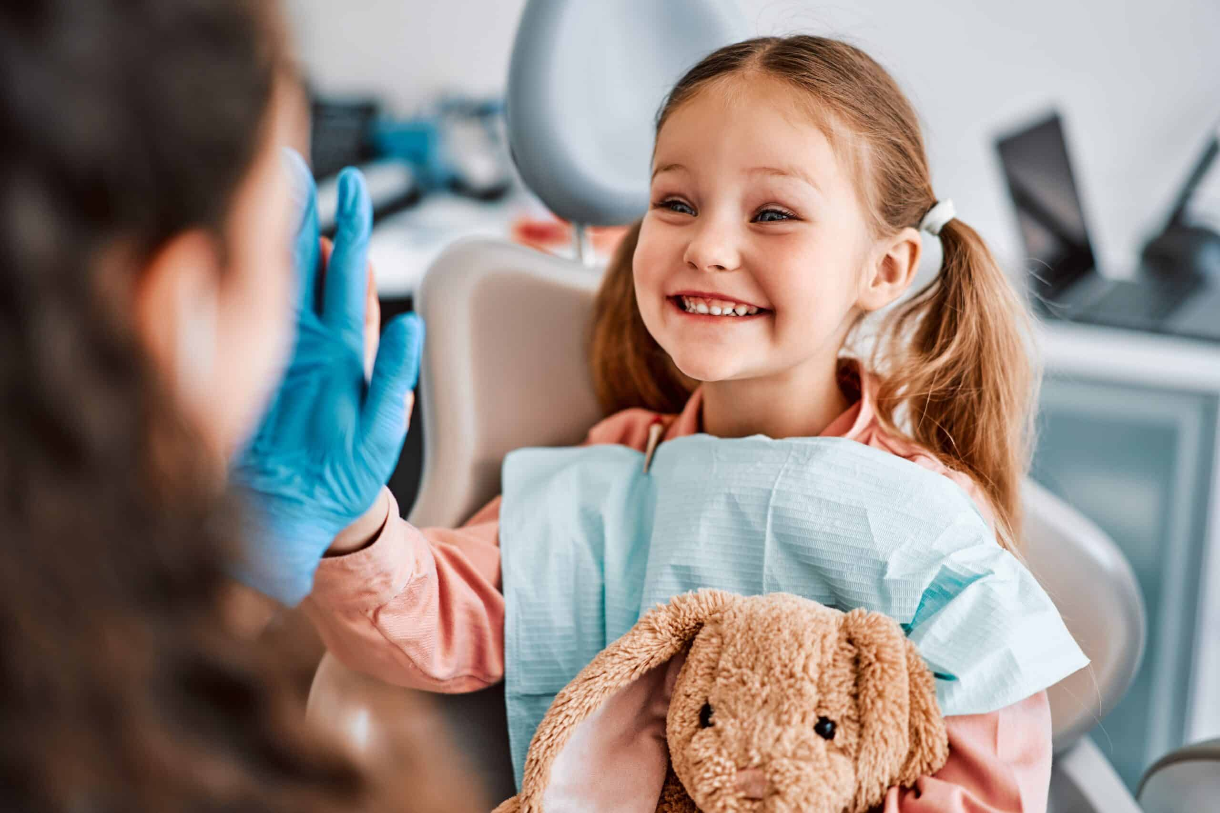
Module 9
Silver Diamine Fluoride
Follow up after Silver Diamine Fluoride
Typical follow up is 6 months, with re-application of SDF at that visit.
Adjust follow up re-assessment and SDF re-application (if needed) sooner if clinically appropriate.
Photo credit: Shutterstock
If the dental caries disease is severe or lesions are non-cleansable, consider reapplying in as little as 1 week or several times over 3 months.
    For children aged 3-5, having more caries lesions than number of years old is consistent with severe disease.
    For younger children, severe is defined as having a caries lesion on the lip/cheek side of the teeth.
If the possibility of longer-term follow up is unlikely (e.g. street medicine or a short-term residential setting) re-application in 1-3 months could be considered.
Notes:
References:
American Academy of Pediatric Dentistry. Policy on early childhood caries (ECC): Classifications, consequences, and preventive strategies. The Reference Manual of Pediatric Dentistry. Chicago, Ill.: American Academy of Pediatric Dentistry; 2020:79-81.
Horst, J.A., (2018). Silver Fluoride as a Treatment for Dental Caries. Adv Dent Res. 2018 Feb;29(1): 135-140. doi: 10.1177/0022034517743750.
Zhi, Q. H., Lo, E. C., & Lin, H. C., (2012). Randomized clinical trial on effectiveness of silver diamine fluoride and glass ionomer in arresting dentine caries in preschool children. J Dent. 40(11):962–967.
Fung, M. H., et al., (2016). Arresting dentine caries with different concentration and periodicity of silver diamine fluoride. JDR Clin Trans Res. 1(2):143–152.
Duangthip, D., Chu, C. H., Lo, E. C. M., (2016). A randomized clinical trial on arresting dentine caries in preschool children by topical fluorides—18 month results. J Dent; 44:57–63.
Yee, R., et al., (2009). Efficacy of silver diamine fluoride for arresting caries treatment. J Dent Res; 88(7):644–647.
Oliveira, B. R. A., Veitz-Keenan, A., Niederman, R. (2018). The effect of silver diamine fluoride in preventing caries in the primary dentition: a systematic review and meta-analysis. Caries Res; 53(1):24–32.
Hendre, A. D., et al. (2017). A systematic review of silver diamine fluoride: effectiveness and application in older adults. Gerodontology; 34(4):411–9.

